Slide 1
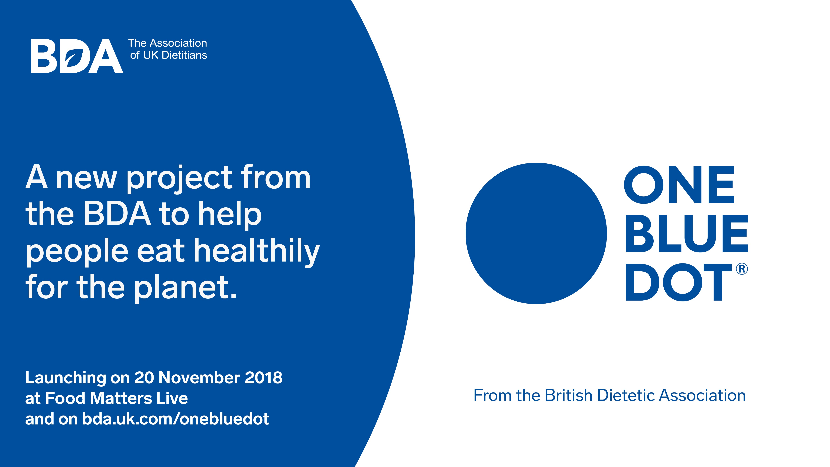
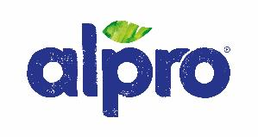
From The British Dietetic Association with support from the science and nutrition team at Alpro
Notes:
References available from https://www.bda.uk.com/professional/resources/obd_ref_guide.pdf p81-90

Slide 2
Why collective action is needed
15.5%
1 out of every 6 deaths in the UK attributed to poor dietary habits alone
Win-Win
Diets can be better for us and better for the planet
By 2050
IPCC: need to keep global temperature rise below this
UK GHG
emissions by 80%
Notes:
We know that our diets are bad for our health
In October 2018 – the Lancet published the latest findings from the Global Burden of Disease study – 1990-2016. 14.4% - 15.5% of deaths in the UK – almost 1 out of every 6 deaths, were attributed to poor dietary habits alone i.e. excluding disease states and other disease risk factors.
The biggest disease burden is of course obesity with almost 2/3rd of the adult population o/weight or obese and a quarter to over a third of children aged 2-11 years o/weight or obese.(2)
Prevalence of childhood obesity is double the rate in the most deprived socioeconomic groups compared to the least deprived.
The high rate of obesity has resulted in an explosion of non-communicative diseases which are driving the NHS and our economy to destruction.
Diabetes – 5-fold increased risk with obesity
3.8m people in England + 200,000 new cases EVERY YEAR
5million are at risk of developing DM2.
Diabetes is also the leading cause of preventable blindness and amputations in the UK.
Heart disease:
Obesity alone (excluding other metabolic or lifestyle factors) increases heart disease risk by 28%. Obesity alongside other risk factors e.g. high blood pressure, other unhealthy lifestyles, more than doubles the risk.
2.3m living with heart disease in the UK – 1 person dies every 8 minutes from CHD.
Obesity is second only to smoking for increased risk of 12 cancers – with the biggest association for colonic and breast cancer.
Obesity TRIPLES postmenopausal risk of breast cancer
We also aware of other lifestyle related disease states such us osteoporosis, gut health and poor mental health.
This is unsustainable economically especially from an NHS perspective – with over £6billion NHS costs per annum and almost £30 billion to the overall economy attributed just from the NHS.
We also know our diets are bad for the planet
Whilst a temperature rise is inevitable, the UN Intergovernmental Panel on Climate Change (IPCC) has proposed a safe limit for global warming increase by 2050. The original IPCC agreement of 2006, set the safe global temperature rise to be between 1.5°C and no more than 2°C above pre-industrialised levels by 2050. However, the more recent IPCC meeting of October 2018, has refined the original agreement and tightened its recommended safe limit for global warming increase to no more than 1.5°C by 2050 if we are to prevent catastrophic consequences for extreme weather conditions: heat, droughts, floods and poverty.
What does this mean? As GHG emissions are responsible for global warming – a significant reduction is needed. If we are to keep the global temperature rise below 1.5°C by 2050, a challenging GHG emission reduction of 70-95% will be needed. As the food system is responsible for an as much as 30% of all GHGe – it is clear that the food system will need to change.
The UK government has signed up to the IPCC agreement with the formulation of the Climate Change Act in 2008 – committing to the earlier IPCC target of no more than 2°C temp rise globally. The target was set for an 80% reduction in UK GHGe from all sources including: travel, manufacture, agriculture and dietary patterns. The government has more recently committed to becoming carbon neutral by 2050, representing an even bigger net reduction. Initial progress was impressive with the switch away from fossil fuel use in power generation, however, since 2012 little progress has been made, especially in agriculture and food waste.
It’s a win-win
However, improving our diets can be a win-win – addressing both climate change and our health concerns. We’ll look at how over the next few slides. A 2016 paper The Eatwell Guide: Modelling the Health Implications of Incorporating New Sugar and Fibre Guidelines. Found that changing the average diet to that recommended in the new Eatwell Guide, without increasing total energy intake, could increase average life expectancy by 5.4 months (95% uncertainty interval: 4.7 to 6.2) for men and 4.0 months (3.4 to 4.6) for women; and avert 17.9 million (17.6 to 18.2) DALYs over the lifetime of the current population.

Slide 3
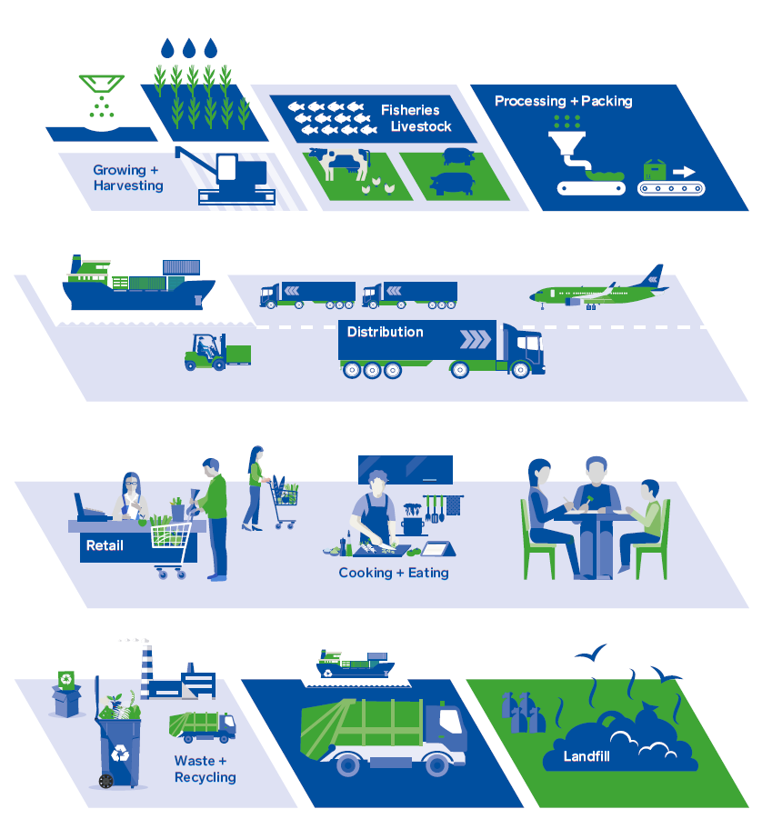
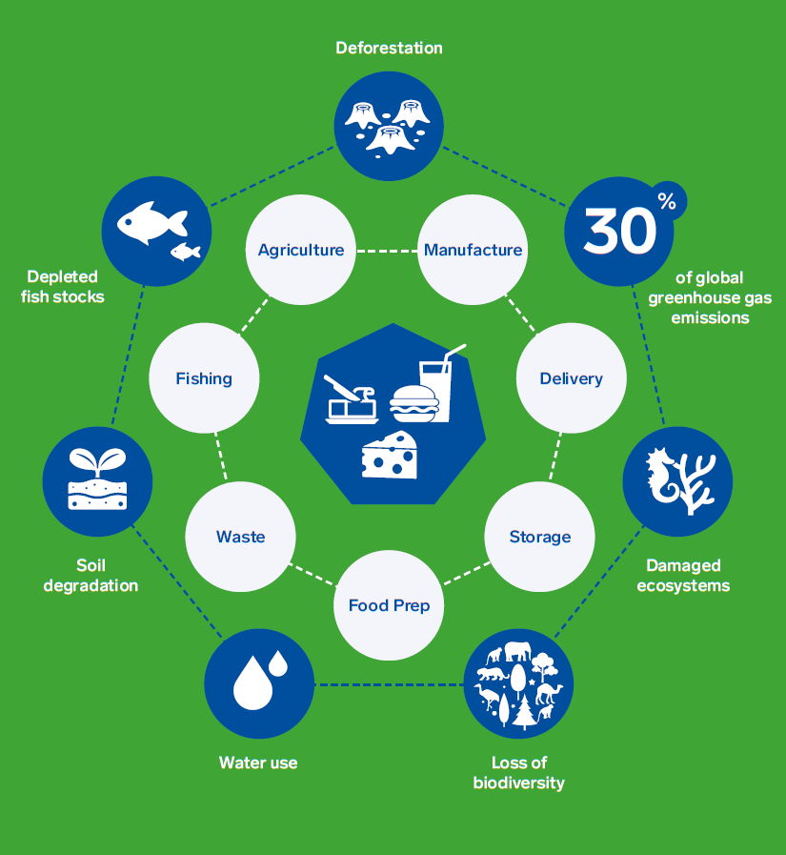
Our food systems are damaging the planet
Notes:
From farm to fork to waste, each stage has environmental impacts – farming and manufacturing processes and the way we eat and dispose of food are damaging the planet.
Taking into consideration farming, production, distribution, delivery through to waste, our current food system:
Contributes 18-25% of total greenhouse gas (GHG) emissions in the UK and 20-30% of GHG emissions globally - contributing significantly to global warming.
Is a leading cause of deforestation, biodiversity loss and soil and water pollution around the world
Accounts for 70% of all human water use.
10 million tonnes of all food produced is spoiled or wasted in the UK every year with the majority (71%) occurring in the home. Most of this is avoidable and represents a waste of land, water and other inputs and produces ‘unnecessary’ potent GHG emissions.
Over fishing and poor fishing practices have impacted on fishing stocks with 85% of fisheries now fully exploited and / or over fished, the marine vertebrae population has been halved and the marine ecosystem has been damaged. Fish stocks around the UK are particularly vulnerable.
Agriculture and livestock farming are by far the biggest contributors to GHG emissions, deforestation, biodiversity loss, soil pollution as well as land and water use.
So food choices we are recommending will have a direct impact on sustainability. It can no longer be simply about the impact of food on health outcomes, but we have to consider the environment. This may seem daunting but it would be irresponsible to ignore the issue. As the experts in dietary intervention and ability to translate dietary science into context of different population groups, the BDA strongly feels we should be leading this topic. We need to ensure that any sustainable advice around food choices will also be beneficial to overall health outcomes and meet the nutritional – especially micronutrient – needs of the population.
As the population grows – estimated growth from current 7 billion to 9-10 billion by 2050, the demand for food will grow, that means more food needs to be grown and produced which means more GHGe, more depletion of the planets natural resources.
Specific impacts
Although GHGe are the focus of most headlines, it is all other environmental factors are just as important for the security of food production. For example:
DEGRADATION OF SOIL: suitable soil is essential for agriculture and production of adequate food. As the climate changes, and as precipitation patterns alter, the quality of soil will degrade making conditions for growing crops difficult. for growing crops is likely to change. Drought can lead to dry exposed soils, and extreme flooding can lead to waterlogging, causing anaerobic inhospitable soils.
WATER SUPPLY for irrigation is needed to support crop growth, this is impacted by rainfall, soil drainage, infrastructure and competing demands from non-agriculture.
Global warming’s impact on extreme flooding and droughts will impact on precipitation, soil moisture, run-off and evaporation. It is estimated that currently dry lands are set to get dryer and wet lands are set to get wetter. Both drought and flooding are likely to have negative impacts. In some countries e.g. UK the increase in precipitation may increase food production – however, this will only be for the short term.
ECOSYSTEM / BIODIVERSITY - insects and other invertebrates are needed for pollination, pest control and soil quality (e.g. aeration, breakdown of organic matter). Changes in temperature, season patterns and rainfall have consequences for insects and vertebrae which provide a vital agriculture ecosystem.

Slide 4
What are environmentally sustainable diets?

Slide 5
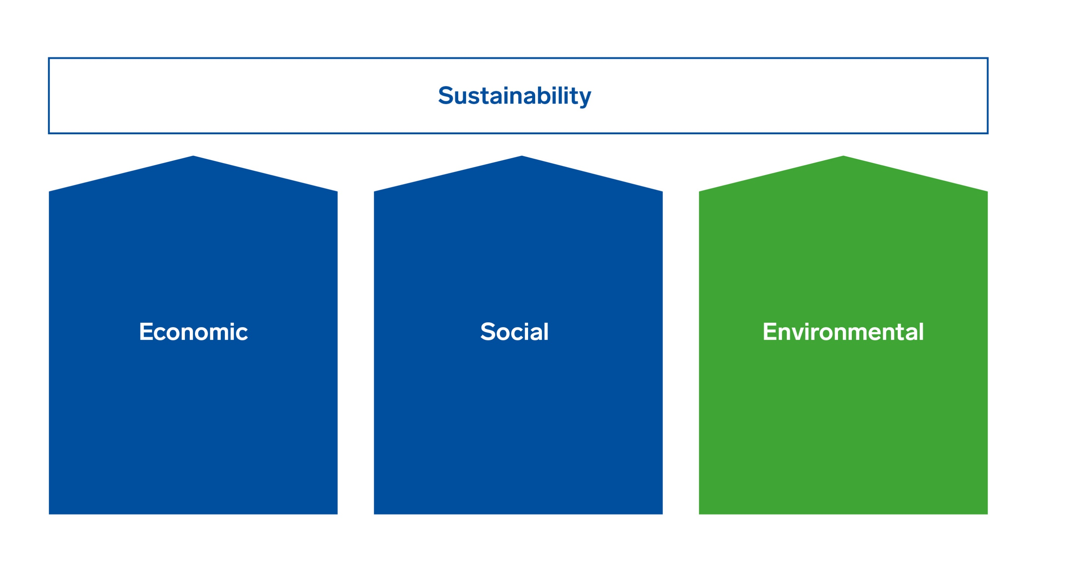
What is meant by a ‘sustainable diet’?
Notes:
Defining what is meant by a sustainable diet is difficult, and there is currently no consensus. Important to consider that there is more than one definition of sustainability.
Sustainability as a whole is determined by three key “pillars”
economic,
social and
environmental.
All these are important, and dietitians will already be considering economic and social factors when making dietary recommendations. The purpose of OBD is to focus on the third – environmental. So when we refer to sustainable diets, this is what we mean.

Slide 6
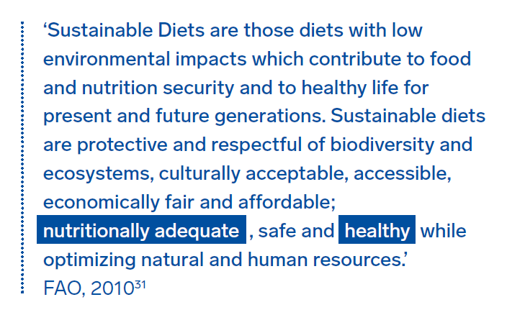
What is meant by an ‘environmentally sustainable diet’?
Notes:
In terms of defining sustainable diets, the most commonly referred to are the FAO 2010 definition which is all embracing and the more nutritionally focused Fischer and Garnett.
An important emphasis of all definitions is that a sustainable diet must meet the nutritional and health needs of the public. Fischer and Garnett’s more detailed explanation (please see the OBD reference guide) is more reflective of dietary recommendations across the globe including the Eatwell Guide.
All three are important when considering overall sustainability, but within the context of this reference guide and the BDA’s Sustainable Diets policy, we have focused specifically on an environmentally sustainable diet.

Slide 7
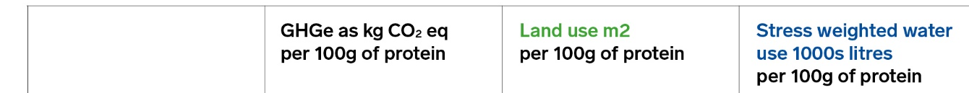

How do we assess sustainability in food?
The average quantity of GHGs emitted and land & water use to produce 100g of protein from animal and plant foods.
These are average values based on a combination of data sets from around the world therefore there will be significant variability depending on country of origin and production practices.
Other important measure include water pollution, soil degradation, impact on biodiversity & ecosystems, nitrogen and phosphorus output (from pesticide use) etc.
Notes:
Assessing the sustainability of food is complex given the wide range of factors in play. On this slide we have an explanation of how the impact of protein sources are commonly assessed. Other factors: biodiversity, ecosystems, soil degradation, Nitrogen and Phosphorus flows (pesticide use), over-fishing.
Whilst most publication investigate GHG emissions, this study also looked at land and water use to give a much better picture of the impact of protein food sources on the sustainability of the planet.
Mean GHG emissions, water us and land use values of different foods to produce 100g of protein.
These are average values based on a combination of data sets from around the world. It is important to highlight that there will be significant variability depending on numerous environmental factors such as country of origin, farming practices, dry or wet weather conditions, transportation use, green-house use etc. A table in the reference guide (page 42) provides a table with the full range of values.
We include other measures than just GHGe because environmental impacts are always more complex than simply one measure. For example “Water stress” considers several physical aspects related to water resources, including water scarcity, but also water quality, environmental flows, and the accessibility of blue (stored) water for human consumption. Therefore a product with high stress weighted water use, implies it is using blue water (storage water) as irrigation due to dry conditions…this is depleted water stores that could be used for human consumption in an area whose overall water levels are already scarce. Crops relying more on rainfall will utilise more ‘green’ water, thus their stress-weighted water use will be lower. Additionally, stress-weighted water use can include grey water (polluted water) use which can be used in irrigation. What is interesting to note, is that water use does not always correlate with the amount of GHGe - for example, nuts agriculture is water intense, and although nuts have the lowest GHGe per 100g protein, they do in fact use the most water – this is important when nuts are grown in regions where water is already scarce and receive little rainfall.
Land use is also significant as this is land that might otherwise be used to either more efficiently produce protein from another source or it may be that this land could be forested and thus having a positive impact on GHGe – the soil acting as a carbon sink taking carbon out of the atmosphere. Again, there’s more detail than these figures can express (hill farming livestock being a better use of land that lowland farming of livestock for example or grazing cattle vs intensely farmed cattle).
NB these measures do not include water pollution, soil degredation, biodiversity, ecosystems, nitrogen and phosphorus (from pesticide use) leaking into the oceans etc.

Slide 8
Dietary recommendations for sustainable diets

Slide 9
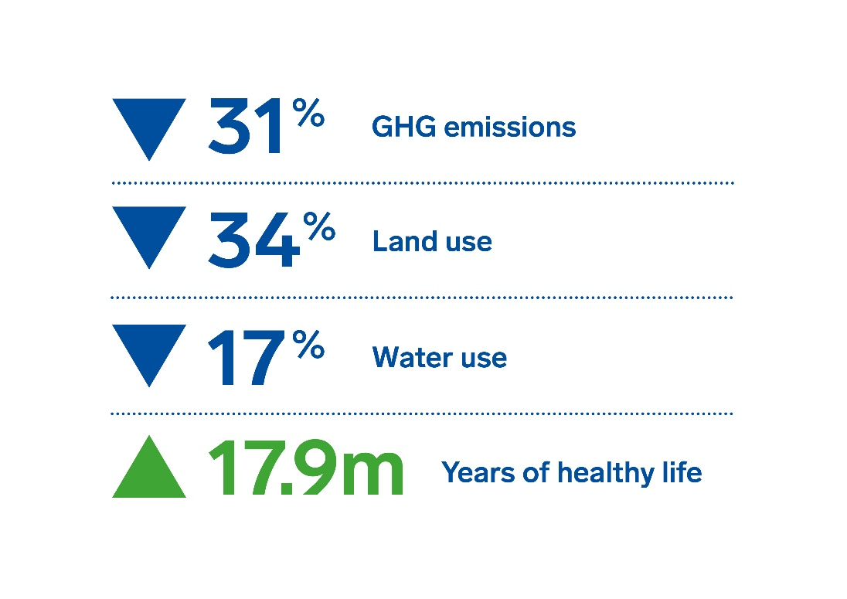
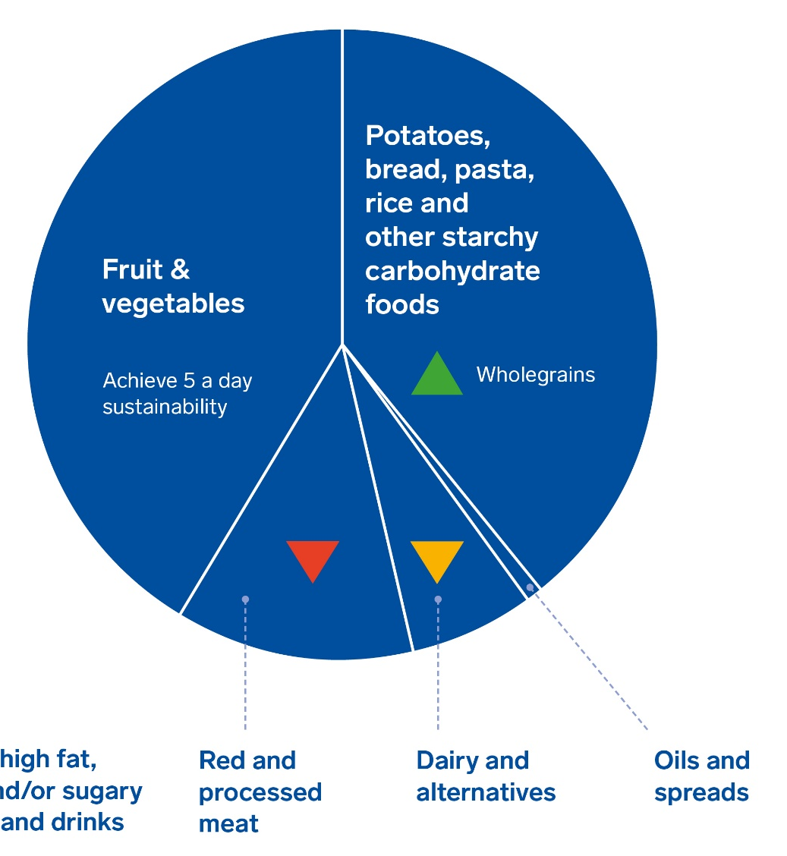
Can a UK sustainable diet be a healthy diet?
Calories
Sat fat
Sugars
Salt
Fibre

5-a-day
Vits & mins
Notes:
The 2016 review of the government dietary recommendations (Eatwell) incorporated sustainable factors for the first time. The Eatwell guide is now more sustainable whilst aiming to bring energy and macro nutrients down to within recommendations and meet micro-nutrient needs of all over five years.
Possibly the most notable is the clear focus on plant-based proteins over meat proteins with this section now called ‘Beans, pulses, fish, eggs, meat and other proteins’ with a subheading to ‘eat more beans and pulses’ – and a limit of red meat to no more than 70g (cooked weight) per person per day.
Other notable changes:
Reduced dairy section by 1/3rd.
Removal altogether of foods HFSS.
New small section on Oils and veg spreads.
Fruit and vegetables and starchy foods esp. wholegrains remain the biggest part of the guide.
The Carbon Trust undertook a carbon footprint assessment comparing current intakes (NDNS) with the new Eatwell guide and found that if the population could adopt the new dietary recommendations, the overall carbon footprint would be reduced by almost a third (32%): 31% reductions in GHGe, 17% reduction in water use and a whopping 34% reduction in land use.
That 2016 Carbon Trust Paper “The Eatwell Guide: Modelling the Health Implications of Incorporating New Sugar and Fibre Guidelines” found that changing the average diet to that recommended in the new Eatwell Guide, without increasing total energy intake, could increase average life expectancy by 5.4 months (95% uncertainty interval: 4.7 to 6.2) for men and 4.0 months (3.4 to 4.6) for women; and avert 17.9 million (17.6 to 18.2) DALYs over the lifetime of the current population. A large proportion of the health benefits are from prevention of type 2 diabetes, with 440,000 (400,000 to 480,000) new cases prevented in men and 340,000 (310,000 to 370,000) new cases prevented in women, over the next ten years. Prevention of cardiovascular diseases and colorectal cancer is also large. However, if the diet recommended in the new Eatwell Guide is achieved with an accompanying increase in energy intake (and thus an increase in body mass index), around half the potential improvements in population health will not be realised.

Slide 10
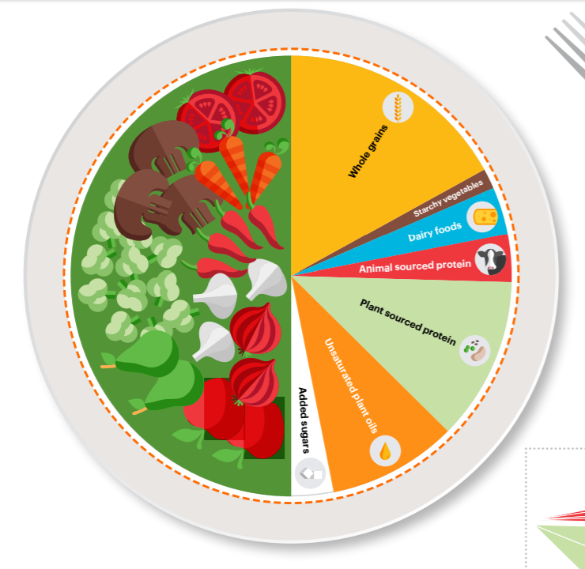
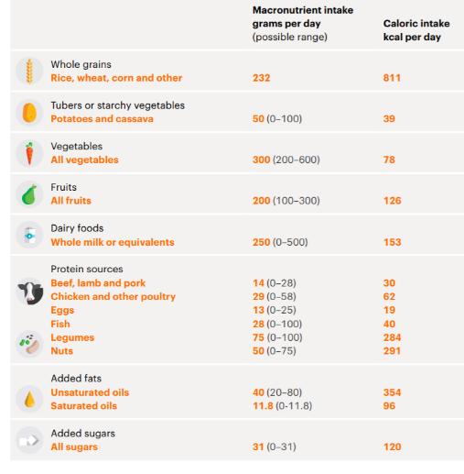
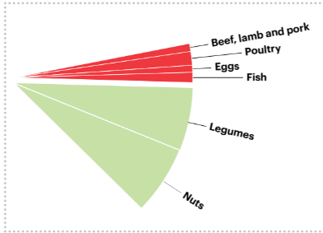
EAT Lancet recommendations
Notes:
Published in 2019, the EAT Lancet report is one of the biggest studies into sustainable diets in recent years. The EAT Lancet commission is made up of 37 experts from 16 countries across a range of disciplines.
The EAT Lancet dietary recommendations are not to be applied directly to national guidelines, but to be adapted by each country to meet specific nutritional and cultural needs as well as meeting population preferences. They are not too far from Eatwell guide recommendations.
The EAT Lancet recommendations are based on 2,500kcal per day – with the opportunity for countries to modify. On a global average the recommendations would help reduce individual energy intake by 300kcal per day.
What is important to note is the significant range in recommendations per food group which will enable countries to adapt to better fit their national guidelines. Some countries in the world may need to increase their meat intakes to ensure adequate iron intakes (sub-Saharan Africa) whilst other countries such as Mexico will need to significantly reduce their meat intakes.
The key aims of the guidance is to allow flexibility to meet multiple preferences and highlights that a healthy sustainable diet can be achieved whether one continues to consume meat and dairy (be at reduced quantities) or whether one follows a vegan / vegetarian diet.
Over half our intake to be based on fruit and vegetables – with recommendations of 300-900g per day – in line with the Eatwell guide of 400g or 5 servings.
EAT carbohydrate recommendations not only prioritise wholegrains over tubers and starchy vegetables – but starchy vegetables are highly limited to no more than 100g per day. The evidence is taken from US cohort studies which found higher GI / refined carbohydrate intakes and especially when carbohydrates contributed >60% total energy intake, to increase risk of total mortality. Additionally, meta-analysis and reviews of 3 large American cohort studies found a direct correlation between higher potato intakes and higher body weight, higher blood pressure and higher incidence of type 2 diabetes. This is at odds with UK carbohydrate recommendations and it is not surprising as the studies used by EAT were:
Based on US participants with possibly higher daily intakes of potatoes
Mashed, boiled, baked and chipped potatoes were grouped together
The cohort studies commenced in the late 1980’s and early 1990’s – when trans fats were prominent in prepared potato such as chips/crisps and were not included within the confounding factors.
Individuals with higher potato intakes were also more likely to smoke, have a higher sugar intake and lower intakes of fruit and vegetables as well as wholegrains.
Plant oils and spreads - in line with Eatwell guide.
Dairy foods are reduced from 0-500ml of low fat milk per day per person – the upper range is similar to the Eatwell guide
Sugars recommended at no more than 31g per adult per day – this again is in line with the latest UK sugar recommendations.

Slide 11
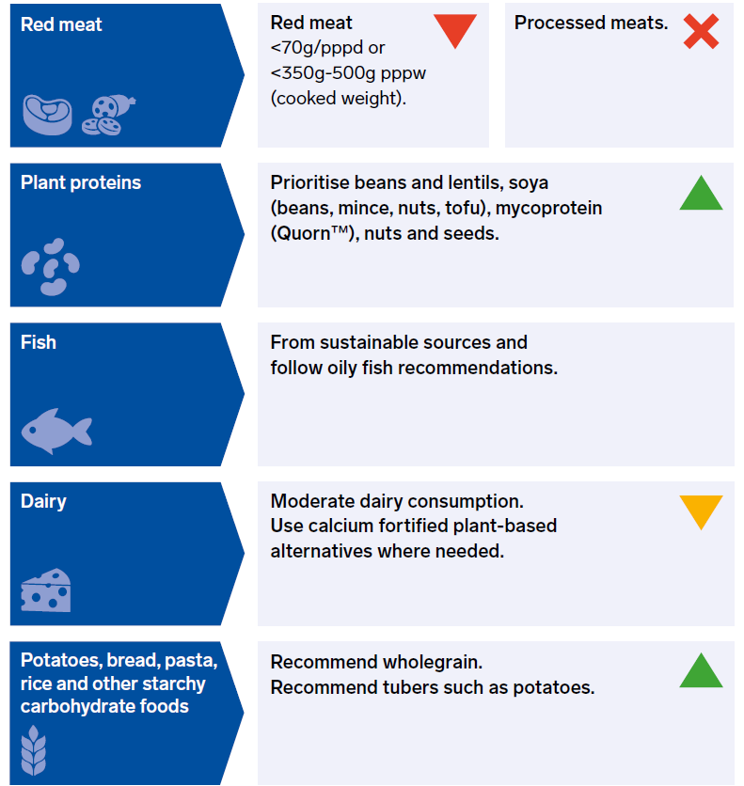
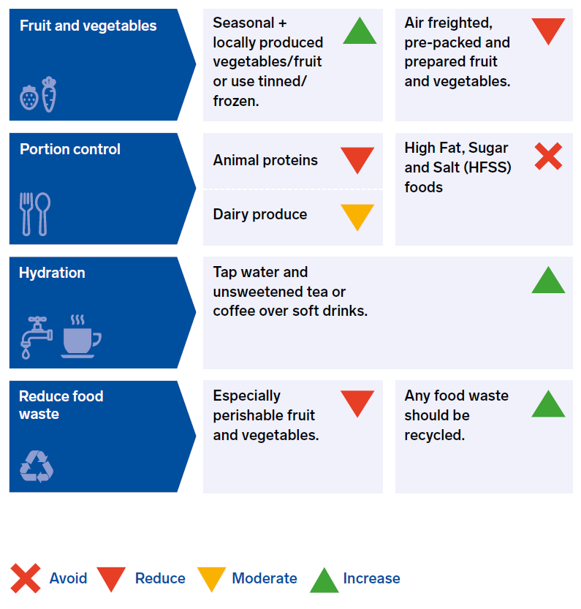
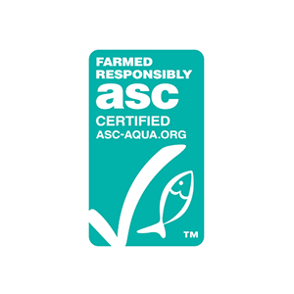


The BDA sustainable diet recommendations
Notes:
This is the overview of the BDA environmentally sustainable diet. Some of these recommendations will be explained in more detail in the following slides and there is a lot more detail in the One Blue Dot toolkit. Spare Slide #1 is a table that collates the major studies that support the key recommendations.
First and foremost, reducing not necessarily avoiding red meat especially beef and lamb should be prioritised as it has the biggest environmental burden. The transport of animal products represents 6% of GHG emissions; while the production of feed and methane emissions represent 84%. Emphasis is on reduction rather than avoidance as red meat is a key source of iron and zinc. However, processed meats should be avoided. These foods are key sources of salt and saturated fat in the diet.
Whilst reducing red meat, plant food sources of protein should be prioritised over other animal proteins – i.e. reductions in red meat should not be compensated for by increased white meat consumption. Plant proteins have a much lower environmental burden and have a more rounded nutritional profile.
Globally, fish stocks are at an all time low with 85% of oceans overfished with an increased reliance on farmed fish. This is in contrast to UK current eating habits where less than one serving of fish is achieved by a handful of the population. However, by focusing on more sustainably sourced fresh water and farmed fish (Look for the MSC logo for sustainable wild fish or ASC logo for sustainable farmed fish) – we can reach the recommended two portions (one of which should be oil-rich) whilst still protecting current stocks and minimising further damage to the ecosystem.
Dairy and alternatives should be moderated. Dairy cattle, like beef cattle are environmentally burdensome. If plant-based alternatives are used, calcium and, where available, iodine fortified variants should be chosen.
Fruit and particularly vegetable intake should be increased. Buying seasonally and locally produced fruit and vegetables which are not grown in greenhouses is important. If out of season fruit and vegetables which are grown abroad are consumed, canned or frozen variants will be more sustainable. Any produce that is airfreighted, pre-packed and / or pre-prepared or grown in greenhouses should be discouraged.
Portion control is not only on the government health agenda, but it also a priority for a more environmentally sustainable future. Over consumption means excess food grown and produced – which will only exacerbate the multiple environmental burdens: water use, biodiversity loss, deforestation, ecosystem damage, soil and water pollution as well as excessive GHGe and global warming. The BDA environmentally sustainable dietary advice supports current government recommendations and will ultimate lowers portion sizes, energy dense food, saturated fat, salt and sugars whilst improving intakes of fibre, healthier fluids and micronutrients such as iron, zinc and calcium.
Waste - Household waste accounts for 70% of all food and drink waste which equates to approximately 25% of all food purchased. Perishable fruit and vegetables make up the majority of household waste which is a major source of potent GHG emissions. The environmental impact of using more affordable frozen or tinned fruit and vegetables is not necessarily greater than opting for fresh produce which will also require refrigeration, are often air freighted and make up the largest proportion of unavoidable food waste. The government has been advised that policies to reduce food waste are paramount if the UK is to meet its future carbon foot print targets. The government has appointed a food waste champion to lead this https://www.gov.uk/government/news/gove-appoints-food-waste-champion

Slide 12
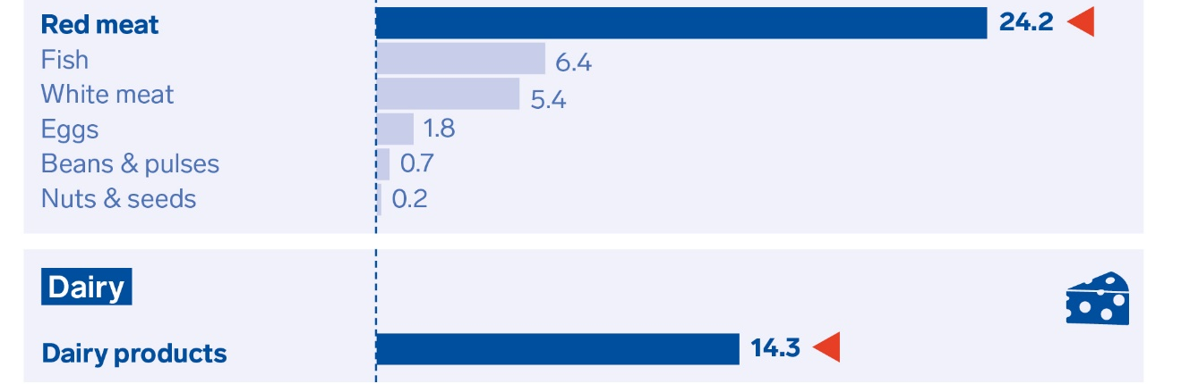
Meat and dairy key environmental burdens
Foods that contribute the most to GHG emissions in the UK diet (% GHG)
Carbon Foot Print reduces if total meat daily intake reduced
Notes:
To eat more sustainably, it’s important to remember that meat does not have to be omitted but reduced. The current Eatwell guide which is more sustainable than current intakes suggests that if meat is consumed:
Red meat should not exceed 70g per person per day / 500g per week & processed meat should be avoided.
And the reduction in red meat should not be compensated by an ↑ of other non-ruminant meats such as chicken.
Dairy is the second largest contributor. Because of its important role from a nutritional perspective, the BDA recommendation is to moderate dairy intake, and focus on healthier dairy options and reduce intake of foods such as cheese, which tend to be high in saturated fat.
Refs:
Daily dietary GHGe per person per day in the UK. Scarborough et al. 2014
Green et al using 2008-11 NDNS data vs WHO dietary recommendations.
Murakami et al using 2008-14 NDNS data compared to DASH & Med diet.

Slide 13
More plant proteins
Plant proteins – lower protein quantity but more rounded nutritional profile:
  Complex carbohydrate, fibre and minerals
Current UK protein intakes far exceed recommendations for all age groups
  Even vegans
Essential Amino Acids (EAAs)
  Even a diet based purely on plants + meets energy requirements over the course of a day can meet all EAA needs
  Plant protein combinations at each meal time not needed
  Nitrogen balanced is achieved over a course of a whole day
Notes:
Alongside reducing red and processed meat, the main aim is to increase plant proteins (not to replace pork and beef with chicken)
Plant sources = lower protein concentrations but a more rounded nutritional composition:
Protein, complex carbohydrates and fibre.
Studies consistently demonstrate even vegans exceed protein dietary recommendations.
Current UK intakes way in excess of the 0.75g / kg body weight / day recommendations.
Including those following a vegan diet.
Plants contain ALL EAAs – however, some EAAs in a single plant food serving too low to meet all EAAs human needs. However…
Nitrogen balance is achieved over the course of day’s consumption of EAAs and where energy meets are met.
Therefore, even a diet based purely on plants, over the course of the day and if energy needs are met, will meet all human EAA requirements.

Slide 14
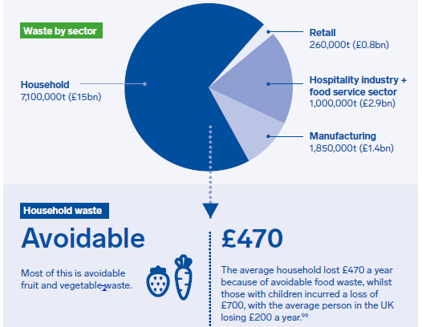
Reducing food waste
70% of all waste comes from the home
Households – 7.1 million tonnes of food waste.
25% all food purchases
60% avoidable
No.1 = perishable fruit and veg
Notes:
Food waste is the least controversial or difficult recommendation – because uneaten food has no nutritional value and significant environmental impact. Individual households have the biggest role to play as well – this is not an issue easily dealt with “systemically”.
Fruit and veg which are perishable are the biggest contributors to household waste, and there is some complexity in this message for the public as we do not want to discourage fruit and vegetable intake – message has to be waste less, buy tinned/frozen, and use leftovers in soups, sauces, stews etc.
The Courthauld Commitment 2025 baseline covers food waste from UK households, retail, manufacturing and the hospitality industry and food service sector as at 2015. The target is 1.5m tonnes less food waste per year by 2025.
Important to emphasise that food waste is also expensive – a typical household is spending £470 a year on food which is then thrown away – and this figure is higher still for families with children.
Messages for the public may need nuancing depending on local issues – e.g. in Wales recycling rates (including food waste collection) are higher; in Scotland fruit and veg intakes are generally lower but waste from e.g. bread or takeaways may be higher. The BDA does not have data on this.

Slide 15
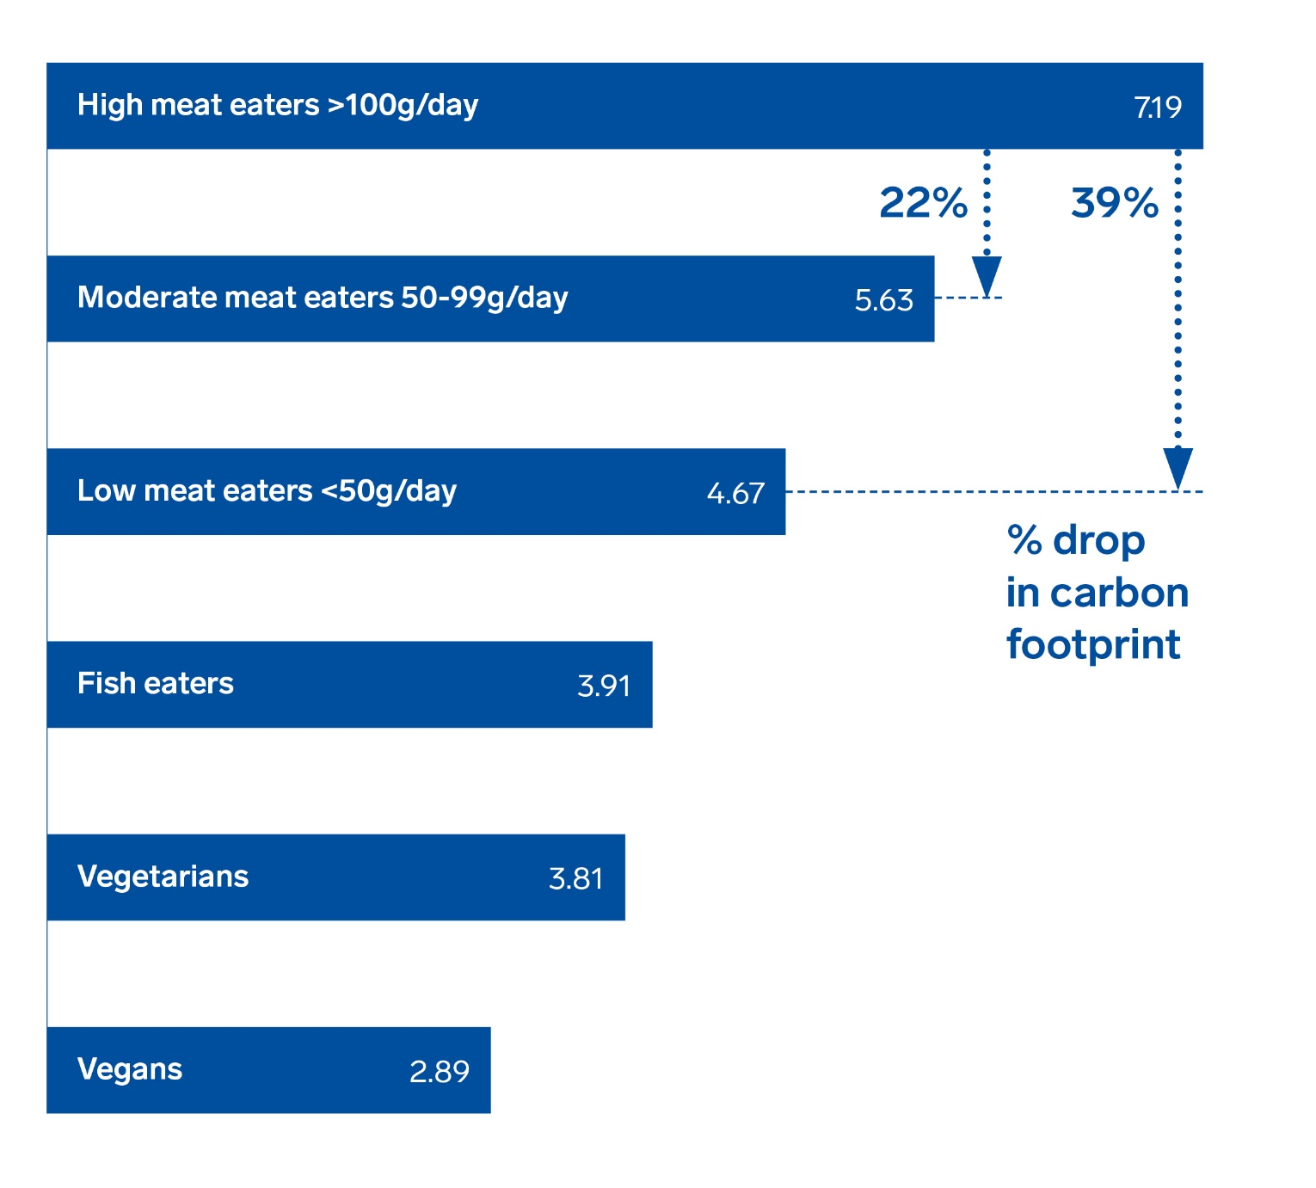
Veganism and Vegetarianism
Notes:
Important to be clear that OBD is not encouraging or endorsing that a sustainable diet has to be vegan or vegetarian.
The BDA’s aim is to help the population as a whole to adopt a more healthy and sustainable diet. To achieve that, we fully understand that any recommendations must be realistic and achievable for the population whilst resulting in significant reductions in our carbon footprint.
The BDA acknowledges the superiority of vegan and vegetarian diets from a purely environmental point of view. If consumed with variety and in a balanced way, these diets can meet all micro nutrient requirements. Long-term vegans being the exception requiring supplementation with vit B12. The BDA believes dietitians should be able to support an individual actively seeking to follow such a dietary pattern with planning to ensure on nutrient needs are met.
However, when looking at the population as a whole and often the groups which are in most need for dietary change, we do not believe vegan or even vegetarian diets are realistic. Adopting a vegan and vegetarian eating pattern would mean overcoming significant barriers and a drastic change to current eating habits.
<1% population is vegan & ~2% vegetarian
This trend is predominantly increasing among the ABC1 socioeconomic groups.
Also considering that less than 1% of the population achieve the existing government recommendations – the Eatwell guide – the BDA does not feel it is realistic or beneficial for the mass population to be encouraged to follow a vegan or vegetarian diet, which would be a very radical change.
Taking into consideration the practical reality and driving dietary behaviour change, the BDA wants to individuals to take small but achievable steps to adapt their eating habits to contain less meat and dairy with a long term aim of achieving the Eatwell guide recommendations. Once consumers achieve this, then a switch to more plant-based eating can be made possible.
Also outside the remit of the BDA environmentally sustainable diet recommendations are issues of organic farming and animal welfare. The BDA appreciates both these issues do resonate with some individuals and, the latter in particular, is a growing drive towards consuming less meat in the UK. However, we have chosen not to factor these into our recommendations. More information on Organic food can be found in our FAQs.

Slide 16
Nutritional considerations and general advice

Slide 17
Protein
Encourage non-animal protein foods daily
Go meat free several days a week
Starchy foods / wholegrain cereals: low in protein, but can support overall protein intake as eaten in high quantities
Canned chickpeas 7g/100g | Brown lentils 9g/100g | Mixed Nuts 7g/30g | Tofu 17g/75g | Mycoprotein (QuornTM) 11g/100g
Notes:
Meeting recommended intakes of protein – many of us are over-consuming protein, even vegetarians and vegans. Moving to plant-based protein food sources will not be an issue.

Slide 18
Iron
Animal protein
70g beef
2-2.5mg
Iron from plant sources less bioavailable.
Inhibited by phytates, polyphenols & tannins naturally found in plant foods.
Optimising non-haem absorption in plant-based diets:
  Consume high tannin / polyphenol containing foods e.g. tea, coffee, spinach at least 2 hours away from non-haem iron foods.
  Choose lower phytate options e.g. tubers, canned beans
  Including some animal protein e.g. fish or chicken may help enhance absorption
Fortified Cereal 2.8-4.4mg/30g | Wholemeal Bread 2mg/2 slices | Tinned prunes 1.8mg/80g | Lentils 3.3mg/100g | Mixed Nuts 0.6-1.9mg/30g
Notes:
NB Low iron stores remain an issue for young women in westernised societies but the prevalence of iron deficiency anaemia (low haemoglobin levels) remain relatively low.
The reference nutrient intake (RNI) for iron is 8.7 mg/day for men and postmenopausal women, and 14.8 mg/day for premenopausal women
With non-haem iron – the body adapts: When levels are low and with high consumption of high fibre / phytate intakes (12-week study → 41% increase in absorption)
SACN indicated that: reducing red meat in high consumers (90g+ /day) will not compromise iron intakes.
Individuals following plant-based diets
Meet national and international recommendations.
Plant food sources of iron = lower bioavailability but ways to optimise and overcome this PLUS long-term high phytate consumption results in improved iron utilisation by the body.
Lower iron (ferritin) stores vs omnivores, however, within normal range.
Evidence regarding iron deficiency anaemia in vegetarians and vegans is limited:
NO DIFFERENCE in prevalence between vegans, vegetarians & omnivores.

Slide 19
Calcium
Animal source
200ml semi-skimmed milk
248mg
Low intakes in teenagers and young women.
Calcium ubiquitous in the diet with significant quantities coming from white flour-based products
Switching to fortified plant-based alternatives will not compromise calcium intakes – bioavailability from alternatives same as dairy.
Low oxalate calcium rich dark green veg e.g. broccoli and pak choi – double bioavailability compared to dairy.
Fortified plant drink 240mg/200ml | Broccoli 35mg/80g | Silken Tofu 105mg/75g | Dried Figs 60-70mg/30g | Tahini paste 129mg/15g
Notes:
RNI for adults aged 19 to 64 - 700mg of calcium a day.
Non-dairy foods can contribute up to 400mg calcium daily e.g. low oxalate dark green vegetables, nuts, seeds and in the UK mandatory fortification of what flour makes white bread a significant contributor to calcium intakes alongside other white flour based goods.
Year 7&8 NDNS food contributors to calcium intakes:
Cereals and cereal products
11-18 years – 39% vs 34% from dairy products
19-64 years – 31% vs 34% from dairy products
Dairy foods are the second biggest contributor (after red meat) to dietary GHGe as well as deforestation, soil degradation, biodiversity loss etc. Thus reductions in dairy intake are paramount to protect the planet. From a health perspective, higher fat, salt and sugar-containing dairy foods should be prioritised for reductions e.g. cheese, full cream yogurts and milk as well as flavoured milks with added sugars.
Plant-based alternatives to milk and yogurt are in the main fortified not only with calcium but also vitamin D (in the UK, dairy milk is not fortified with vitamin D). It is the Organic variants that tend not to be fortified with calcium.

Slide 20
Zinc
Animal source
70g beef
5.3-6.7mg
Meat currently major dietary source.
Teenage boys and girls have significantly low intakes:
  A fifth of boys and over ¼ girls below LRNI.
Plant sources, with the exception of mycoprotein, are lower in zinc.
Optimise by adding sprinkles of seeds and nuts onto cereals, soups and yoghurts + choosing wholemeal / wheatgerm breads
Mycoprotein (QuornTM) 7mg/100g | Tofu (Firm) 1.5mg/75g | Wheatgerm Bread 1.8mg/2 slices | Peanut Butter (Thick spread) 1.2mg/40g
Notes:
RNI Zinc – men 9.5mg per day; women 7mg per day

Slide 21
Vitamin B12
Animal source
70g beef – 1.4-2.1mcg
200ml milk – 1.8mcg
A healthy sustainable diet does not have to exclude meat and dairy which will provide adequate vitamin B12.
Those wishing to follow a dairy and meat free diet → high risk of vitamin B12 deficiency:
  Especially if fortified plant-based options are not consumed daily
Fortified plant food sources include plant-based drinks, yeast extract and most fortified breakfast cereals.
Fortified cereal (30g) with fortified plant drink (150ml) 1.1mg | 150g of fortified soya yoghurt 0.6mg | Yeast Extract (Marmite) Two toast slices 0.6mg
Notes:
Requirement for adults 1.5mcg
More info: https://www.bda.uk.com/professional/resources/obd_other_sources_b12.pdf

Slide 22
What can dietitians do?

Slide 23
Dietitians as advocates for the planet
Upskill to gain knowledge
Read the One Blue Dot toolkit and follow up materials
Facilitate dietary change:
  Provide information, address barriers, highlight benefits
Aim personally to eat a more sustainable diet
Consider new types of influence
  Policy at hospital, Trust/Board, local or national level
  Partnerships with NGOs who could benefit from nutritional input
  Join citizens’ movements including local food groups
  Food system – identify key actors and players who you can influence
Notes:
NGOs include local agencies who may be running food growing, environmental education or health projects which would benefit from including nutrition

Slide 24
Workshop activity

Slide 25
Activity
Group 1 to discuss: Nutritional implications of a sustainable diet
Is a sustainable diet nutritionally adequate?
List some of the nutritional implications of a sustainable diet
Suggest alternative food sources
Group 2 to discuss: Challenges of adopting a sustainable diet
  How can nutrition professionals get involved to overcome barriers?
  Nominate a speaker who will present your findings to the team for further discussion.

Slide 26
Resources and further reading

Slide 27
Resources
One Blue Dot toolkit - www.bda.uk.com/onebluedot
NutriWebinars on One Blue Dot and EAT Lancet- http://nutrilicious.co.uk/nutriwebinar/
EAT Lancet Commission on food, planet, health - https://eatforum.org/eat-lancet-commission/
Food Climate Research Network - https://www.fcrn.org.uk/

Slide 28
Spare Slides

Slide 29
Author - Year | Method | Comparisons | Impact
Green 2015 | Modelling study | UK NDNS 2008-11 vs WHO recommendations & less meat and dairy | -17% to -40% GHGe
Horgan 2016 | Modelling study | NDNS 2008-11 vs dietary recommendations & GHGe targets | -15% to -17% GHGe
Biesbroek 2017 | Dutch EPIC Cohort study | Impact per WHO and Dutch HDI SD | Per HDI SD -1.9% to -3.7% GHGe -1.9% to -3.3% Land use -7% to -12% total mortality risk
Dinu 2017 | Meta-analysis: 10 cohort studies | Vegan, vegetarian vs omnivore diets | IHD mortality / incidence: -25% Cancer incidence: -8%
Dinu 2017 | Meta-analysis: 86 cross sectional studies | Vegan, vegetarian vs omnivore diets | ↓BMI, total cholesterol & LDL-cholesterol
Kramer 2017 | Linear modelling | Identifying which food groups in the Dutch diet → biggest reduction on GHGe whilst meeting micro and macro nutrient recommendations | ↓ red meat was most effective at lowering GHGe and meeting dietary requirements.
Seves 2017 | Modelling study | Dutch eating habits: 30% meat and dairy intakes replaced with plant proteins | Sat fat, Zn & calcium (but non-calcium fortified plant altern. used). ↑ Iron & fibre. No change in vitamins A, thiamine, B12 or D. ↓ Land use and GHGe by 14%
Gonzalez-Garcia 2018 | Systematic review: 66 dietary scenarios. | Comparison of NRD9.3 score with diets: Atlantic, Med, vegan, Danish, healthy, New Nordic, Finish, Modified, vegetarian, omnivore. | Highest NRD9.3 low ruminant, higher plant proteins, moderate white meat. Best nutrition score: lowest GHGe impact
Murakami 2018 | Modelling study | NDNS 2013-2014 vs HDI, Med Score, DASH. | Taking into consideration underreporting, dietary related GHGe inversely associated with all 3 healthy diet scenarios.
Notes:
Further references for recent papers considering the issue of sustainable diets for the environment and health.

Slide 30
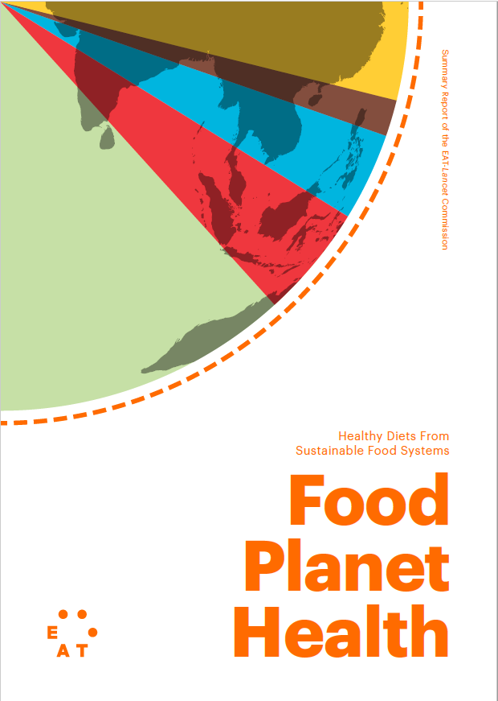
EAT-Lancet planetary health diet - 2018
37 experts from 16 countries
  Health, nutrition, environmental sustainability, foods systems, economic, political governance.
6 environmental systems:
  Climate change, biodiversity loss, land-system use, freshwater use, and nitrogen and phosphorus flows.
  Safe operating system and upper-limit boundaries to avoid potential ecological catastrophe.
Healthy diet:
  Optimum dietary habits that would meet essential macro and micronutrient needs, bring energy intakes in line with requirements → reduce premature deaths worldwide by 19–23%.
  Dietary patterns, specific foods groups, macro and micronutrients investigated.
The EAT Lancet reference planetary health diet:
  A range of daily intakes of specific food groups that would meet the environmental boundaries & optimise health outcomes.
  Target for 2050 to adequately meet the needs of a global population of 10 billion.
Each country to align the recommendations to meet cultural and national needs and preferences.
Notes:
More information about EAT-Lancet:
This is a major publication. The EAT Lancet commission is made up of 37 experts from 16 countries across a range of disciplines. The group included Prof Walter Willet who headed the dietary health aspect of the scientific review, Johan Rockström, Brent Loken, Marco Springmann, Tim Lang, Sonja Vermeulen, Tara Garnett, David Tilman, Fabrice DeClerck to name but a few.
The group was tasked with reviewing the evidence and setting the first scientific dietary targets for health and environmental sustainability.
The environmental targets focused on setting boundaries for food systems with regard to climate change, biodiversity loss, land and water use as well as nitrogen and phosphorus flows which mainly reflect pesticide use and consequent drainage into rivers, lakes and oceans.
The health impacts of different dietary habits were reviewed by food types and dietary habits e.g. vegan, vegetarian, pescatarian, meat eaters. The commission also investigated the impacts on specific macro and micro-nutrients intakes from dietary adaptations e.g. saturated fats, omega-3, iodine, zinc and calcium and made specific recommendations.
The final ‘Reference planetary health diet’ provides ranges for daily intakes of key food groups which would result in optimum health from consumption of foods from sustainable food sources. For each key food group a minimum and maximum intake has been recommended. The specific quantities of foods recommended has been based on the ability to meet the nutritional and health needs of the world in 2050 where population is set to grow to 10 billion from the current 7 billion.
Often misunderstood, the dietary recommendations are not to be applied directly to national guidelines, but to be adapted by each country to meet specific nutritional and cultural needs as well as meeting population preferences.
The EAT commission’s key focus now is to bring together all players within the food system from policy makers, scientists, regulatory bodies, manufacturers, farmers and advertisers to make the changes necessary within the food environment that will enable consumers and nations to meet the reference planetary health diet.

