Slide 1
Critical Care Dietetics
Crash Course
Carys Davies
2020

Slide 2
Nutritional Requirements
Energy:
15 – 20kcal/kgABW (BMI <30kg/m2)
11-14kcal/kgABW (BMI >30-49.9kg/m2)
22 – 25kcal/kgIBW (BMI > 50kg/m2)
Protein:
Non renal patient: 1.2-1.5g/kg
On filter: 1.5-2g/kg
Off filter (with AKI / CKD / low eGFR): 1-1.2g/kg
Obese:
1.3g/kgAdjBW
2g/kgIBW (BMI 30-40kg/m2)
2.5g/kgIBW (BMI > 40kg/m2)

Slide 3
Refeeding
Pabrinex as per refeeding guidelines
No need for build-up feeding regimen on ICU
Electrolytes to be topped up as required
Watch out for loose stools if having enteral electrolytes

Slide 4
Fluid balance and / balance targets
We do not advise on flushes / fluid requirements
Fluid balance will be decided on a daily basis by consultant
(e.g. 500-1L +ve or 1L –ve)
These targets help guide us with what feed to use e.g. if aiming for very negative balance to use twocal to reduce input

Slide 5
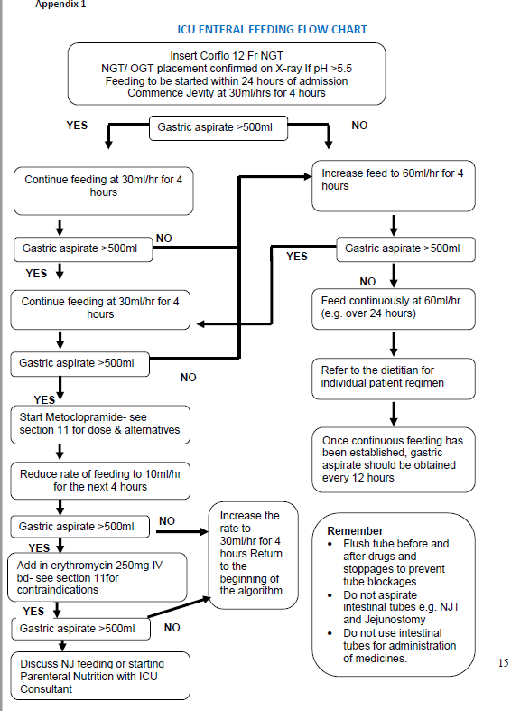
Gastric Residual Values
Aspirate 4 hourly on starting feeding
See ICU enteral feeding flow chart for details
**Aspirate >500ml = concerns**

Slide 6
Drugs
Sedation:
Propofol – to count if receiving >200mg/hr ~ 1kcal/ml
May have impact on gut motility
Other examples: fentanyl, clonidine, midazolam
Paralysis:
Atracurium / Rocuronium – commonly used in those with severe respiratory disorders to allow for improved ventilation
Impact: reduced gut motility – can improve with motility agents in short term if requiring long term paralysis with poor absorption may require PN
Motility agents:
To be used for a short duration, with max 5 days
Metoclopramide (IV) – to be used first line, if no improvement within 48 hours to add second agent
Erythromycin (IV) – to be used as second agent
*Contraindications for both – see guidelines page 9*
Vasopressors and inotropes:
Noradrenaline, Adrenaline, vasopressin, metaraminol
When on high levels can cause reduction in blood flow to the gut – overfeeding when requiring ++ BP support can increase risk of gut ischaemia – always aim for lower end in this population

Slide 7
Filtration
Amend nutritional requirements as above
Fluid:
On filter: feed as usual – can modify fluid clearance on filter
Off filter: Aim for low volume (i.e. Twocal) – may be anuric / have low UO
Feeding plan to include both on and off filter regimen e.g.
Target regimen:
On filter: 1221ml Jevity plus HP (1.3) @ 51ml/hr for 24 hours = 1600kcal, 99g protein, 53mmol Na, 40mmol K+
Off filter: 800ml Twocal @ 33ml/hr for 24 hours = 1600kcal, 67g protein, 45mmol Na, 41mmol K+

Slide 8
Feeding in the prone position
Many patients are requiring proning
See statement below from ICHT ICU guidelines
“Enteral feeding is possible when the patient is in the prone position for mechanical ventilation. Each case should be discussed with the ICU consultant. These patients are more likely to experience GI intolerances (Reignier 2004), therefore prokinetics should be given regularly with the head of the bed elevated (Reigneir 2011)”

Slide 9
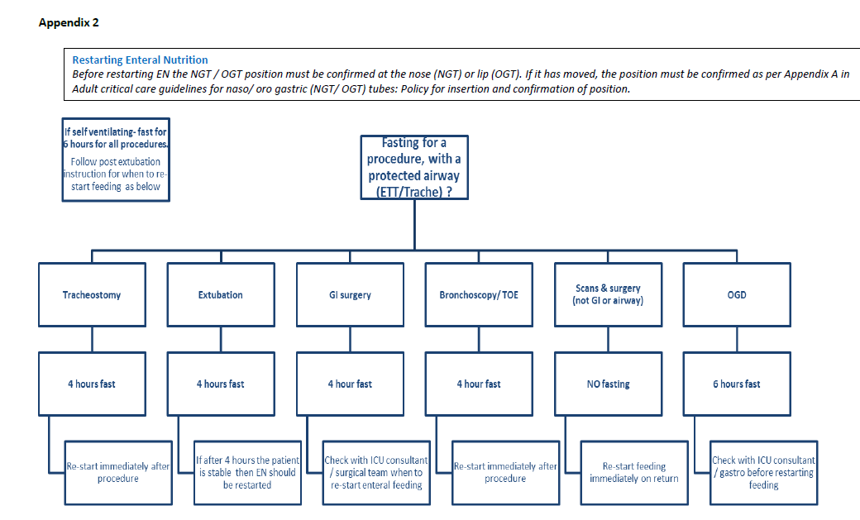
Fasting

Slide 10
Contact details
Please, please, please contact if you have any questions..
HH: Jacqui – Ext: 33496 Bleep: 9606
CXH: Gerii – Ext: 30326 Bleep: 1445
SMH: Carys – Ext: 22440 Bleep: 1304
Renal team: Ext: 35807 / 34584

