Slide 1
Restrictive eating behaviour in a young child that developed scurvy
Nicole Rothband
Specialist Paediatric Dietitian
London Northwest Healthcare NHS Trust

Slide 2
Case Study
Male, South Asian
First referred as outpatient age 2yrs 1 month
PC faltering growth, unknown cause
Weight: 0.4th Centile
Height: 0.4th Centile
Birth weight: 25th Centile

Slide 3
Feeding/diet history
Breast fed 14/12
Bottle introduced 14/12 full fat milk
Complementary foods introduced 6/12
Was taking family foods and textures until aged 22/12 mouth ulcers & stopped eating
Drinking milk only from bottle for 4/12
Accepting yoghurt from spoon
Anaemia triggered referral to dietitian
Bowels open alternate days ?functional difficulties
Taking Sytron and multivitamins

Slide 4
Advice
Commenced on 1/7 trial Paediasure Plus od & Paediasure Plus Fibre od
Continue yogurt
Advice to try runny potato & baby rice
Progress with textures as soon as child allows
Notes:
Starchy foods to increase energy density

Slide 5
Follow up
Regular follow up over a year
Gaining weight 9th-25th centile
Height 25th centile
Increasing variety in types and textures of foods as a result of messy food play & gradual progression with textures by adding fruit to yoghurt
BO alternate days with fig syrup
Not talking or babbling
FG resolved so discharged
Notes:
Paediasure given by syringe as use of feeding bottle discontinued on HV advice therefore will not drink milk
gradually weaned off
Yoghurt bread and butter cheese rice lentils chap vegetables mixed in with food e.g. pasta sauce stuffed chapatti
Refusing fruit

Slide 6
9 months later
Referred 4 days post admission for advice re: weight loss
Non weight bearing, haematuria, 3/52 history of fevers, weight loss, reduced appetite, spontaneous bruising of legs & swollen left knee, spontaneous bleeding of gums, X-rays show abnormality of bones, multiple petechiae everywhere on body.
Abnormal blood film, past history of anaemia
?Malignancy underlying cause unknown
Known to have diagnosis of autism ?when made
Notes:
Now 3 yrs 9months old
Feeding difficulties, non verbal, nappies 24/7, co sleeping with mum
Abdominal ultrasound, xrays, MRI brain & spine under sedation, urine & blood culture, coagulaton to check fibrinogen
MRI bilateral oedema of long bones

Slide 7
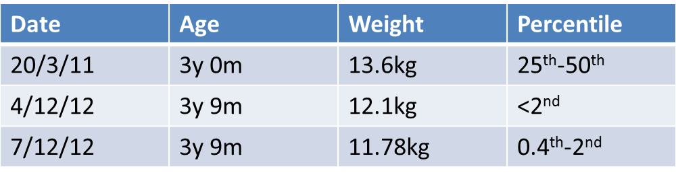
Weight history

Slide 8
Biochemistry
Hb 9.4 (range 11.0-14.0) ?iron deficient, ?thal trait, ?viral infection. Prior history of iron deficiency. RA
Sodium, creatinine, alk phos, albumin were all low
CRP high
Notes:
RBC aniso-poikilocytosis, microcytes, hypochromia, elliptoid forms, reactive looking lymphocytes. No evidence of haematology neoplasm.

Slide 9
Feeding history
Improvement lasted a few months but diet started to become more restricted
bread & butter or cheese sandwiches and yoghurt
Holiday in Spain refused yoghurt
Can’t drink from a straw, rigid re which drinks from which vessels - water only
Lack of routine meals & sleep
Poor dentition as refuses tooth brushing

Slide 10
Diet History
Breakfast: bread/spicy chapatti & butter /cheese
Lunch: as breakfast, previous day had jacket potato with baked beans
Dinner: lentils with rice & carrots (since admission)
Before bed: rice & lentils & slice bread
Sytron 2.5ml tds, no multivitamin
Notes:
Gluten free diet since hospital admission led to intake improving amount and variety

Slide 11
Advice
Gluten & casein free diet
Food fortification advice
Commence Abidec multivitamin
Follow up in reg review
Ongoing follow up to support GF/CF diet
Mum to weight fortnightly with HV
Notes:
Mum keen to follow GF &CF diet

Slide 12
Investigations
Haematology GOSH
Radiology GOSH
Radiology RNOH
Rheumatology GOSH
Heamoncology GOSH
Infectious diseases St Mary’s
Immunology GOSH
Notes:
Unable to get hold of ID
Radiology RNOH queried vitamin C deficiency

Slide 13
Review
Due for tx GOSH under immunology team
Suspected vitamin C deficiency
“Since starting Abidec 40% better”
Suspected coeliac gluten back in diet
Food chart discontinued as eating much better
Commencing 125mg therapeutic dose vitamin C
Increased variety in diet; jacket potato, chicken, lentils, baked beans, mixed veg biryani, omelette
More responsive increased eye contact
Weight 12.2kg up 420g in 4 days
Notes:
Initially seen on Friday review the next Monday

Slide 14
Plan
Continue Abidec multivitamin
Commence calcium sandoz
Mum to keep journal diet, behaviour & bowels
Outpatient follow up

Slide 15
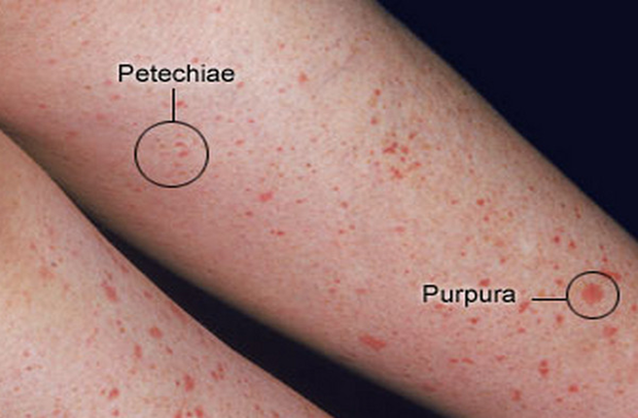
Recognising scurvy
Symptoms
Petichiae
Bleeding gums
Bone pathology accompanied by pain
Swelling
Petechiae
Anaemia
Bruising
Lack of appetite
Irritable
Poor wound healing
www.medicinenet.com/
Notes:
Classic presentation of symptoms not recognised as never seen before by any clinicians
Accompanied by iron deficiency as helps abspn of iron
Life threatening disease many infants died of scurvy in the 19th century due to the introduction of heated milks which reduced infant mortality & morbidity from bacterial contamination of raw milks but increased incidence and mortality from scurvy
Often seen with rickets in the past

Slide 16
Vitamin C requirements
RNI 30mg/d
EAR 20mg/d
LRNI 8mg/d
Abidec multivitamin syrup vitamin C 60mg/10ml
No vitamin C in Abidec drops
Notes:
RNI 1-10 yr olds
Infants fed on dried milks providing 5 mg/d do not develop scurvy

Slide 17
Follow up
Continued on GF CF diet - butter only
Greater interest in food much more varied diet
Constipation resolved
Weight increased to 50th centile
Height <25th centile
Monitored at special school so at mothers request discharged
Notes:
Coeliac screen negative
Eggs baked beans ganthia bhajia chapatti curry rice lentils spicy pancake vegetables in curries
No sweet foods or fruit
Food fortification advice then discontinued
Meeting Ca requirements from non-dairy sources but if unable commence Osteocare liquid
Continue Mvitamin

Slide 18
Summary & learning points
ASD
Erratic eater
Does better on GF/CF diet
When eats wheat & dairy becomes more restrictive in his eating behaviours
Diet minimal vitamin C content
Awareness of dietary deficiency diseases very poor
Cost of extensive tests & clinical time & resources
The trauma of these investigations & risks to the child
Know clinical signs of vitamin & mineral deficiency diseases

Slide 19
References
Department of Health (1991) Dietary reference values for food energy and nutrients for the United Kingdom. Report on health and social subjects No. 41, HMSO, London
Rajakumar K. Infantile scurvy: A historical perspective. Pediatrics. 2001;108;e76
http://pediatrics.aapublications.org/content/108/4/e76.full.html
Leger D. Scurvy: Reemergence of nutritional deficiencies. Can Fam Physician. 2008;54:1403-6

