Slide 1





Nutrition in chronic pancreatitis:
PEI, bone health & type 3c diabetes
Sinéad Duggan PhD
Research Fellow, Department of Surgery, Centre for Pancreatico-Biliary Diseases,
University of Dublin, Trinity College, Tallaght Hospital, Dublin, Ireland
BDA Northern Ireland Branch Study Evening
3rd May 2018, Belfast City Hospital

Slide 2
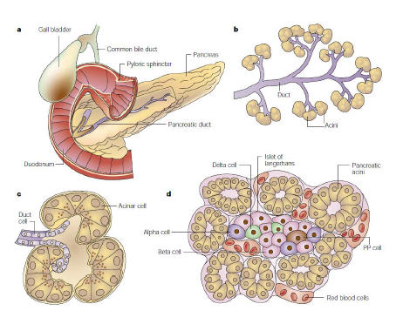
The pancreas
  Exocrine function
  Pancreas secretes 2.5L of exocrine fluid per day
  95-98% of pancreas per weight
  Acinar (majority), centroacinar, ductal cells
  Nutrients in the intestines stimulate exocrine function
  Acinar cells connected to the pancreatic duct by ductules, lined by columnar epithelium – secrete a bicarbonate-rich fluid
  Endocrine function
  Cells arranged in diffusely distributed nests (islets)
  Only about 1% of weight, higher concentration in tail
  Islet cells: 60% insulin-secreting β-cells, 25% glucagon-secreting α-cells
    Insulin (anabolic hormone)
    Glucagon (induces hyperglycaemia)
δ-cells secrete somatostatin (supresses both insulin and glucagon)
PP cells secrete pancreatic polypeptide (stimulate enzyme secretion)
  Soft, lobulated, yellowish gland
  14-18cm long
  85-100g in weight
  Head, neck, body, tail
  Upper peritoneum, between upper duodenum and spleen
  Associated with many vascular structures
  Key organ in digestion and metabolism

Slide 3
Chronic pancreatitis
Definition
Defined as a continuing inflammatory disease of the pancreas characterised by irreversible morphological changes that typically cause abdominal pain and/or permanent loss of pancreatic function
Pathology
Progressive exocrine atrophy, with replacement of the normal pancreatic tissue with fibrous tissue leading to gland enlargement
Main duct dilated, tortuous and strictured
Gland becomes fibrotic and shrinks
Secretions may calcify
Islets initially preserved, but later blood supply compromised and they atrophy
Cause
Excess alcohol consumption
Pancreatic duct obstruction
Pancreas divisum
Cystic fibrosis
Hypercalcaemia
Autoimmunity
Gene mutations
Hypertriglyceridaemia
Idiopathic
Incidence
Est. 3.5-10 per 100,000 population per year (Europe)
More common in males, particularly alcoholic aetiology
Usually begins in adulthood

Slide 4
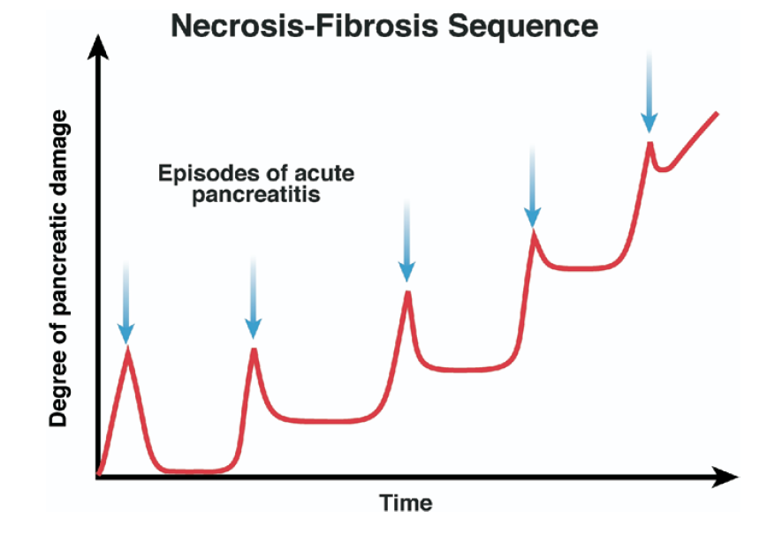
Disease spectrum
Acute Pancreatitis
Chronic Pancreatitis
Evidence of both exocrine and endocrine damage even after mild acute pancreatitis
Witt H, Apte MV, Keim V, Wilson JS. Gastroenterology 2007;132(4):1557-73.

Slide 5

A difficult disease
‘The management of chronic pancreatitis is challenging... There are no effective means to stop progression or reverse this syndrome.’
Forsmark, Gastroenterol, 2013
‘Chronic pancreatitis remains an enigma in the field of gastroenterology.’,
Draganov, World J Gastroenterol, 2008
‘The management of this condition is challenging, and most patients remain symptomatic despite medical, endoscopic and surgical therapy.’
Gupte et al, Curr Opin Gastroenterol, 2014
‘Nutrition in chronic pancreatitis is a problem area.’
Lankisch PG. Curr Opin Gastroenterol. 2007.

Slide 6
Drivers of undernutrition in chronic pancreatitis
Undernutrition
Maldigestion
Malabsorption
Resting energy expenditure
May be higher by 30-50%
Insufficient secretion of pancreatic lipase
Insufficient micelle formation due to inadequate bicarbonate production
Precipitation of bile acids due to acidic SI
Bacterial overgrowth
Poor dietary intake
Chronic pain
Anorexia
Smoking
GI symptoms
Social circumstances
Diabetes
Alcohol
Major causal factor
Displaces food
Affects appetite
Malabsorption
Chronic Inflammation
Diabetes
Weight loss, low BMI
Vitamin deficiency
Osteoporosis
Sarcopenia
Poor functional capacity
Lower QOL
Poorer outcomes

Slide 7
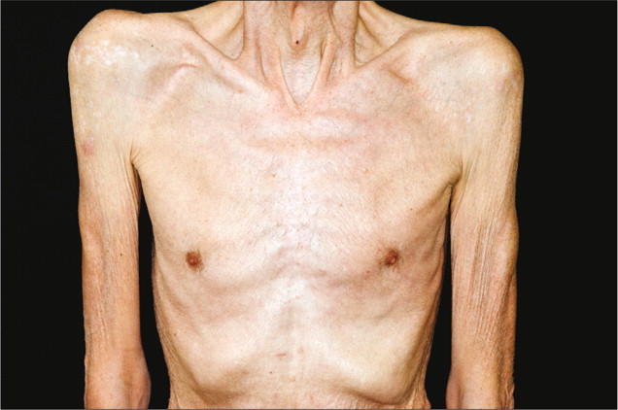
Case study
35 yr old male presented with severe malnutrition and fat malabsorption. He had a history of chronic pancreatitis, diagnosed 10 years prior.
Nutritional assessment showed that he had low serum levels of 25OHD, vitamin E and vitamin A.
DXA scan showed osteoporosis at the hip and spine.
He had severe exocrine impairment, and endocrine work-up revealed a diagnosis of impaired glucose tolerance.
Few studies, no guidelines… management?

Slide 8
Pancreatic exocrine insufficiency

Slide 9
Nutrient digestion
Optimal digestion and absorption of nutrients requires a complex interaction between motor and secretory function of the GI tract
Digestion of macronutrients is a pre-requisite to absorption and occurs mostly via enzymatic hydrolysis
Pancreatic enzymes play an important role: lipase, amylase, trypsin and chymotrypsin
Enzymes of the brush border, other pancreatic and extrapancreatic enzymes also play a role

Slide 10
Exocrine response to a meal
For a short period after a meal, pancreatic enzymes secreted into the duodenum
Level x 3-6 fold above inter-digestive levels
Followed by 2 hour period of sustained enzyme release
Level 3-4 fold above inter-digestive levels
Level of response depends on:
- Calorie content and composition of meal
- Fat content
- Meal consistency

Slide 11
Normal exocrine function
Digestive juices stored in an inactive form inside zymogen granules in the pancreas
To release digestive enzymes, the zymogen granules fuse with the apical surface of the acinar cells and are secreted in to the ductular system
Trypsin is the key proteolytic enzyme which triggers the release of the other zymogens in a cascade manner
2 key hormones involved
  CCK – triggers the release of pancreatic enzymes from the pancreas
  Secretin – stimulates bicarbonate secretion form the pancreas to ↑ pH

Slide 12
Exocrine function
Normal fat digestion
  Following a meal, enzymes delivered rapidly
  Fat digestion begins in the mouth (very limited) and stomach (10-30% of all lipid breakdown¹)
  Most fat digestion by pancreatic lipase
  Approx 20,000-50,000 units of lipase are needed to digest a typical meal
1. Layer P et al. Lipase supplementation therapy: standards, alternatives and perspectives. Pancreas. 2003;26(1):1-7

Slide 13
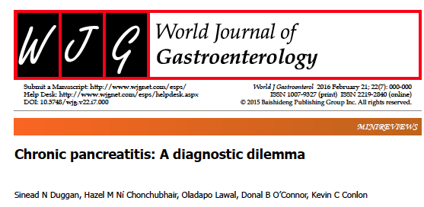
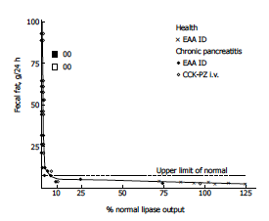
‘The pancreas has a large exocrine reserve’ = Accepted consensus
DiMagno et al, 1973:
‘90% of the gland must be functionally destroyed or obstructed before steatorrhoea or creattorhoea occur’
Enzyme output measured in response to duodenal perfusion with
essential amino acids and intravenous cholecystokinin-pancreaozymin
Based on a study of 17 chronic pancreatitis patients / 33 healthy controls
Observations:
- Those with <10% lipase secretion (i.e. ‘severe’ insufficiency) had fat excretion >7g day
- No moderate / mild insufficiency subjects, therefore, cannot conclude that fat excretion only occurs <10% function
- Range of fat excretion for those <10% function remarkably broad: 7 g to almost 100 g / day
CP patients:
16/17 pts had lipase secretion <10%
Healthy controls: ‘normal lipase output’

Slide 14
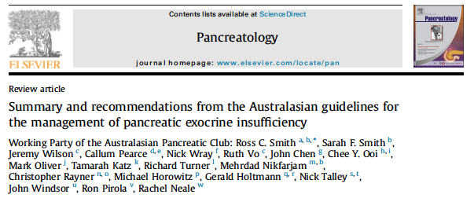
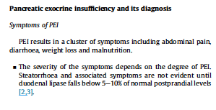
The DiMagno paper is still often quoted and has greatly influenced understanding and practice in pancreatic exocrine insufficiency
Consequences
Pancreatic exocrine insufficiency is ignored / disregarded / untreated for all but the most severe patients
PEI-related symptoms
Weight loss
Muscle depletion
Nutrient deficiency
Poorer QOL
Osteoporosis and fracture
2015
‘90% of the gland must be functionally destroyed or obstructed before steatorrhoea or creattorhoea occur’
?

Slide 15
Assessing exocrine function

Slide 16

Signs and symptoms of malabsorption
-Steatorrhoea (pale, floating, oily stool) -Loose, watery stool -Undigested food in stools -Post-prandial abdominal pain -Nausea / colicky abdominal pain -Gastro-oesophageal reflux -Bloating / food intolerance -Malnutrition -Weight loss -Vitamin deficiencies (especially A, D, E, K) -Hypoglycaemia in diabetes
Late symptoms
Under-recognised symptoms
The Parenteral and Enteral and Enteral Nutrition Group of the British Dietetic Association (2011)
A Pocket Guide to Clinical Nutrition. 4th Edition. Chapter authors (Pancreatic Disease in Adults): Philips M, McGeeney L, Duggan S, Arregui-Fresnada I. (Being updated 2018)

Slide 17
Diagnosing malabsorption
Usually clinically evident
  But malabsorption may exist even in the absence of overt steatorrhoea
  Patients may reduce intake to counteract symptoms
Direct tests
  Collecting pancreatic secretions via duodenal intubation
Indirect tests
  Cheaper and easier to administer
  Less sensitive and less specific
  4 categories
Indirect tests
Faecal tests
Breath tests
Urinary tests
Blood tests

Slide 18
Indirect tests (Source: Australasian treatment guidelines for the management of PEI)
Faecal tests | Breath tests | Urine tests | Blood tests
3-day faecal fat test | Triolein breath test | Bentiromide | Trypsinogen
Steatocrit |  | Fluoresceine Dilaurate
Faecal Chymotrypsin
Faecal Elastase-1
Sudan III stain
Gold standard: 3-day fat test -100g fat for 3-5 days -Weigh food -keep dietary records -Stools collected over 72-96 hours | -Ingested lipids liberate CO2 following hydrolysis -Not fully validated Do not differentiate between pancreatic and non-pancreatic causes | -Use non-absorbable substrates that are specifically cleaved by pancreatic enzymes -Urine collection over time period -Superseded by simpler blood tests | -Trypsin exclusively synthesised by the pancreas and small amts released into blood as tripsinogen -Validated in CF

Slide 19
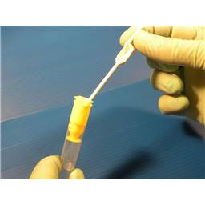
Faecal Elastase-1
Widely used
Cheap, non-invasive, widely available
Pancreatic enzyme that is not degraded during digestion and may be measured in the stool
Not affected by enzyme use
Does not require timed stool collection
Does not require special diet
Reference range
< 100 μg/g severe deficiency
100-200 μg/g PEI
>200 μg/g normal
200-500 μg/g ???
-
Sensitivity limited in mild pancreatic insufficiency

Slide 20

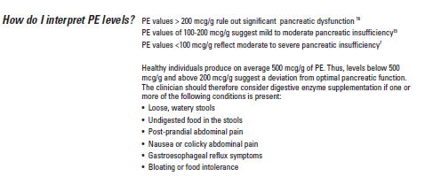

Slide 21

Practicalities:
How should PERT be administered?

Slide 22
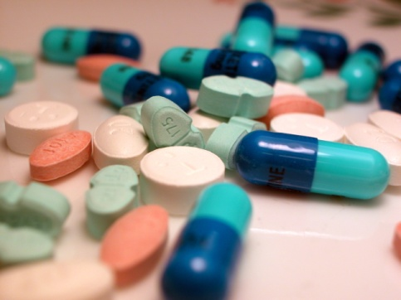
Administration
General information I
PERT with meals. Where >1 capsule needed, spread out over the meal
Capsules may be opened if necessary and the the granules / microspheres mixed with an acidic fruit puree and swallowed without chewing
Dietary assessment vital – check diet regularly
Try a PPI
Dosage
Min dose 25,000-50,000 / meal to reduce steatorrhoea to <15g/ day to compensate for PEI¹
Dose should be gradually increased until symptoms are controlled²
Keller & Layer. Human pancreatic exocrine response to nutrients in health and disease. Gut 2005; 54(Supp VI):vi1-28
Imrie et al, Expert commentary: how we do it. Aliment. Pharm and Ther 2010; 32 (suppl 1): 21-25

Slide 23
Administration
General information II
Flexible administration
Patients will not usually have a set amount of PERT per day
Variety of doses useful
They will take as many times as they eat
If they skip a meal they won’t need to take one
Maximum dose?
No max enzyme dose, though if reached 10,000 lipase u/ kg /day reconsider:
Other causes of malabsorption
Recheck correct administration

Slide 24
Reasons for treatment failure
Spanish Pancreatic club recommendations, 2013
  Inadequate patient compliance
  Inadequate acid suppression
  Bacterial overgrowth
Other causes of malabsorption (Imrie 2010, Toouli et al, 2010):
  Coeliac disease
  Giardiasis
  Biliary obstruction

Slide 25
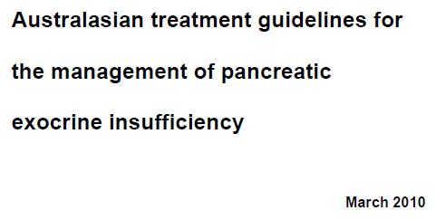


Australasian Guidelines
PERT should be used to treat PEI in patients with unresectable disease to maintain weight and improve QOL (evidence grade 2a)
Recommended doses:
  Initial dose recommended: 25,000-40,000 units lipase with each meal, titrated to a maximum of 75,000-80,000 units lipase per meal
Dietary management:

Slide 26
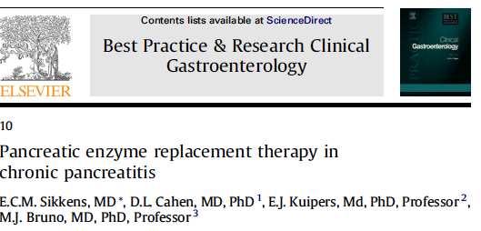
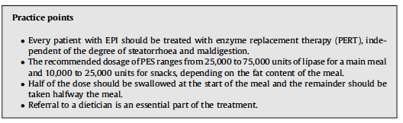
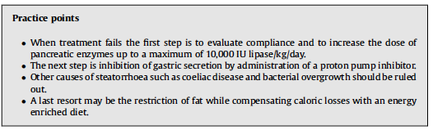
PERT in Chronic pancreatitis
When treatment fails..

Slide 27
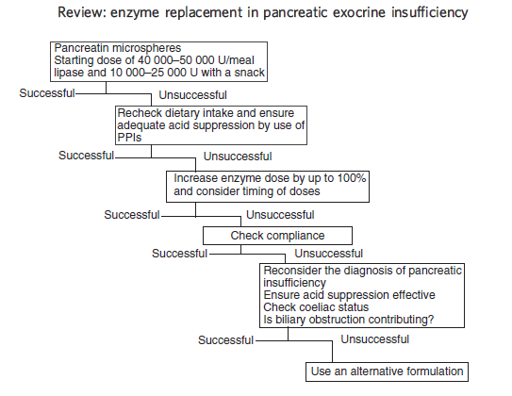
ALGORITHM
Imrie et al, 2010: based on Layer & Keller, 2003
‘At every step in the algorithm, dietary intake should be completely reassessed, and diet & pancreatic enzyme dose altered if necessary’

Slide 28
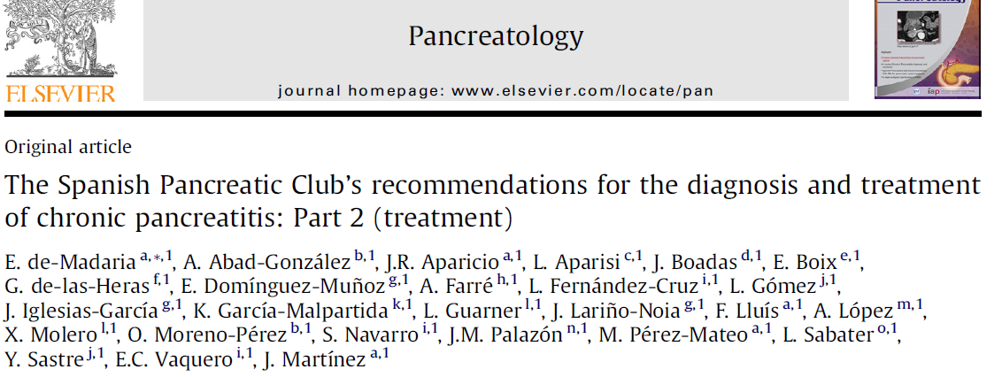
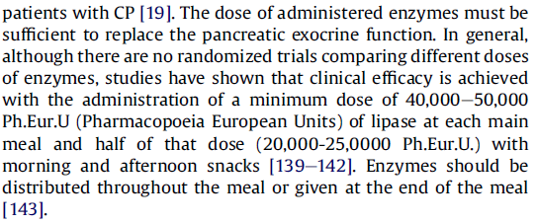

Slide 29
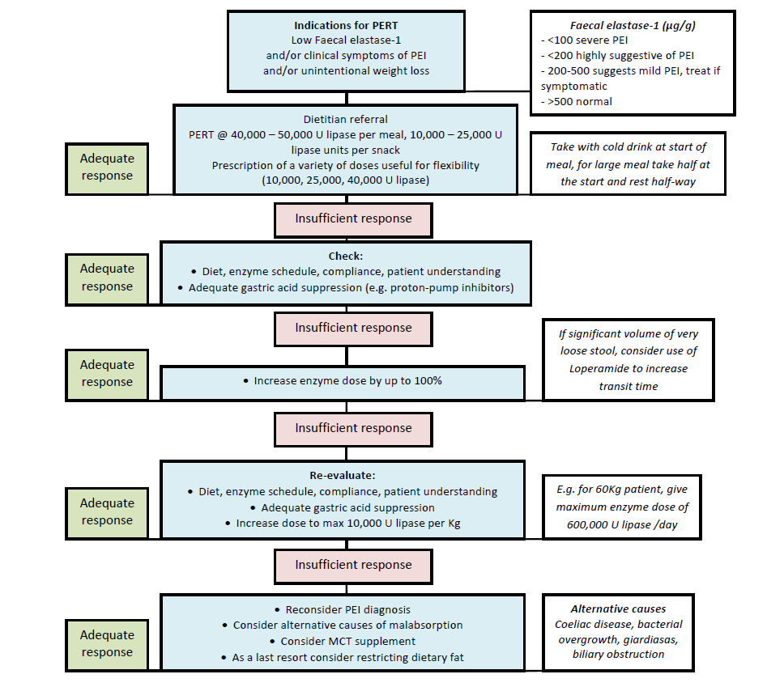
Duggan et al, Practical Gastroenterol. 2013

Slide 30

Dietary assessment
Diet
Meals, snack, supplements, liquids
Meal timing, frequency
Fat content
Fibre content
Cooking
Volume at each meal
Diabetes?
Enzymes
How many taken
Dosage
Timing
How are they taken
Storage
Compliance
Patient understanding
Other
PPI/ H2 blockers
Symptoms
Anthropometry
Micronutrients
Bone health (DXA)
Supplementation
  MCT, ONS, vitamin
Food and symptom diary
Individualised patient education vital

Slide 31
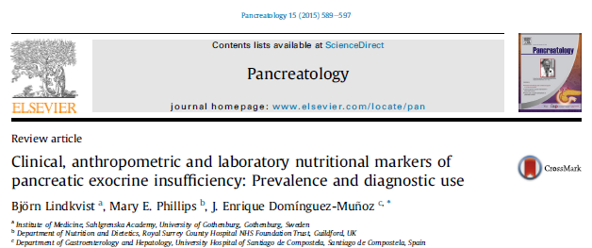

Nutritional status as a marker of PEI
Lindkvist et al, Pancreatology, 2015
Narrative review on parameters (including nutritional markers) to measure PEI and monitor PERT efficacy
Limited evidence
Some suggestion that vitamin E, RBP, magnesium and zinc may be useful in the diagnosis of PEI, monitoring of PERT
Dietary limitations need to be considered
Poor dietary intake
Optimise diet
PERT
PERT
PERT
Malabsorption
PERT
PERT
Diet
PERT
PERT
Improved nutritional
outcomes
Undernutrition
Deficiency
Optimal nutritional status

Slide 32
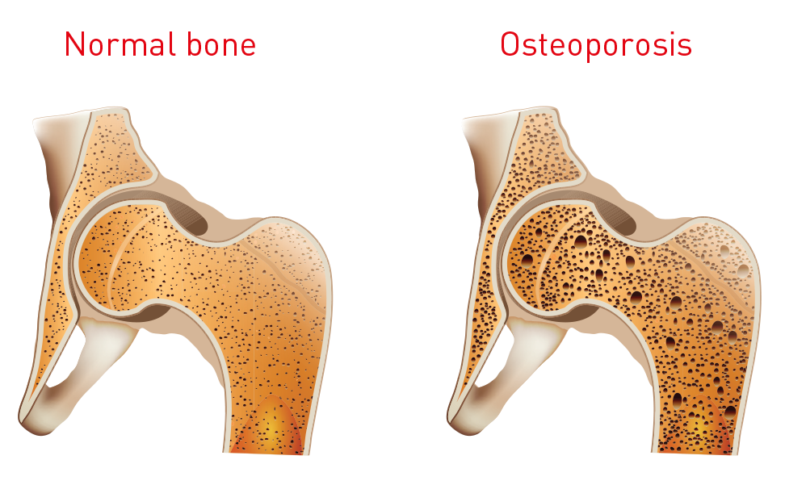
Bone health

Slide 33
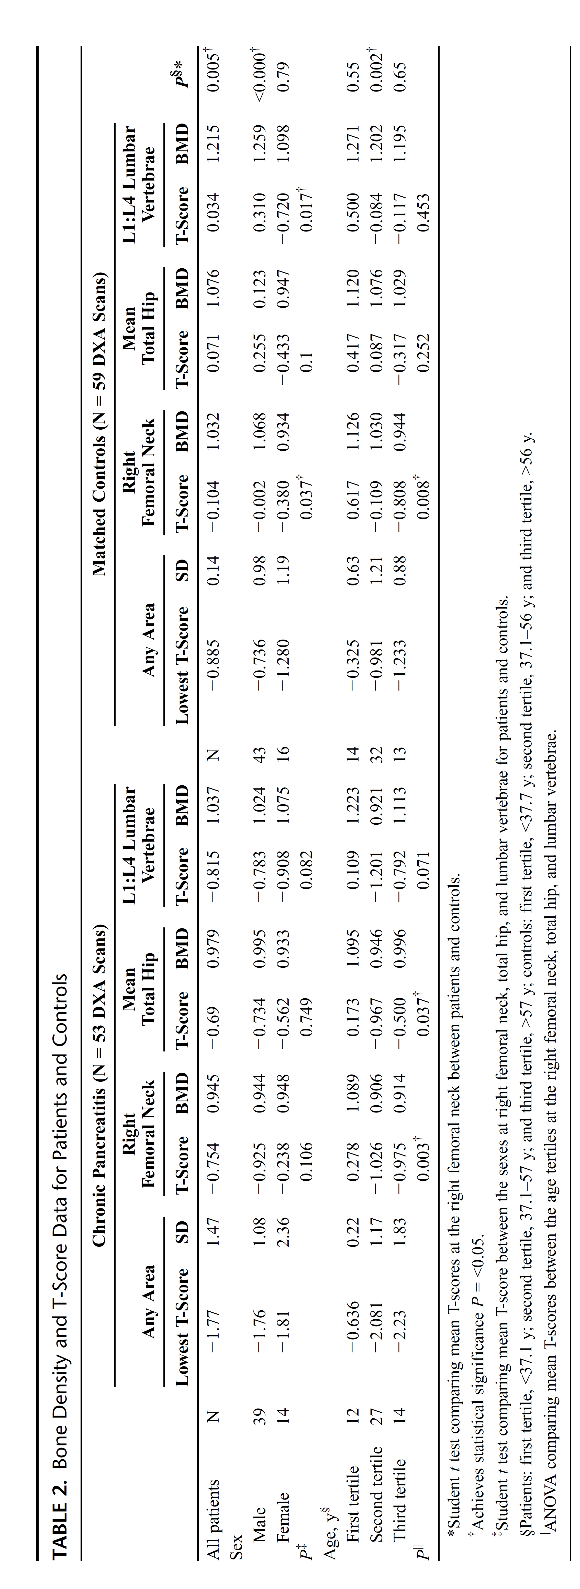
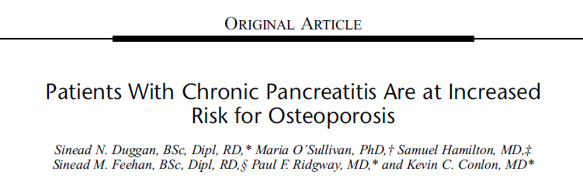
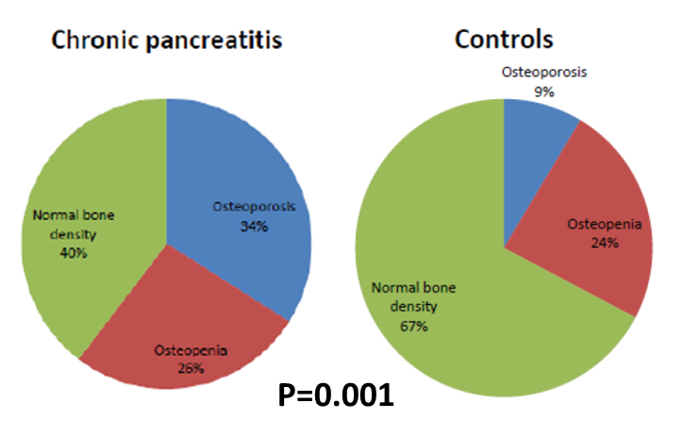
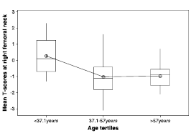
Pancreas. 2012 Oct;41(7):1119-24
34%
9 %
Smokers had lowest T-scores
No age difference above 37 years
No gender difference
Age

Slide 34
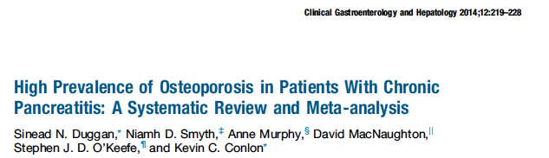
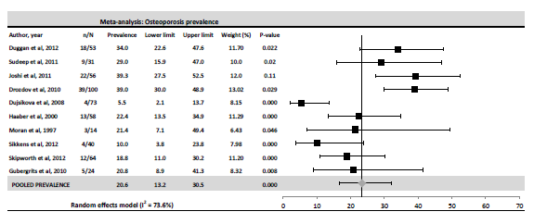
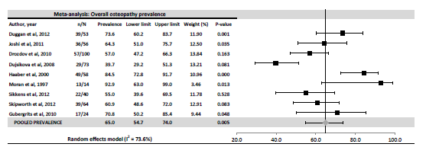
Osteoporosis in chronic pancreatitis
Systematic review & meta-analysis
Duggan et al. Clinical Gastroetnerol Hepatol. 2013
Osteoporosis pooled prevalence
23.4%
Overall osteopathy pooled prevalence
65%

Slide 35
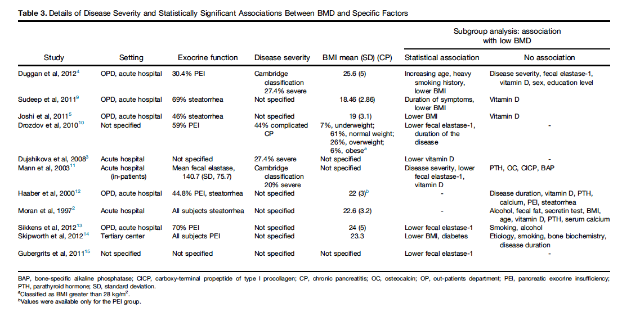
Associations
Associations with PEI; no studies looking at the effect of inflammation

Slide 36
Bone metabolism and inflammation in chronic pancreatitis
Measuring diseases of bone
  Biopsy, calcium accretion studies
  DXA – clinically useful, gold standard, but not immediate
  Bone turnover markers (BTMs) – measureable in blood and show rate of bone formation and resorption
Markers of bone formation
Procollagen 1 aminoterminal propeptide: (P1NP)
Osteocalcin
Marker of bone resorption
Carboxy-terminal telopeptide of type 1 collagen (CTX-1)
Bone Markers Standards Working Group (Vasikaran, Osteoporos Int. 2011. 22(2): 391-420)

Slide 37
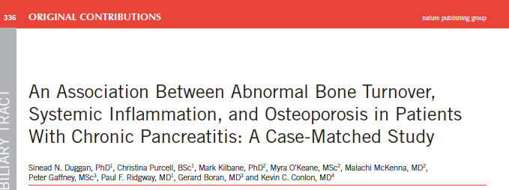
Osteoporosis and inflammation
Duggan et al, Am J Gastroneterol, 2015
 | Patients | Controls | p
Bone-related biochemistry P1NP ug/L Raised P1NP OC ug/L mean Raised OC CTX-1 ug/L Raised CTX-1 25-OH D nmol/L 25-OH D <30 nmol/L PTH pg/ml | 52.5 (33.2) 8 (27.6) 13.7 (4.5) 1 (3.4) 0.419 (0.30) 7 (24.1) 31.0 (39.5) 14 (48.3) 47.1 (19.4) | 41.7 (17.35) 0 11.5 (3.0) 0 0.386 (0.25) 1 (3.4) 42.0 (32.5) 6 (20.7) 46.3 (14.0) | 0.0068^{β}* 0.006 § * 0.033^{µ}* # 0.559 ^{β} 0.016§* 0.0126^{β}* 0.026§* 0.867 ^{µ}
Other measures hs-CRP mg/L IL-6 pg/ml^{φ} | 3.15 (1.3-7.75) 5.61 (5.23) | 0.9 (0.5-2.15) 3.58 (1.82) | 0.0013^{β}* 0.057^{µ}
TSH mU/L Free T4 pmol/L FSH U/L LH U/L Oestradiol pmol/L Testosterone nmol/L | 1.9 (2.1) 16.57 (2.7) 6.0 (9.0) 7.0 (9.5) 177.0 (506) 18.54 (9.94) | 2.8 (2.2) 15.27 (2.38) 7.0 (14) 6.0 (9.0) 84.0 (361.5) 17.2 (5.1) | 0.063^{β} 0.57^{µ} 0.61^{β} 0.95^{β} 0.9^{β} 0.624^{µ}
Objectives
-To assess bone metabolism in CP patients by measurement of bone turnover markers and bone density
-To investigate the relationship between inflammatory makers and bone metabolism
CP n=29
Matched controls n=29

Slide 38
Results
 | Normal BMD Mean (SD) | Low BMD Mean (SD) | p
P1NP, ug/L | 45.2 (11.3) | 66.2 (32.6) | 0.016*
PTH, pg/ml | 34.9 (11.4) | 51.0 (20) | 0.016*
25-OHD, nmol/L | 46.6 (17.8) | 34.0 (27.1) | NS
25-OHD tertiles#
1st (<19.7) | 0 | 9 | 0.041*
2nd (19.71 - 45) | 3 | 7
3rd (>45.1) | 4 | 6
Log IL-6, pg/ml | 1.18 (0.22) | 1.57 (0.69) | 0.03*
Lowest vitamin D, highest inflammation
Lowest bone density, highest inflammation
Identified a potential relationship between BMD and systemic inflammation
Loss of BMD in part driven by systemic inflammation, along with low vitamin D, smoking and malabsorption

Slide 39
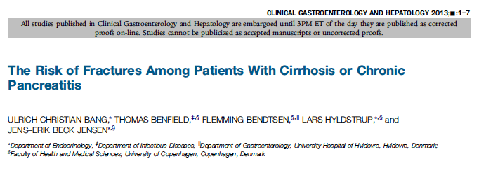
Clinical implication: Risk of fracture
Munigala et al. Chronic pancreatitis and fracture: A retrospective, Population-Based Veterans Administrations Study
Pancreas July 2015
CP versus controls have a higher risk of:
Total fractures (OR 2.35)
Vertebral fractures (OR 2.11)
Hip fracture (OR 3.49)
Wrist fracture (OR 1.68)
-Compared to controls, HR of any fracture was 1.7 (CI 1.6-1.8) for CP patients
-Higher in alcohol aetiology (HR 2.0)

Slide 40
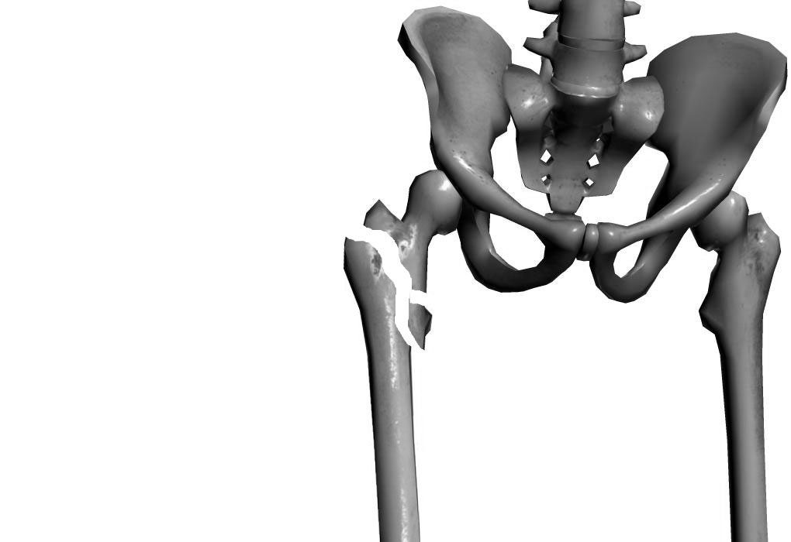
Why does this matter?
Considerable economic burden
Low-trauma fractures, accompanied by considerable morbidity/mortality
Hip fracture mortality 15–30%, most deaths occur within first 6mth
Osteoporosis negatively affects QOL, even in the absence of vertebral fractures
Crucially, osteoporosis is largely preventable
No guidelines for bone health in chronic pancreatitis

Slide 41
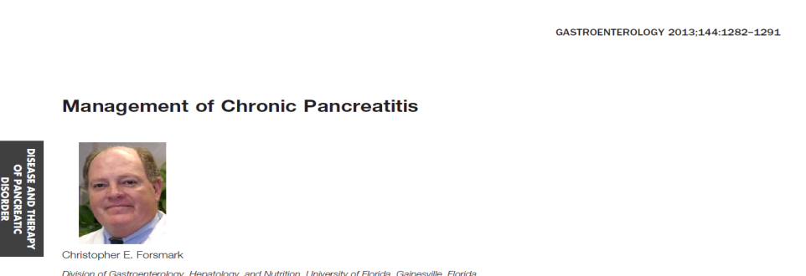
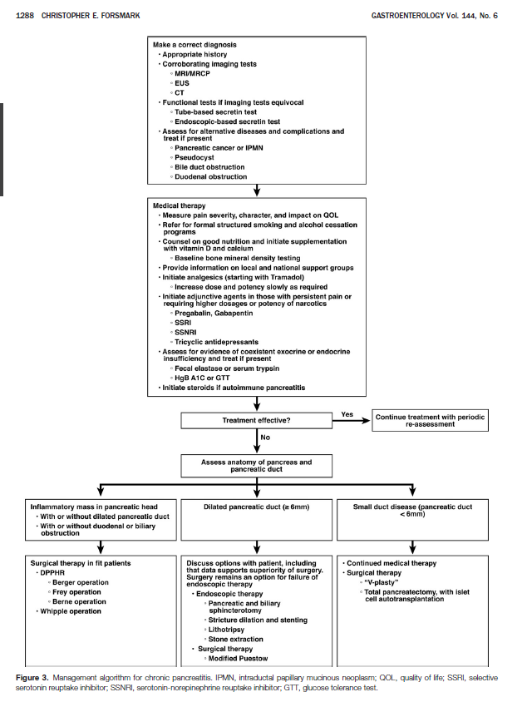
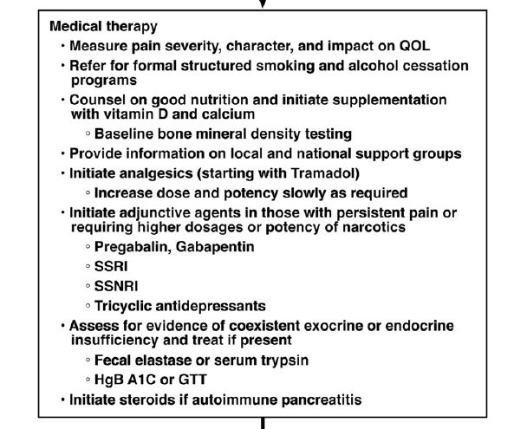
Starting to appear in guidelines and papers

Slide 42
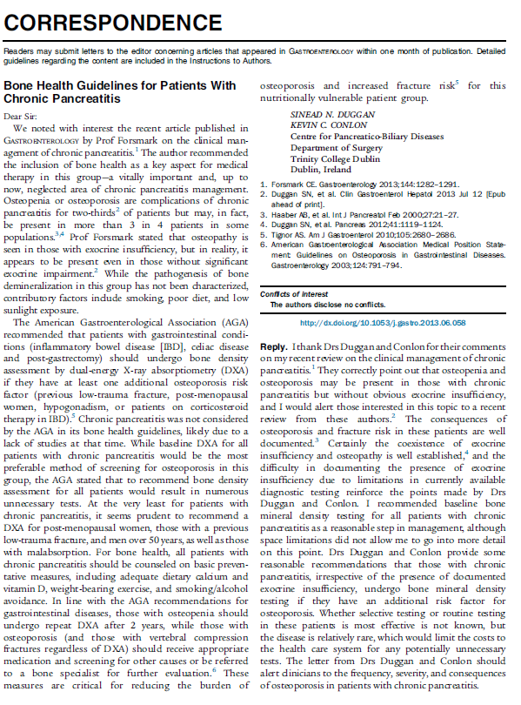
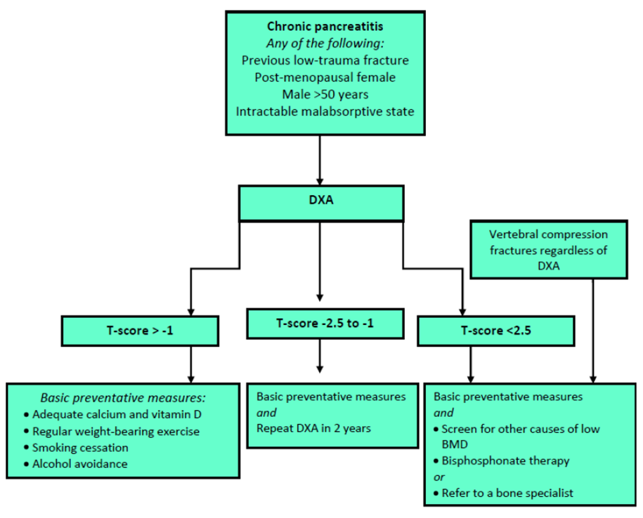
Suggested guidelines based on IBD / coeliac disease guidelines
Or… arguably everyone with CP should get a DXA

Slide 43
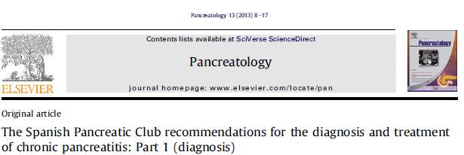
Other guidelines
“Therefore, calcium and vitamin D supplementation, as well as regular monitoring of bone health, should be an integral part of CP nutrition management”
“Adequate treatment is relevant to avoid malnutrition-related morbidity and mortality. For instance, osteoporosis is quite common in chronic pancreatitis, due to malabsorption of vitamin D”
“In patients with EPI, it is advisable to occasionally perform bone densitometry due to the increased risk of developing osteopenia and osteoporosis”

Slide 44
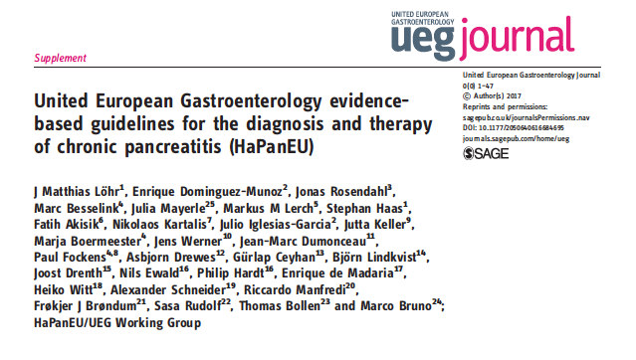
European Guidelines: HaPanEU (2017)
Harmonising diagnosis and therapy of pancreatitis across Europe
Topics
1. Etiology
2. Imaging (Radiology)
3. Imaging (US/EUS)
4. Pancreatic function tests
5. Surgery
6. Medical Therapy
7. Endoscopy
8. Pseudocysts & complications
9. Pain
10. Nutrition (includes bone health)
11. Diabetes type 3c

Slide 45
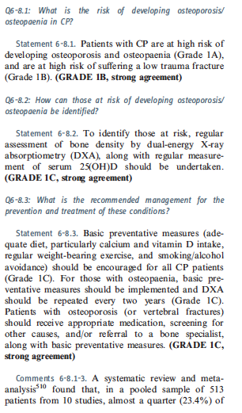
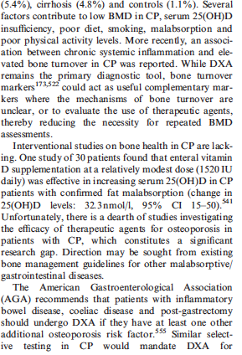
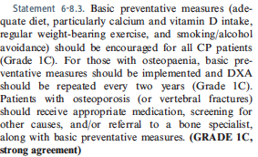
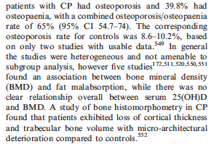
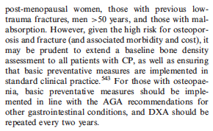
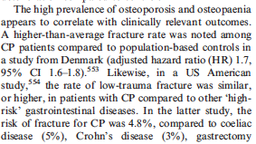

Slide 46
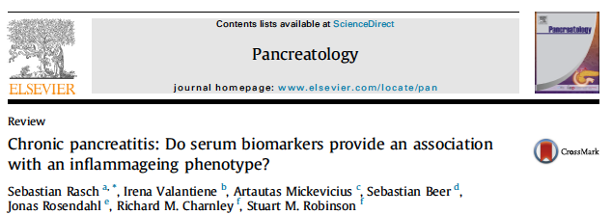
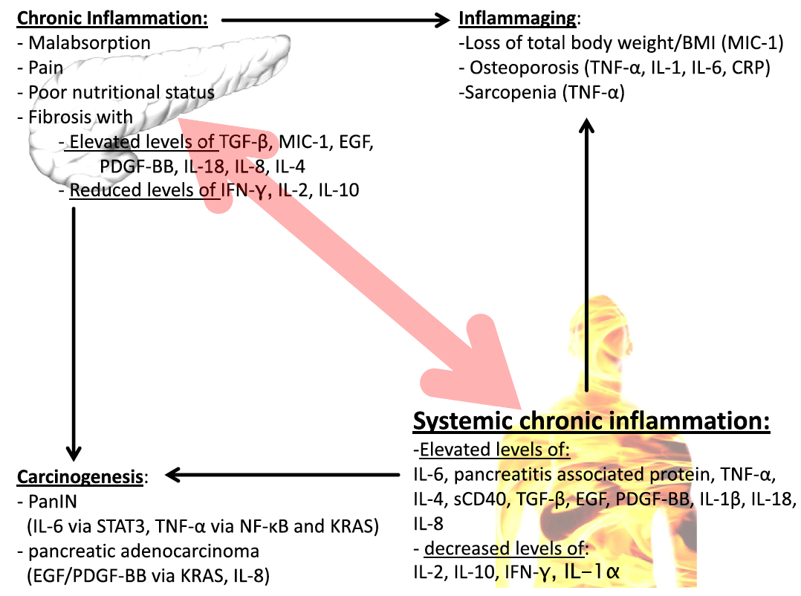
Systemic chronic inflammation/
Inflammaging phenotype
Rasch et al, Pancreatology, 2016
CP: An inflammatory disorder
Accelerated biological aging

Slide 47
Body composition and sarcopenia

Slide 48
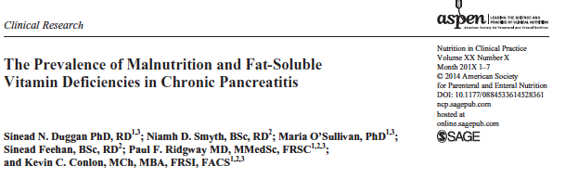
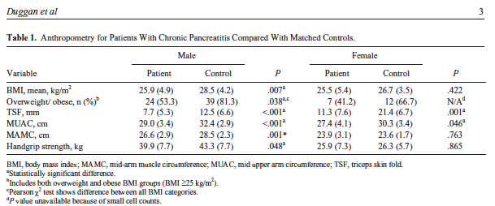
Body composition in CP
Duggan et al, Nutr Clin Pract, 2014
Overweight/obesity common
Lower muscle stores
Lower strength
Notes:
Correlate with exocrine and vitamin levels

Slide 49
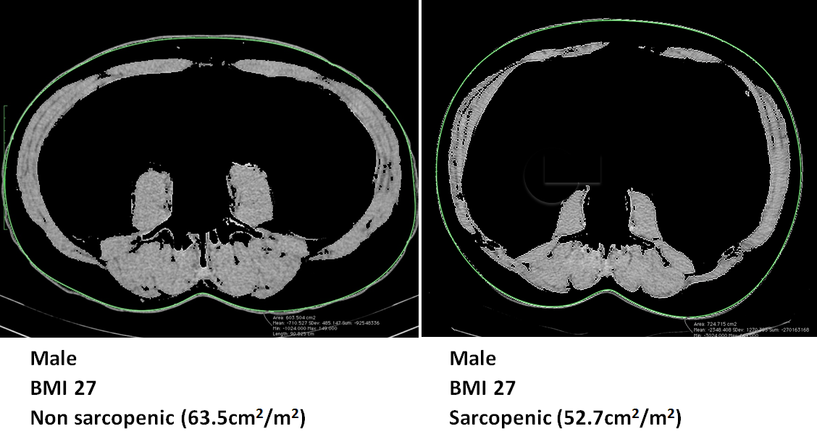
Sarcopenia
Depletion of skeletal muscle mass with a risk of adverse outcomes (physical disability, poor QOL, death)
Assessed by measuring skeletal muscle mass by CT
  2 axial slices L3
  Hounsfield units
  SliceOmatic® software
  Gender specific cut-offs cm²/m²
May be independent of BMI
Few studies on sarcopenia in chronic pancreatitis
Both BMI 27

Slide 50
Sarcopenia in chronic pancreatitis
CP patients (n=29, 12 female, median age 43)
BMI category | Total | Sarcopenic
Underweight | 4 | 3 (75%)
Normal | 10 | 4 (40%)
Overweight | 8 | 5 (62.5%)
Obese | 7 | 3 (43%)
No association with hsCRp, Il-6
BMI categories for CP patients with sarcopenia
O’Connor et al, Pancreatology (supp), 2014

Slide 51
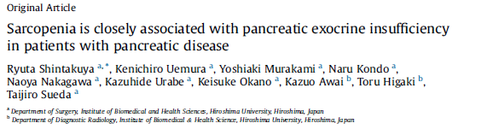

Sarcopenia and PEI
Shintakuya et al, Pancreatology, 2016
Aim: to determine if various nutritional parameters were associated with PEI in pancreatic disease
Patient with pancreatic disease n=132
Multivariable analysis: only sarcopenia independently associated with PEI
Link between sarcopenia and malabsorption
14 CP patients

Slide 52
Endocrine dysfunction

Slide 53
Drivers of undernutrition in chronic pancreatitis
Undernutrition
Maldigestion
Malabsorption
Resting energy expenditure
May be higher by 30-50%
Insufficient secretion of pancreatic lipase
Insufficient micelle formation due to inadequate bicarbonate production
Precipitation of bile acids due to acidic SI
Bacterial overgrowth
Poor dietary intake
Chronic pain
Anorexia
Smoking
GI symptoms
Social circumstances
Diabetes
Alcohol
Major causal factor
Displaces food
Affects appetite
Malabsorption
Chronic Inflammation
Diabetes
Weight loss, low BMI
Vitamin deficiency
Osteoporosis
Sarcopenia
Poor functional capacity
Lower QOL
Poorer outcomes

Slide 54


Classification of DM
Type 3c DM
American Diabetes Association: Diagnosis and classification of diabetes. Diab Care 2011;34(suppl 1): S62-S69

Slide 55
Conditions associated with type 3c DM
Pancreatic cancer
Chronic pancreatitis
Pancreatic surgery
Pancreatogenic / Type 3c DM
Acute pancreatitis
Other:
  Haemochromatosis, Fibrocalculous Pancreatopathy, Pancreatic Agenesis
Cystic Fibrosis

Slide 56



Prevalence
Based on Hardt et al, Diab Care. Feb 2008. 31:
1,922 hospitalised DM patients

Slide 57


Duggan & Conlon, Practical Gastroenterology, 2017

Slide 58
‘Brittle’ diabetes
Up to 25% of patients with CP-related type 3c DM
Hyperglycaemia
Unsuppressed hepatic glucose production
Poor intake/exocrine insufficiency/ alcohol intake
Exogenous insulin
Enhanced peripheral insulin sensitivity
Reduction in glucagon
Hypoglycaemia
Poor dietary practices

Slide 59

Diagnosis
Initial evaluation:
  Fasting glucose and HbA1c
  Repeated annually
  Impairment in either requires further evaluation
Diabetes (ADA)
  HbA1c >48 (6.5%)
  Glucose >7 mmol/L
‘Pre-diabetes’
  HbA1c 38.8-46.4 (5.7-6.4 %)
  Glucose 5.5 – 6.9 mmol/L
Where equivocal, impairment in fasting glucose or HbA1c should be further evaluated by a 75g OGTT
Distinguishing type 3c diabetes from types 1 / 2?

Slide 60

Proposed diagnosis of Type 3c DM
Referent for insulin resistance?
Timing of c-peptide measurement?
PP may be decreased in type 1 and 2 also
Fat soluble vitamins may not always be low

Slide 61

Diagnosis in practice
  Measurement of the following:
  Diabetes-associated auto antibodies (rule out type 1 DM)
  Insulin resistance (HOMA-IR)
  C-peptide:glucose ratio
  Pancreatic exocrine function
  Pancreatic imaging
  Consider also BMI and family history of type 2 DM

Slide 62



Slide 63
Treatment options for DM management
Drugs typically used are the same as for Type 2
Few studies have examined therapeutic efficacy for Type 3c compared to type 2

Slide 64

Treatment of Type 3c DM
Lifestyle changes: Weight loss in obese subjects, daily exercise, diet limited in carbohydrates, abstinence from alcohol and smoking cessation should be described and reinforced at every medical visit.
Add PERT if FE-1 < 100ug/g, or PEI symptoms
Reduce HbA1c <53 (7%), fasting glucose 3.9-7.2 mmol/L
Insulin vs no insulin depends on clinical presentation
Profound hyperglycaemia (HbA1c >69.4 (8.5%), fasting glucose >10 mmol/L), and catabolic with glycosuria and weight loss – insulin is preferred
Metformin is initial drug of choice

Slide 65


Dietary management
‘Individualised medical nutrition therapy programme by a registered dietitian. Those with diabetes should actively engage with self-management, education and treatment planning with his health-care team, including the collaborative development of an individualised eating plan.’

Slide 66
Case study
35 yr old male presented with severe malnutrition and fat malabsorption. He had a history of chronic pancreatitis, diagnosed 10 years prior.
Nutritional assessment showed that he had low serum levels of 25OHD, vitamin E and vitamin A.
DXA scan showed osteoporosis at the hip and spine.
He had severe exocrine impairment, and endocrine work-up revealed a diagnosis of impaired glucose tolerance.
More studies, more guidelines, structured management

Slide 67


Structured nutritional management
-Exocrine status
-Bone health
-Endocrine status

Slide 68
Problems and research gaps in the nutritional management of CP
Complex disease
Multifactorial reasons for nutritional compromise
Until recently, few guidelines
Under-recognition, under-treatment of PEI
More studies on type 3c diabetes (Characterisation and intervention)
More interventional studies required for improving bone health
Patients require individualised, structured dietetic intervention and monitoring

Slide 69
Thank you

