Slide 1
Medical Emergencies in Eating Disorders (MEED)
Sarah Fuller
Clinical Lead Dietitian for CAMHS, Northamptonshire Healthcare NHS Foundation Trust
Research Dietitian, Imperial College London
Twitter: @chattydietitian

Slide 2
Case Study
Katie, 14y old girl.
In January
Starts eating ‘more healthy’
Missing some meals
Weight loss
In February
Taken to GP as parents worried about weight loss
Weighed 42kg (no previous weights)
Bloods: U&E’s, LFT’s, Coeliac screen, Iron – all normal
Reassures parents that this is ‘probably a phase’ and ‘come back in a month if still worried’

Slide 3
Case Study
March
School worried
Friends & teachers worried
Katie is becoming more withdrawn
Went back to GP – lost 10kg (32kg)
GP phones Paediatric Rapid Assessment Unit in local Hospital
?? Cancer
Seen by Paediatric Reg the next day
Thin with recent weight loss
Talking and walking
Bloods: ESR & CRP (normal)
Pelvic ultrasound (normal)
Speaks to Consultant – arranges follow up in clinic next week

Slide 4
Case Study
In the meantime, Katie stops eating for 2 days
Parents take her to A&E
‘? Eating disorder’
Checks bloods from last week – all normal again
Calls CAMHs and arranged for a community referral the following week
3 days later
A&E again, admitted to Paediatric ward for monitoring
Ward referral to CAMH
Managed to not eat regularly on the ward
Discharged Friday afternoon as all medical investigations normal

Slide 5
Case Study
Next day – Katie was found dead at home.

Slide 6
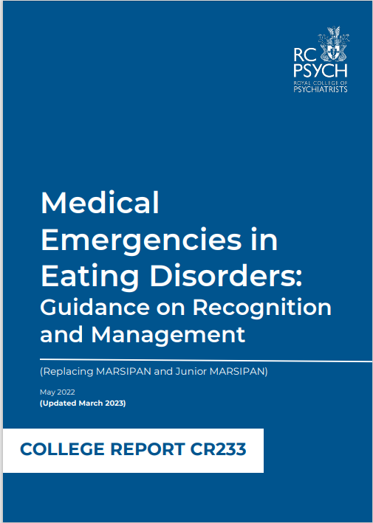

MEED Guidelines
Content goes here
Replaces previous guidance – Junior MARSIPAN
Risk framework that gives CEDS and Paediatircs a common language
Medical history and examination

Slide 7
MEED Guidelines
Physical health risks:
Anthropometrics
Rate of weight loss
% median BMI
Cardiovascular health
ECG abnormalities
Heart rate (awake)
Hydration
Temperature
Muscular function
Associated clinical states
Bloods
Biochemical
Haematological
Mental health risks:
Disordered eating behaviours
Engagement with treatment
Exercise
Purging
DSH

Slide 8
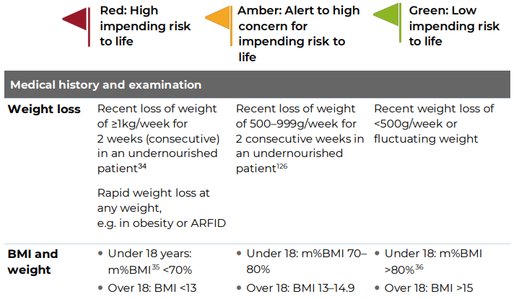
Anthropometrics

Slide 9

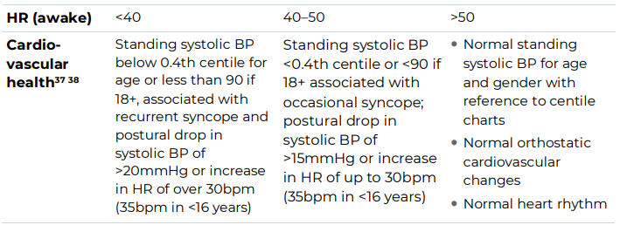
Cardiovascular

Slide 10
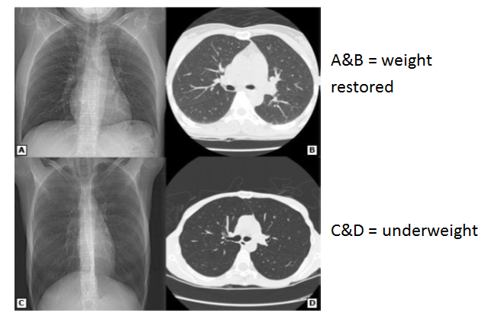
Coxson et al. Am J Respr Crit Care Med 2004; 170: 748

Slide 11
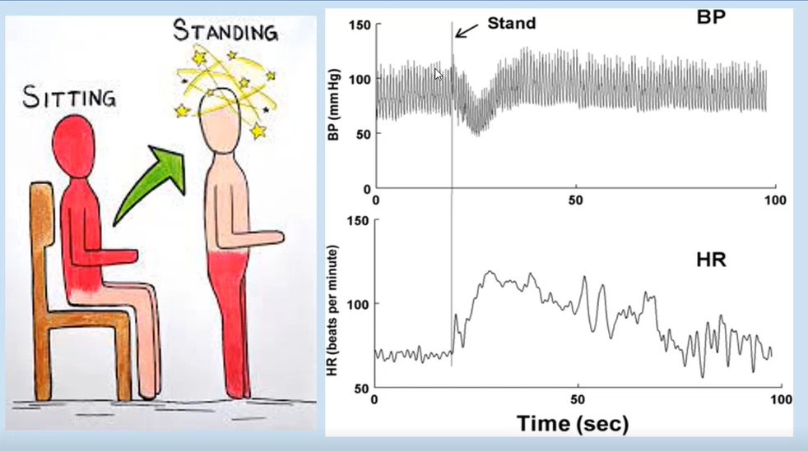
Vagal tone
BP drops on standing
HR slow to catch up
Dizzy on standing is very common in EDs
Can lead to fainting which is of concern in CYP

Slide 12
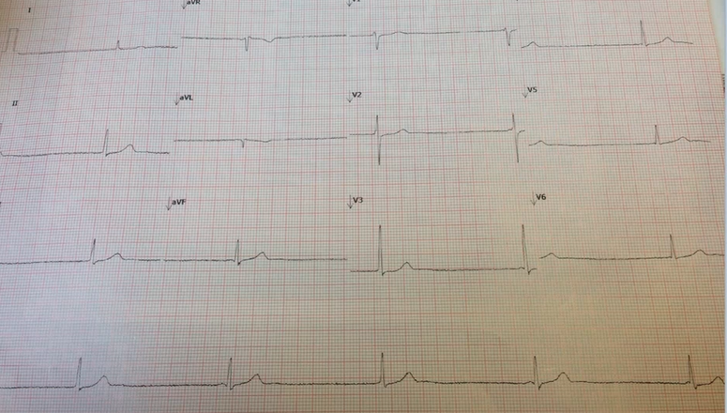
ECG’s: why is this one worrying?

Slide 13
ECG – why is this one worrying?
Slow heart rate – 31bpm
Lack of P wave
- P waves represent the atria contracting and comes from the SA Node (the natural pacemaker at the top of the heart, beats ~70-80bpm)
- 2nd pacemaker in the centre of the heart, AV node (backup, beats 20-30bpm)
- Typically the SA node overrides the AV node
- In starvation, the vagal nerve from the brain is telling the SA node to slow down to conserve energy. If the SA node is then slower than the AV node it will kick in producing a junctional rhythm and an absence of P waves.

Slide 14
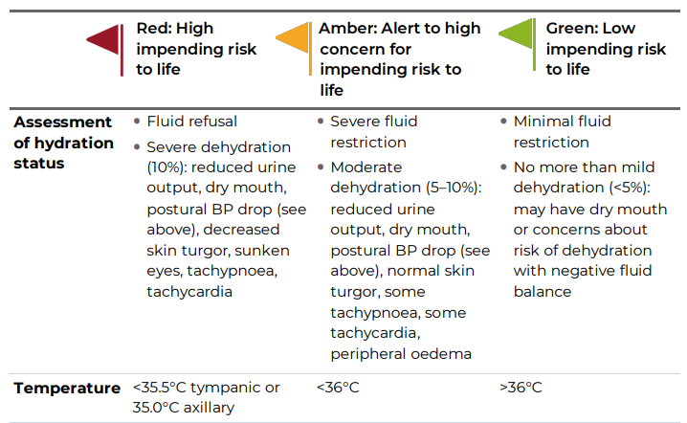
Hydration and temperature

Slide 15
Hydration / dehydration
Hydration status is notoriously difficult to assess in the context of malnutrition. Examining mucous membranes, eyes (whether sunken or not), skin turgor, pulse, BP, postural hypotension, capillary refill time and urine output are all important but unreliable.
Serum urea and electrolytes and haematocrit may be abnormal. Weight loss can be secondary to dehydration.
Young people with eating disorders who are undernourished usually have baseline bradycardia. In this context, a HR within the normal range or elevated or a significant postural drop in blood pressure (>20mm Hg) may be signs of hypovolaemia.
Hypoalbuminaemia in the absence of other conditions is very rare in anorexia nervosa. It must therefore be assessed carefully, particularly if associated with oedema, which, in the context of an eating disorder, may be the result of refeeding, sudden cessation of laxatives or vomiting, or occasionally congestive cardiac failure.
A low albumin level in a patient with an eating disorder should prompt assessment for infection or other inflammatory causes.

Slide 16
Hypothermia
Hypothermia is found in 32% of adolescents with anorexia nervosa
Likely due to loss of body fat combined with slower metabolic rate
Data from adults indicates:
34–36°C: Patient feels cold and moves around more. They may become withdrawn or aggressive.
33–34°C: Patient may stagger and become confused and drowsy. Paradoxical undressing may occur because the person thinks they are warm, or it may occur deliberately to increase energy expenditure.
26–32°C: Coma may occur.
<26.C: Death may occur, sometimes following ventricular fibrillation

Slide 17

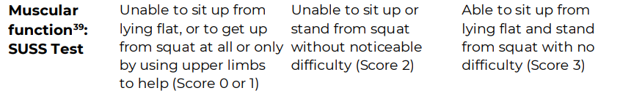
Muscular function

Slide 18
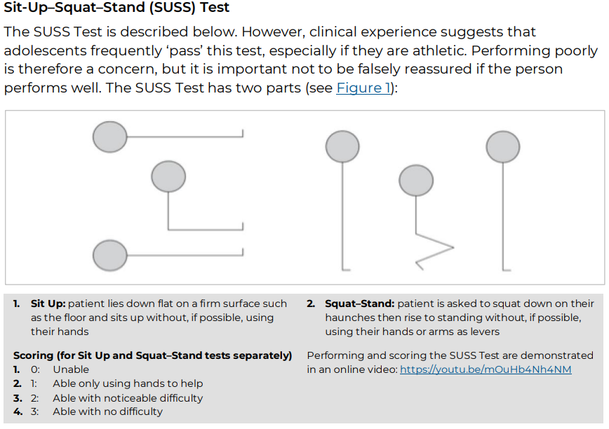

Slide 19

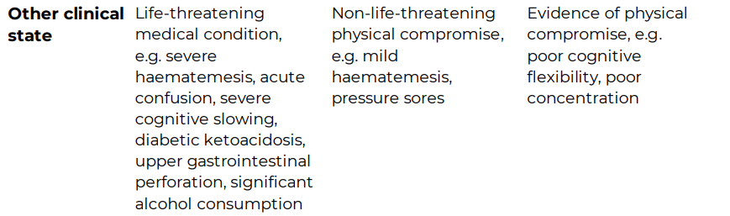
Associated clinical states

Slide 20
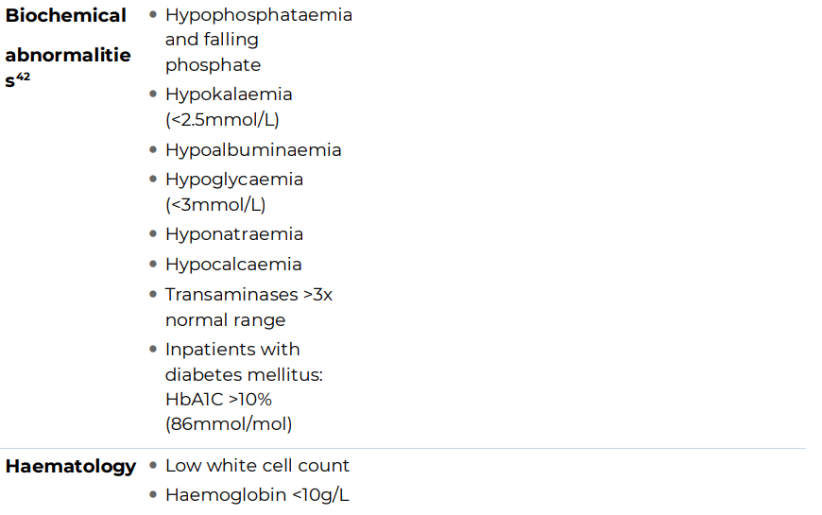
Bloods

Slide 21
Bloods
Potassium
Sodium
Calcium
Phosphate
Serum creatinine and urea
Serum creatinine and urea need careful interpretation. Severe malnutrition can result in low creatinine, because of reduced muscle mass. Urea may be low because of poor protein intake, and as a result a ‘normal’ urea or creatinine level can reflect renal insufficiency, and the glomerular filtration rate should be checked.
White cell count:
A low white blood cell count was associated with an increased risk of refeeding hypophosphataemia
Thrombocyte count:
Thrombocytopenia occurs in 10–25% of patients with anorexia nervosa due to malnutrition related bone marrow suppression

Slide 22

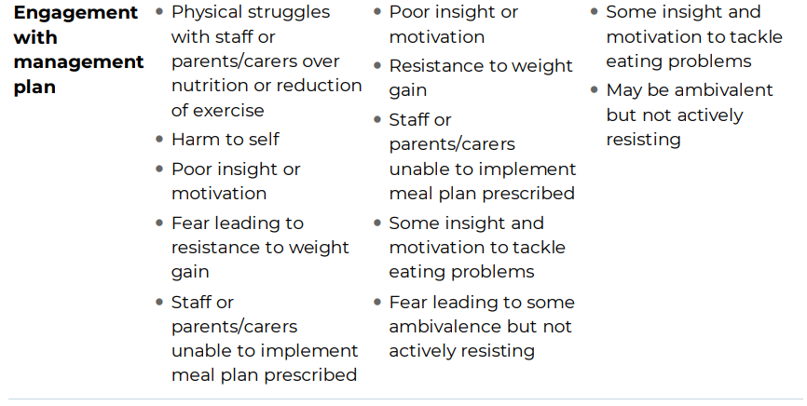

Slide 23
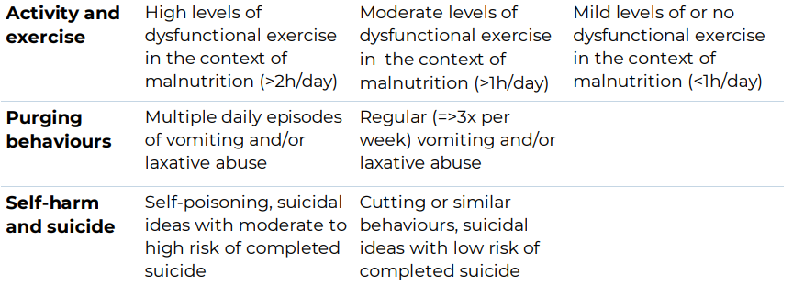

Slide 24
Differential diagnosis
Eating disorders are relatively common (1 in 5 16-25y olds!) – BUT…
Almost all the parameters outlined in the risk assessment framework have multiple aetiologies, and there is a need to consider and exclude potential organic causes
For example, the haematological changes commonly found in anorexia nervosa can be found in primary haematological conditions such as leukaemia and lymphoma, and can present with pancytopaenia and weight loss, as can infection that is either acute (e.g. sepsis) or chronic (e.g. tuberculosis)
All patients should have a history taken and a thorough clinical examination with basic tests (e.g. TTg IgA for coeliac disease, blood film, CRP) and more involved tests if necessary
When the diagnosis is uncertain, offering food can elicit calorie-avoiding behaviour in those with a drive for thinness and fear of weight gain.
Some patients may present with concurrent eating disorders and other pathology; these are complex patients to manage, and specialist advice should be sought

Slide 25


