Slide 1
Nutrition and Wound Healing
Kerry Brennan Tissue Viability Nurse
The views expressed are those of the author and not necessarily of Abbott
ANUKANI180113 Date of Preparation: May 2018

Slide 2
Background
Tissue Viability Nurse for 8 years.
Community Nurse for 4 years
Medical and surgical ward for 2 years
BSc (Hons) 2:1 Nursing
Post Graduate Certificate in Tissue Viability
V150 prescribing
V300 independent prescribing

Slide 3
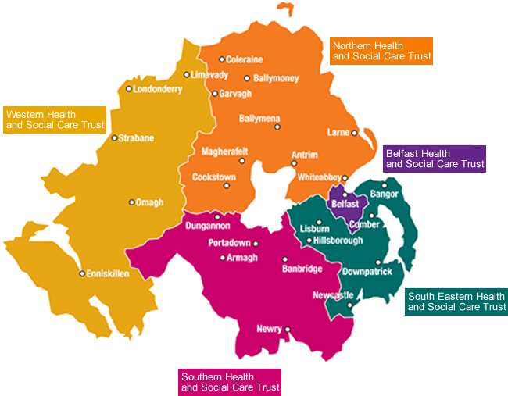
Who refers to TVN?
The Western Trust has a population of approximately 300,000 people
Acute and primary care, including private sector also.
We work as an MDT and accept referrals from all professions.
Our most frequent referrals come from our peers in surgery and nursing staff.

Slide 4
Wounds we see
Leg Ulcers
Chronic venous leg ulceration has an estimated prevalence of between 0.1% and 0.3% in the United Kingdom. Prevalence increases with age
The cost of treating one ulcer was estimated to be between £1,298 and £1,526 per year (SIGN, 2010)

Slide 5
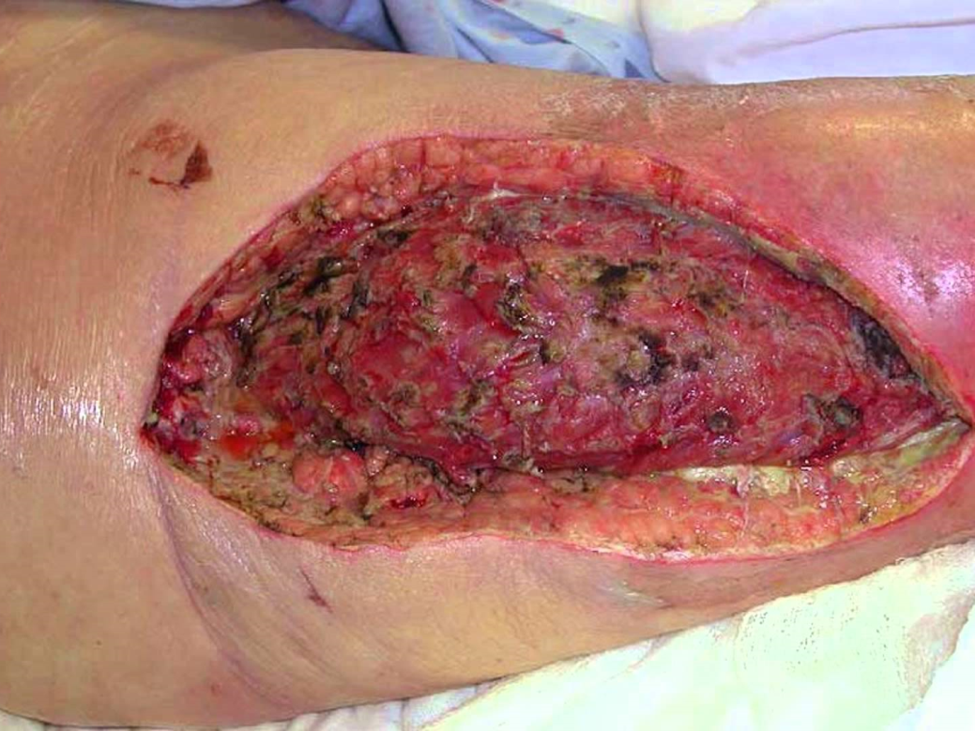
Wounds we see
Necrotising fasciitis
Necrotising fasciitis is a rare but serious bacterial infection that affects the tissue beneath the skin, and surrounding muscles and organs (fascia). NHS Choices, 2016

Slide 6
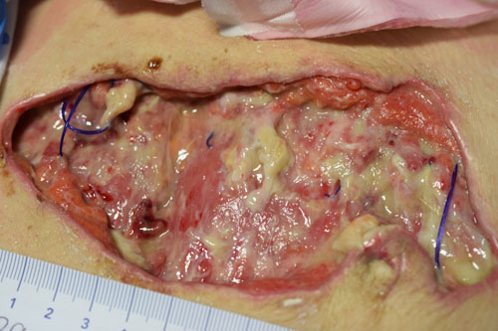
Wounds we see
Surgical wounds, or incisions, are entry sites sutured or held together by a dressing or device after an operative procedure. A dehisced wound is one which has ruptured or burst open, often along the lines of the original surgical incision. (Gotrupp, 2005)

Slide 7
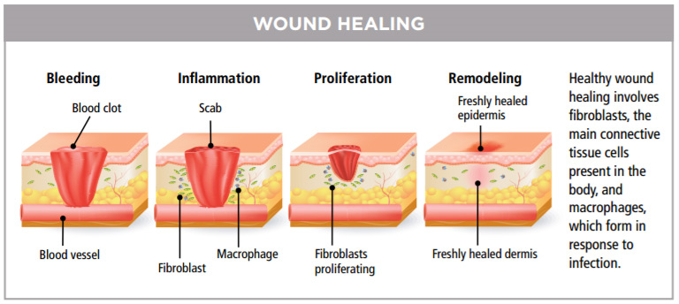
Wound Healing Process

Slide 8
Wound Healing Process
Proliferation: regeneration of new healthy granulating tissue. For this to happen, blood vessels must be able to deliver nutrients and oxygen… during this process fibroblasts are created, strengthening the tissue at the wound site.
Maturation: Known to be the last stage of wound healing. Dermal tissues are overhauled to enhance their strength
***NB even after maturation, wound areas tend to remain up to 20% weaker than the initially were….*** (Advanced Tissue, 2014)
As a TVN this is a vital consideration for patients who a have healed pressure ulcer.
Inflammation: The body’s natural response to trauma. Vessels constrict, seal themselves off creating a plug (clot)…Homeostasis
Once Homeostasis is achieved, blood vessels dilate, allowing for the delivery of vital nutrients, WBC, antibodies and enzymes go to the site and proceed with wound healing…Inflammation

Slide 9
Factors affecting wound healing
INFECTION
MEDICATIONS
AGE
NUTRITION
SMOKING
UNDERLYING DISEASE/ COMORBIDITIES
BMI
ALCOHOL
WOUND MANAGEMENT
EXTENT OF TRAUMA

Slide 10
Nutrition
Skin physiology and nutrition
When the body is lacking…
SKIN: Our skin is often indicative of our state of health and nutrition…A diet receiving sufficient minerals, vitamins and proteins is normally pleasing with healthy hair, nails, and skin, with regular growth patterns
Diets deficient in minerals, irons and proteins or diets which exceed in the consumption of toxins (which can impair nutrient absorption) have lead to reports of brittle nails, impaired wound healing, and rough skin
(Lansdown, 2004)

Slide 11
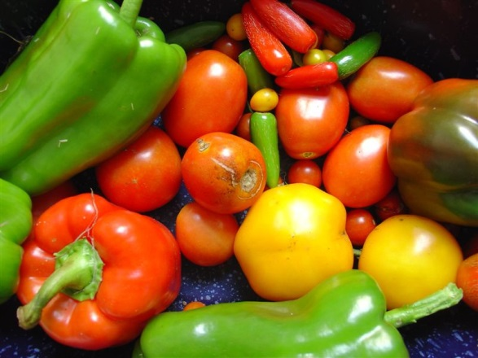
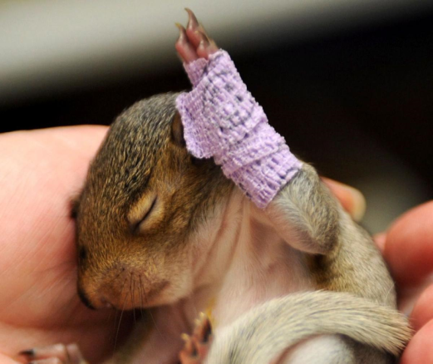
Nutrition and Wound Healing
Numerous experimental studies have been published, demonstrating that deficiencies in nutrients, vitamins and other trace minerals may be a contributory factor in the non-healing of wounds… (Lansdown, 2004)

Slide 12
Nutritional Need
During wound healing, nutrient needs are significantly increased, and this presents a serious factor for the patient community who are already compromised…(Biesalski, 2010)
Men nutrient intake <1800kcal/d
Women nutrient intake < 1500kcal/d
NOT SUFFICIENT

Slide 13
Essential Nutrients for Wound Healing
Protein
Amino Acids: Hydroxyproline, cysteine, cystine, methionine, tyrosine, arginine, glycine
Carbohydrates: glucose
Lipids: linoleic and lilolenic acids, arachidonic acid, eicosanoids, fatty acids
Vitamins: A, B complex, C, D, E, K
Minerals: sodium, potassium,( electrolytes) copper, calcium, iron, magnesium, zinc, nickel, chromium
Water

Slide 14
Nutrition and Pressure ulcers
Offer adults with a pressure ulcer a nutritional assessment by a dietitian or HCP with the necessary skills and competencies
Offer nutritional supplements to adults with a pressure ulcer who have a nutritional deficiency
Provide information and advice to adults with a pressure ulcer and, where appropriate, their family or carers, on how to follow a balanced diet to maintain an adequate nutritional status, taking into account energy, protein and micronutrient requirements

Slide 15
Nutrition and Research
Systematic Review: 15 studies including 8 RCT of oral nutritional supplement or enteral tube feeding
Meta Analysis: nutritional supplements (250-500 kcal, 2-26 weeks) showed a significantly lower incidence of pressure ulcer development in at-risk patients compared with routine care
While individual studies showed a trend towards improved pressure ulcer healing…

Slide 16
The Dietitian
“Dietitians are the only qualified health professionals that assess, diagnose and treat dietary and nutritional problems at an individual and wider public-health level. They work with both healthy and sick people. Uniquely, dietitians use the most up-to-date public health and scientific research on food, health and disease which they translate into practical guidance to enable people to make appropriate lifestyle and food choices” BDA, The Association of UK Dietitians

Slide 17
Dietetics and Wounds
Due to the complexities of wounds which present to us, a multidisciplinary approach is often required.
As a Trust, we advocate that all patients who have a grade 3/4 and DTI pressure damage, are referred to a dietetics service as a matter of urgency
Their vitality in wound improvement is invaluable
Our reliance on the dietetic team to see patients who have these complex needs adds to their workload

Slide 18
Nutrition and Impaired Wound Healing: A practical guide
1. Appreciate the features and behaviours of the wound: i.e. are there particular times when the wound progresses/regresses
2. Consider lab testing (ensure to liaise with medical team if required) to detect abnormal concentrations in zinc, serum iron or vitamins
3.Educate patients about the role of nutrient deficiency or nutrient excess
4.If nutrient deficiency can be identified, rectify it. *With dietetic support*
Monitor progress

Slide 19
Healing and Nutrition The Difficulties
Databases including CHINAL and Cochrane were searched for a link between nutrition and wound healing
Data can be fragmented
Difficult to obtain human studies
Nutrition in tissue repair has been described as a ‘provocative subject’ by authors…because it is difficult to measure
It is not a well researched area
The body requires several different nutrients to function
It may be difficult to identify the specific nutrient that the body is lacking, in order to progress to wound healing
The delay in wound progress may be due to a huge amount of other extrinsic or intrinsic factors…

Slide 20
Any Questions??

Slide 21
Advanced Tissue: understanding the healing stages of wounds, (2014) https://www.advancedtissue.com
British Dietetic Association https://www.bda.uk.com/improvinghealth/yourhealth/dietitians
Gottrup F, Melling A, Hollander DA. An overview of surgical site infections: aetiology, incidence and risk factors. World Wide Wounds. 2005. http://www.worldwidewounds.com/2005/september/Gottrup/Surgical-Site-Infections accessed 10/04/2018
Lansdown, A.B.G. (2004) British Journal of Nursing Nutrition 1: a vital consideration in the management of skin wounds vol13 (19) S22-S26
NHS Quality Improvement Scotland Management of chronic venous leg ulcers
A national clinical guideline Scottish Intercollegiate Guidelines Network (2010)
Scottish Institute of guidelines Network (2010) The management of leg ulcers

