Slide 1

Welcome to The inconceivable truth about male infertility: a webinar hosted by BDA Maternal and Fertility Nutrition Specialist Group
The presentation will start in a few minutes to allow time for delegates to join.
Please keep yourself on mute throughout the webinar and only use the Chat box for questions or relevant comments.
Thank you

Slide 3
Infertility
Infertility defined as inability to conceive after 12 months regular unprotected intercourse
  50% conceive within 3 months
  72% within 6 months
  85% within 12 months
Primary or secondary
1:6 couples affected globally, 3.5 million people in UK
Male factor underlying or contributory cause in over half of all cases

Slide 4
Investigation: male

Slide 5
Diagnostic semen analysis
Parameter | Lower Reference Limit
Semen Volume (ml) | 1.5
Total sperm number (10⁶ per ejaculate) | 39
Sperm concentration (10⁶ per ml) | 15
Total motility (PR + NP, %) | 40
Progressive motility (PR, %) | 32
Vitality (live spermatozoa, %) | 58
Sperm morphology (normal forms,%) | 4
Other consensus threshold values
pH | >7.2
MAR test (motile spermatozoa with bound particles, %) | <50

Slide 6
Diagnostic semen analysis
Parameter | Lower Reference Limit
Semen Volume (ml) | 1.5
Total sperm number (10⁶ per ejaculate) | 39
Sperm concentration (10⁶ per ml) | 15
Total motility (PR + NP,%) | 40
Progressive motility (PR, %) | 32
Vitality (live spermatozoa, %) | 58
Sperm morphology (normal forms,%) | 4
Other consensus threshold values
pH | >7.2
MAR test (motile spermatozoa with bound particles, %) | <50

Slide 7
Diagnostic semen analysis
Parameter | Lower Reference Limit
Semen Volume (ml) | 1.5
Total sperm number (10⁶ per ejaculate) | 39
Sperm concentration (10⁶ per ml) | 15
Total motility (PR + NP, %) | 40
Progressive motility (PR, %) | 32
Vitality (live spermatozoa, %) | 58
Sperm morphology (normal forms,%) | 4
Other consensus threshold values
pH | >7.2
MAR test (motile spermatozoa with bound particles, %) | <50

Slide 8
Diagnostic semen analysis
Parameter | Lower Reference Limit
Semen Volume (ml) | 1.5
Total sperm number (10⁶ per ejaculate) | 39
Sperm concentration (10⁶ per ml) | 15
Total motility (PR + NP, %) | 40
Progressive motility (PR, %) | 32
Vitality (live spermatozoa, %) | 58
Sperm morphology (normal forms,%) | 4
Other consensus threshold values
pH | >7.2
MAR test (motile spermatozoa with bound particles, %) | <50

Slide 9
The inconceivable truth…
Male factor underlying/causative >50% cases subfertility
Currently no treatment or cure
Treatment rests with Artificial Reproduction Technology (IVF/ICSI)
  Expensive
  Invasive
  No guarantee of success
Unmet clinical need for treatment for male infertility

Slide 10
Challenges
Limited understanding of biology of sperm
Difficulties and challenges in sperm research
  Very small cells
  Motile
  Virtually no cytoplasm – post-translational modification main mechanism of intra-cellular signalling
  Gametes – unable to culture
  Knock-out mice infertile

Slide 11
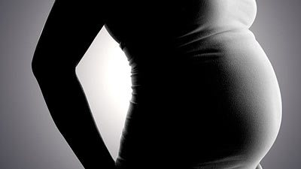
THE BIG PICTURE
Understand sperm dysfunction
Correct sperm dysfunction
Treat male infertility
Understand sperm function

Slide 12
THE BIG PICTURE
Understand sperm dysfunction
Correct sperm dysfunction
Treat male infertility
Understand sperm function
Male contraception

Slide 13
What do we know?
Sperm motility correlated both to spontaneous conception and ART success – attractive therapeutic target
Alteration in [Ca²⁺]_{i} fundamental to sperm motility and function
[Ca²⁺]_{i} relates to IVF fertilisation rates (Alasmari et al. 2013)
pH ([H⁺]_{i}) also crucial to sperm motility and fertility
Calcium stores contribute to [Ca²⁺]_{i}: hyperactivated motility
[Ca²⁺]_{i} and [H⁺]_{i} primarily determined by ion channels and transporters of the sperm plasma membrane

Slide 14
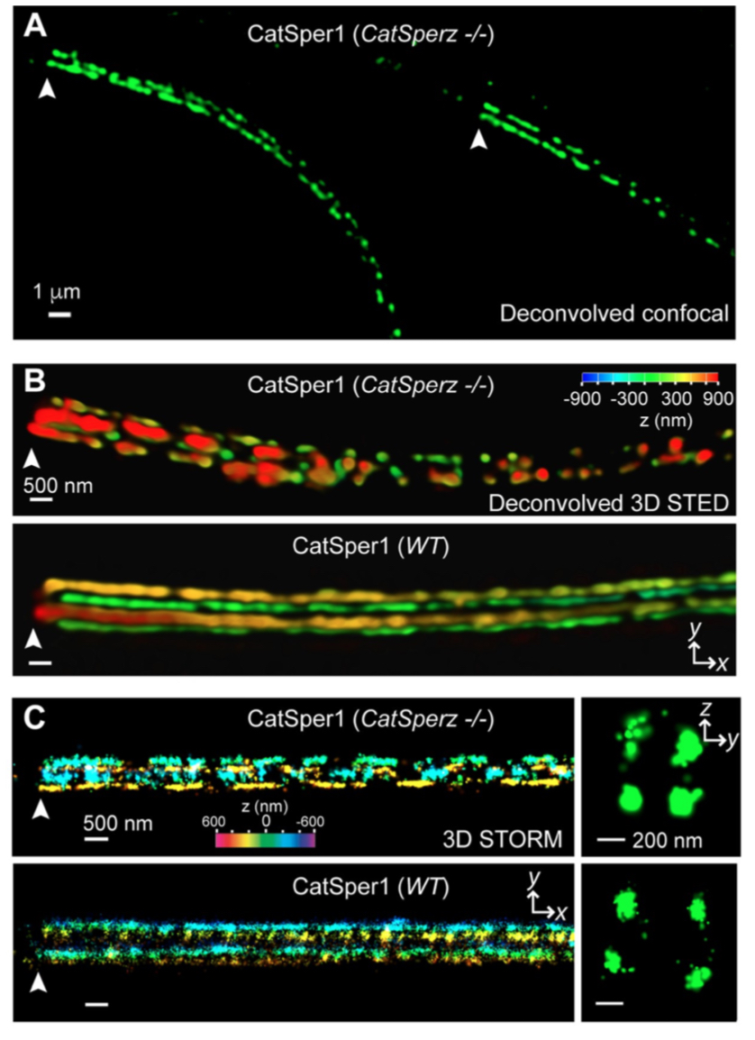
Catsper channels
Cation channel of Sperm
First described 2011
(Lishko et al. 2011; Strunker et al. 2011)
Permeable to calcium
Sperm specific
Located along flagellum
Chung et al 2017

Slide 15
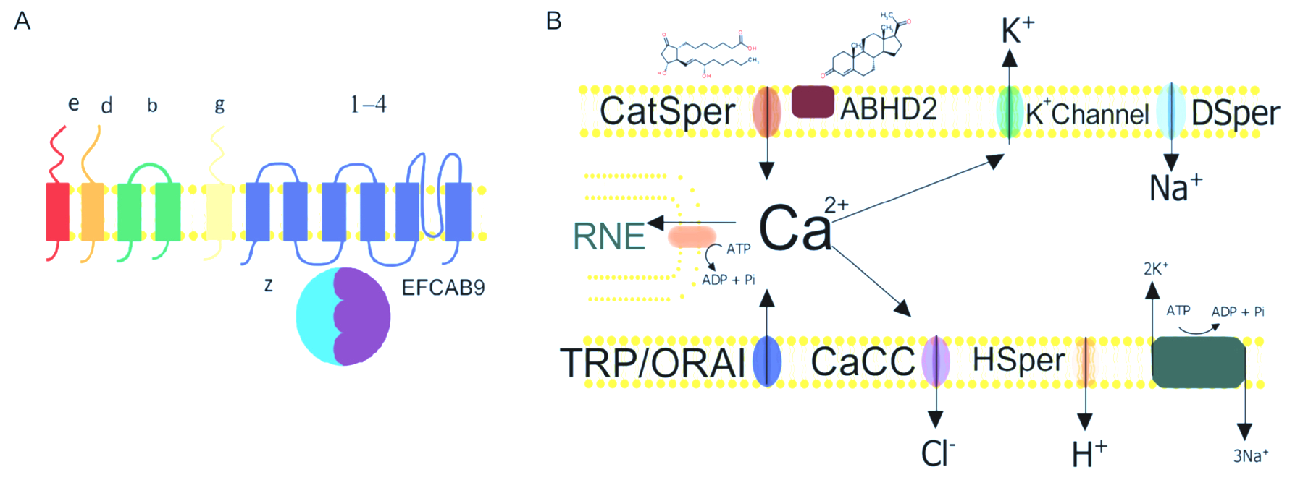
CatSper channels
Large ion channel complex
  4 subunits
  6 auxillary subunits
  Chaperone protein (Catsper tau)
CatSper activation
  Progesterone (ABDH2)
  Prostaglandins
  Increase in intracellular pH / Vm depolarisation
Brown et al 2019

Slide 16
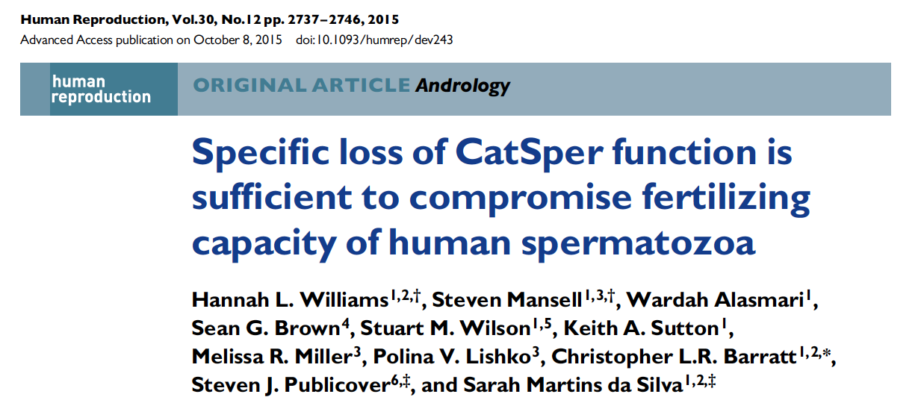
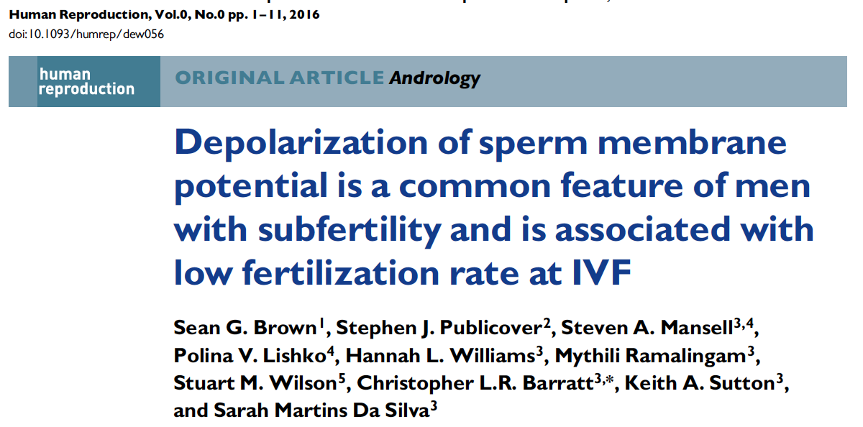
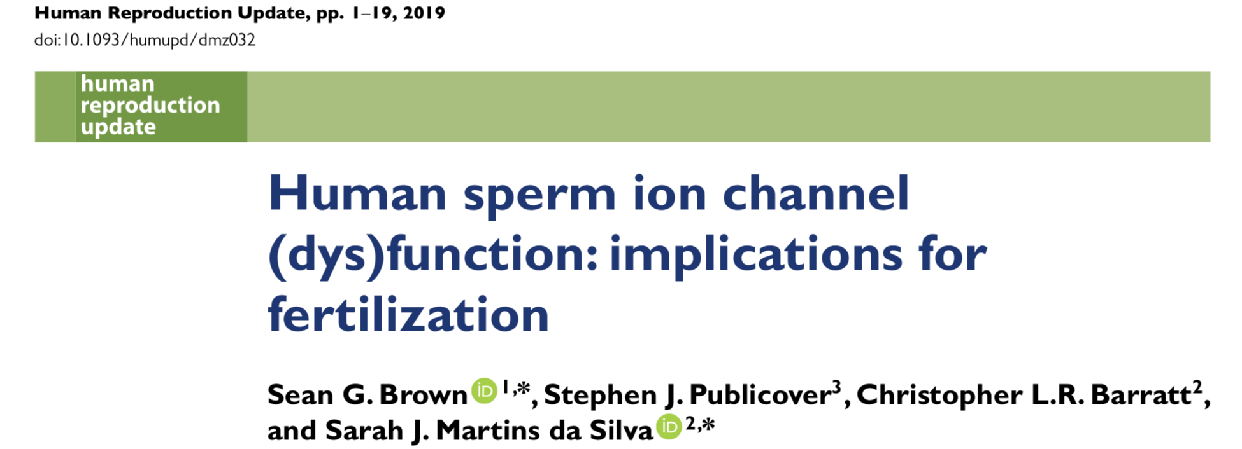
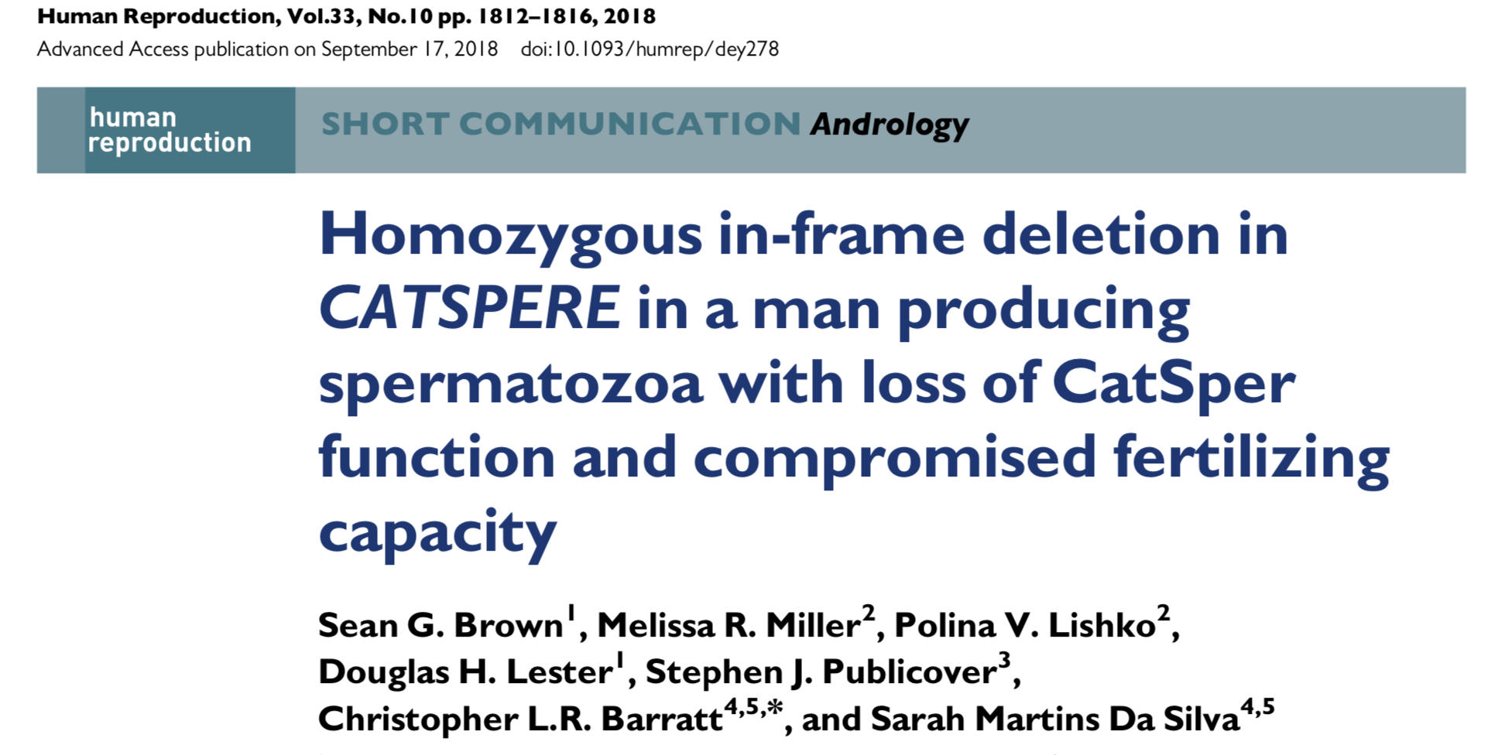

Slide 17
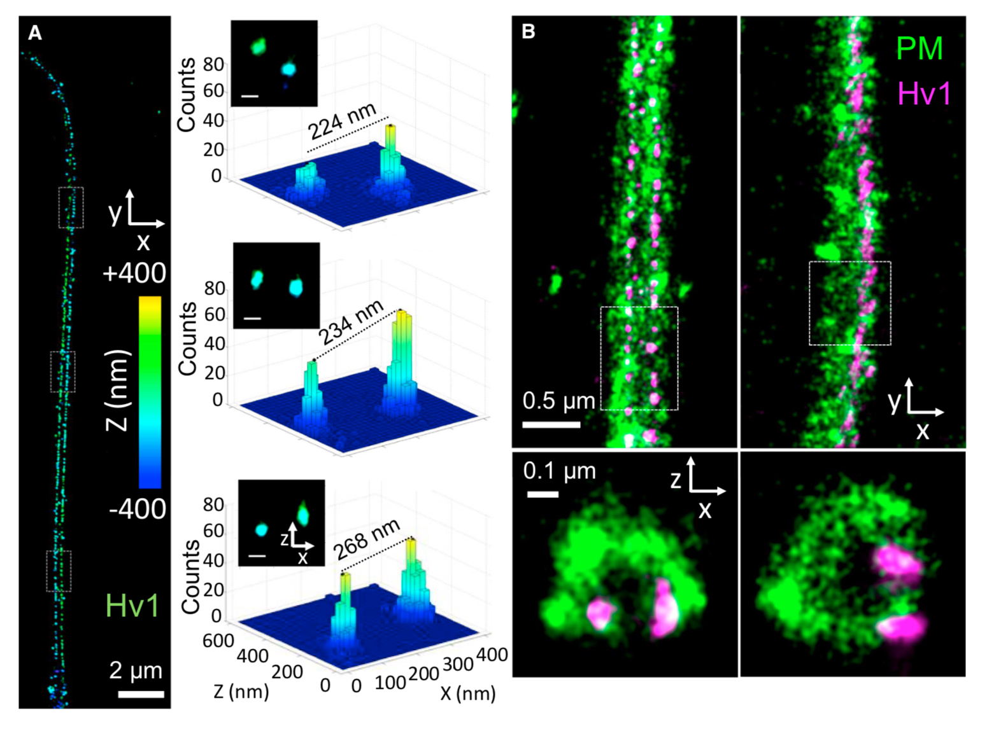
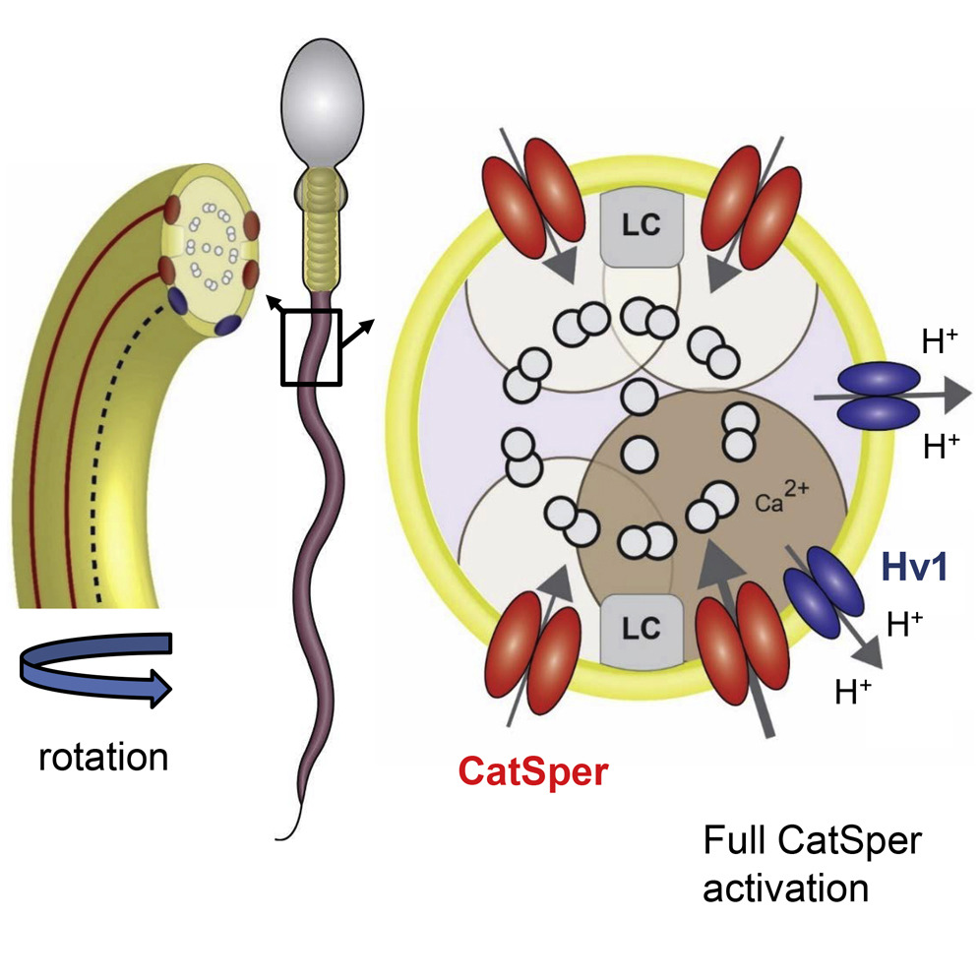
Hv1
Voltage gated proton channel
2 domains, located asymmetrically
Responsible for sperm rotation
Miller et al 2018

Slide 18
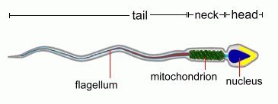

Slide 19

High throughput screening
Time and resource efficient method of identifying potential compounds as new drugs
UoD SLS unique resource: Drug Discovery Unit
  Biotech and pharma capabilities
  Remit for drug discovery in neglected diseases and novel therapeutic targets
  Libraries of thousands of small molecular compounds specifically designed for ‘lead-like’ characteristics

Slide 20

Phenotypic screening
Used to screen small molecules for effects that alter the phenotype of a cell in a desired way
National Phenotypic screening centre
  Integrated robotics, screening platforms and analysis workflow
  Better suited to screening complex biology
  Better at successfully delivering translational outputs (Swinney and Anthony 2011)

Slide 21
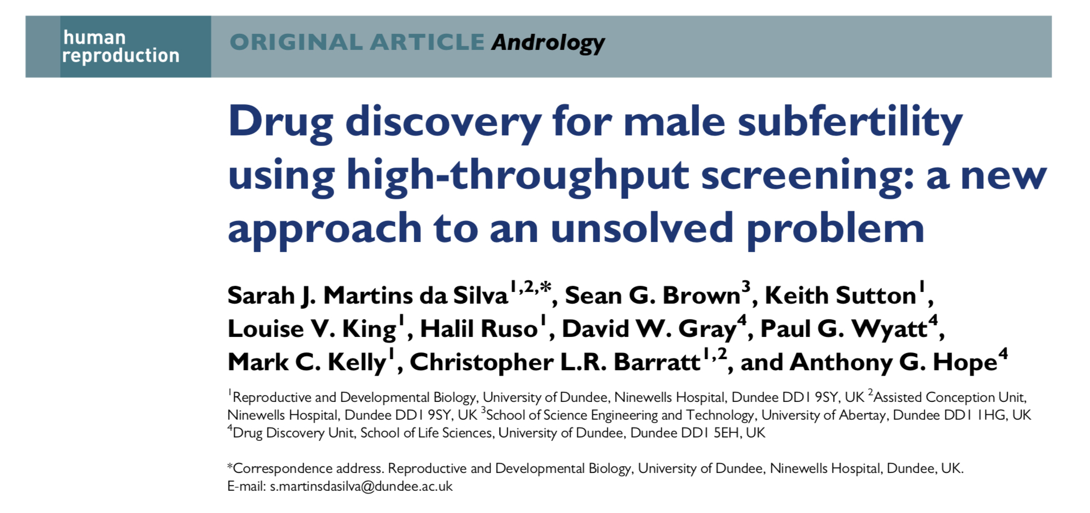
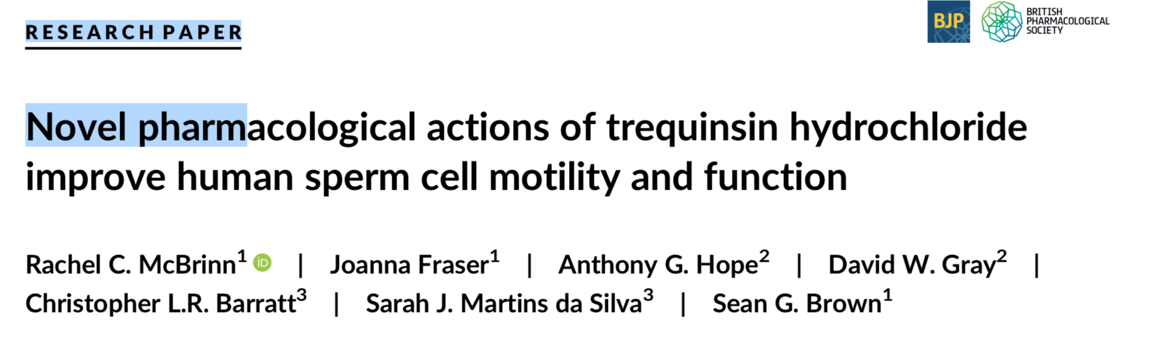
Robust HTS and phenotypic screening assay(s) developed
Drug development for male subfertility – in vitro
Overall aim to develop a prescribable treatment for infertile men
But…

Slide 22
Non-medical treatment
Lifestyle modification
  Smoking
  Alcohol
  Caffeine
  Diet
  Weight loss
  Stress / depression
  Sleep
Antioxidants

Slide 23
Oxidative Stress
  ROS: oxygen ions, free radicals, peroxides
  Spermatozoa actively generate ROS to drive tyrosine phosphorylation required for capacitation, acrosome reaction
Occurs when production of potentially destructive ROS exceeds natural antioxidant defences
  Sperm susceptible++ to oxidative stress

Slide 24
Oxidative Stress
Significant body of evidence to support the role of oxidative stress in sperm dysfunction
  Oxidative parameters higher in semen of idiopathic infertile men compared to fertile men [Aktan et al 2013]
  Common pathology: seen 30-80% all infertile men [Tremellen 2008]
Many lifestyle factors contribute to rising levels of ROS
  Advancing age
  Smoking
  Obesity / poor diet

Slide 25
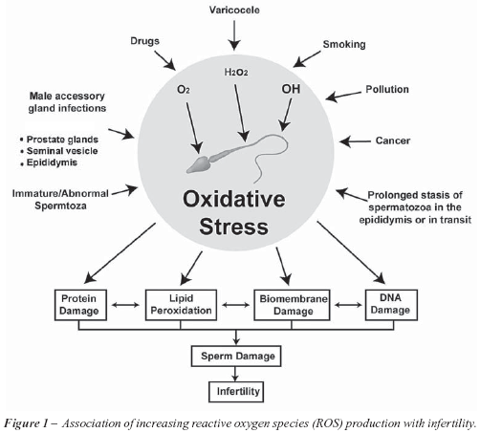

Slide 26
Exogenous ROS
Electromagnetic radiation
Pesticides
Air Pollution
Motor vehicle exhaust
  Non-toxic: N2, H2O, CO2
  Toxic: CO, NO, VOCs (benzene, toluene, ethylbenzene, xylene) O3, particulate matter, polycyclic aromatic hydrocarbons (PAHs)
  Components potentially mutagenic, carcinogenic, and endocrine disrupting agents

Slide 27
Endogenous ROS
Infection
  WBC and inflammatory response aimed at killing the microorganisms
  Leucocytospermia (concentration > 1x10⁶/ml) present in approx 20% of male factor infertility
Immature / abnormal sperm
Female reproductive tract immune defenses?
Metabolic production of ROS

Slide 28
Mechanism of action
  Damage to sperm membrane (lipid peroxidation)
    sperm susceptible due to high levels polyunsaturated fats in cell membrane
  Decrease in sperm motility
    Sperm motility correlated both to spontaneous conception and ART success
    Impaired fertilisation
  DNA damage
    spermatozoa only possess 1st enzyme in base excision repair pathway (8-oxoguanine DNA glycosylase)
    associated with miscarriage / developmental abnormalities in offspring

Slide 29
Antioxidants
Protective agents against ROS (free radical scavengers)
Naturally found in semen
  Vitamins: C, E, folic acid
  Trace elements: zinc, selenium
  Micronutrients: carnitines, carotenoids
Antioxidant therapy theoretically beneficial to subfertile men?
Oxidative stress not routinely assessed
DNA damage testing currently lacks clinical utility

Slide 30
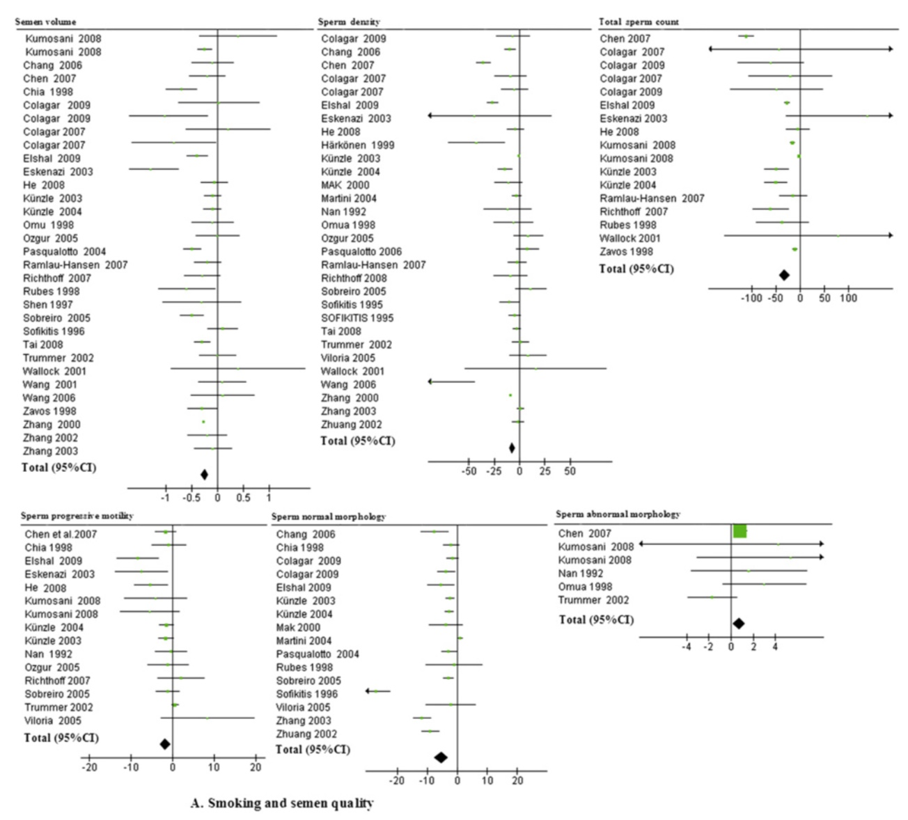
Smoking
Li et al 2011
Notes:
57 studies, 29914 participants included in meta-analysis review: Smoking affects all sperm parameters

Slide 31
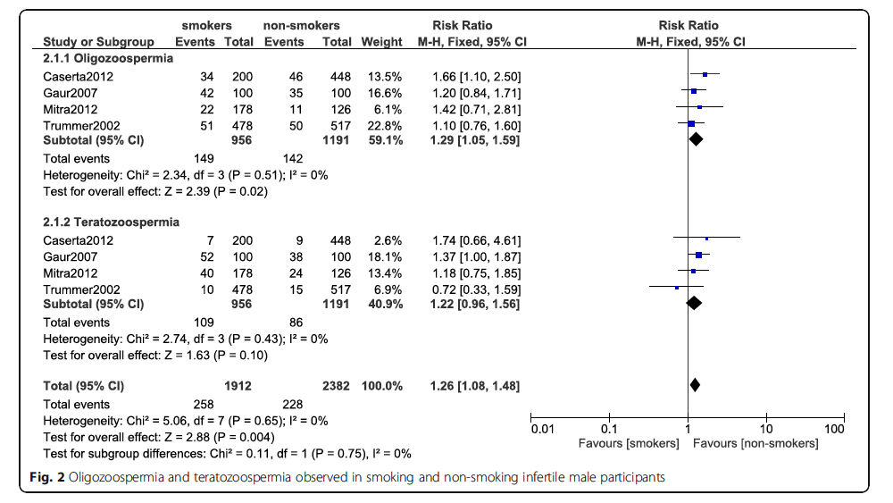
Bundhun et al 2019
Notes:
16 studies, 10823 participants. Smoking negatively affects sperm count and sperm morphology

Slide 32
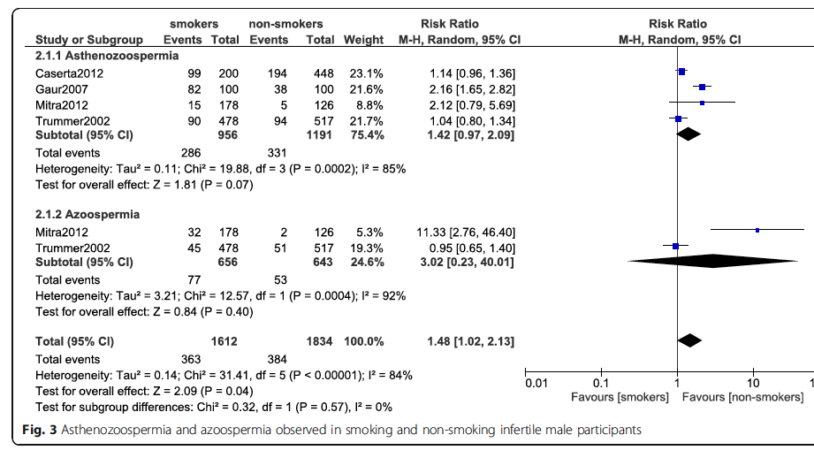
Bundhun et al 2019
Notes:
…but no effect on sperm motility, nor on probability of azoospermia

Slide 33
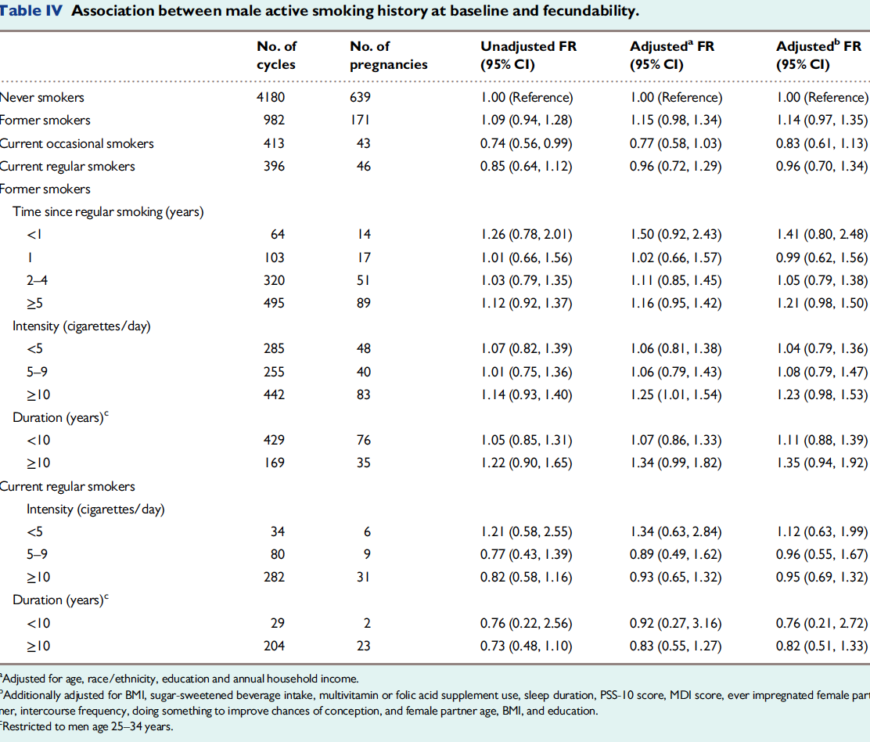
Smoking
+ Male fertility
Wesselink et al 2018
Notes:
5473 female / 1411 male pregnancy planners – no clear association between smoking and male fecundity
Note study numbers and heterogeneity

Slide 34
Smoking
+ ART outcomes
1998
Joesbury et al HR 1998
Male partner smoking: sig reduced chance ongoing pregnancy (n=498)
2004
Jensen et al 2004
Male smoking sig reduces success rate ART (n=301): both IVF (18% v 32%) and ICSI (22% v 38%)
2010
Fuentes et al 2010
Lower live birth rate IVF / ICSI if male partner smoked (7.8% v 21.1% n=166)
Notes:
Negative impact on ART outcomes: study numbers are small

Slide 35
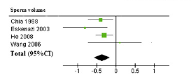
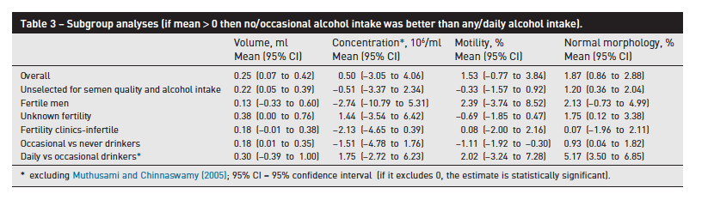
Alcohol
Li et al 2011
Ricci et al 2017
Notes:
15 cross-sectional studies, 16395 men included
High levels of alcohol intake do appear to be associated with changes in semen that may affect fertility, but this review finds no evidence for negative effects of occasional alcohol intake

Slide 36
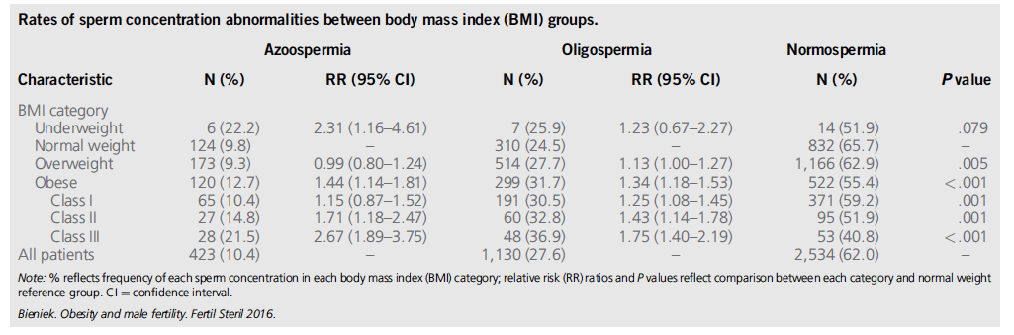
Obesity
Bieniek et al 2016
Notes:
Effect of weight loss intervention is variable and may depend on sped of weight loss and nutritional status
Weight loss intervention is complex – requires change in diet and lifestyle – exercise etc

Slide 37
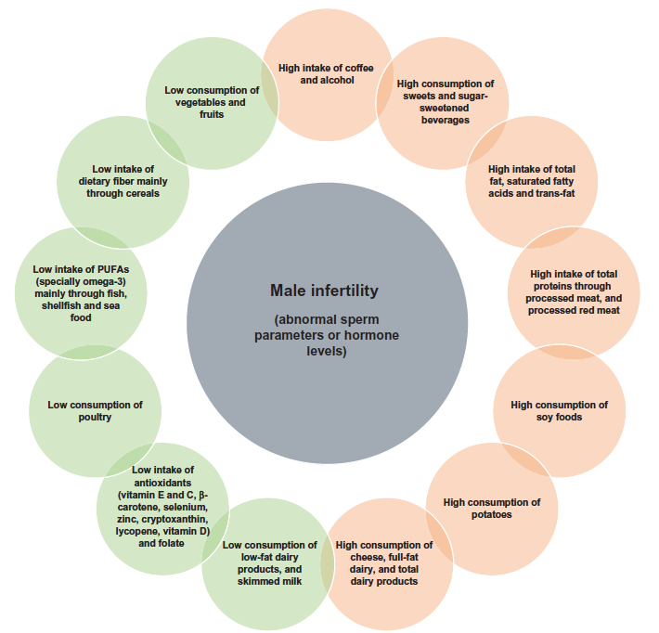
Diet
Notes:
Green = positive association
Orange = negative association
Caffeine
Processed meat
High sugar
Low fruit/veg

Slide 38
VITAMINs
Vitamin C supplement 1000mg/day x 3/12: statistically significant increase in sperm motility [Dawson et al 1990]
Folic acid 15mg daily x 3/12 : 65 males, significant variability following treatment, consistent increase in sperm count and motility [Bentivoglio et al 1993]
Vitamin E supplementation (600mg): improves sperm motility [Suleman et al 1996] and carries significant improvements in CPR and LBR [Kessopolou et al 1995; Suleman et al 1996]
Men with high folate intake have significantly lower frequencies of aneuploid sperm [Young et al 2008]
Vit C + Vit E: reduced DNA fragmentation [Greco et al 2005]

Slide 39
TRACE ELEMENTS
Zinc is essential trace element for spermatogenesis [Yamaguchi et al 2009]
Zinc 250mg BD: beneficial effects on sperm motility and fertilising capacity [Omu et al 1998]
No association with 3/12 or 6/12 zinc supplements and improved sperm motility (compared to placebo) [Azizollahi et al 2013]
Magnesium x3/12: no association with supplementation and sperm motility [Zavaczki et al 2003]
Improvement in sperm motility parameters following 200mg selenium supplementation [Scott et al 1998; Safarinejad et al 2009]

Slide 40
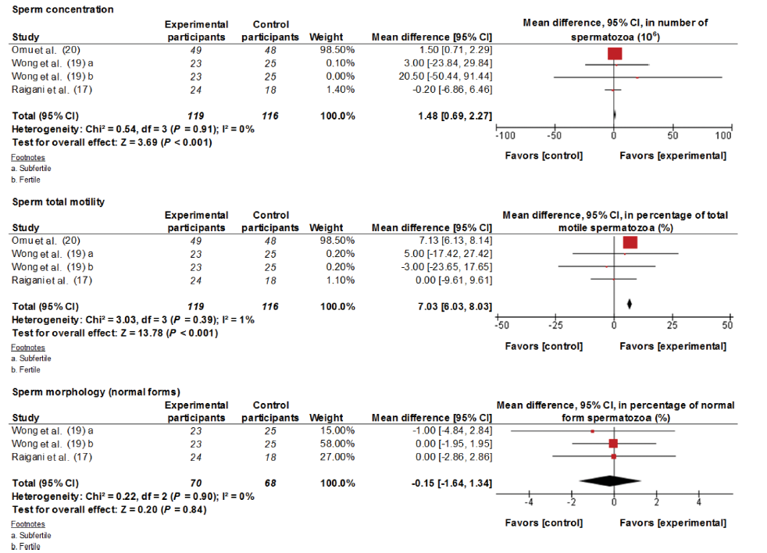
Zinc
Salas-Huetos et al 2018
Notes:
Improves motility

Slide 41
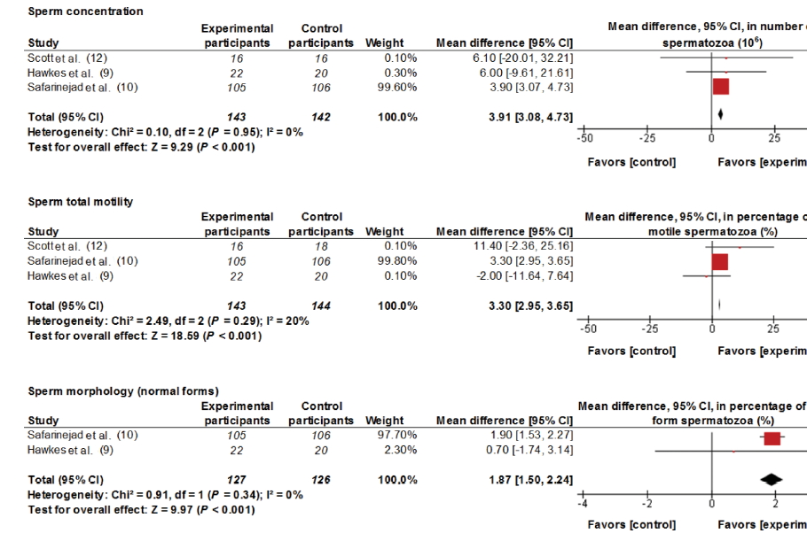
Selenium
Salas-Huetos et al 2018
Notes:
Improves concentration / motility / morphology

Slide 42
COMBINATION THERAPY
66mg zinc + 5mg folic acid daily : 26/52 treatment significantly increased sperm count [Wong et al 2002; Ebisch et al 2006]
Zinc + folic acid x 6/12: no association with improved sperm motility when compared to placebo [Azizollahi et al 2013]
220mg zinc + 5mg folic acid daily : 16 weeks treatment did not ameliorate in infertile men with OAT / severely compromised sperm parameters [Raigani et al 2014]

Slide 43
MICRONUTRIENTS
L-carnitine: significantly increased sperm motility
  Balercia et al 2005; Peivandi et al 2010
Significant increase in pregnancy rates following male L-carnitine supplementation
  Lenzi et al 2003; Cavallini et al 2004; Balercia et al 2005; Peivandi et al 2010
Significant increase in sperm motility following N-acetyl cysteine supplementation
  Ciftci et al 2009; Safarinejad et al 2009; Attallah et al 2013
Improved sperm motility parameters following Coenzyme Q10 supplement
  Balercia et al 2009; Safarinejad et al 2009; Safarinejad et al 2012

Slide 44
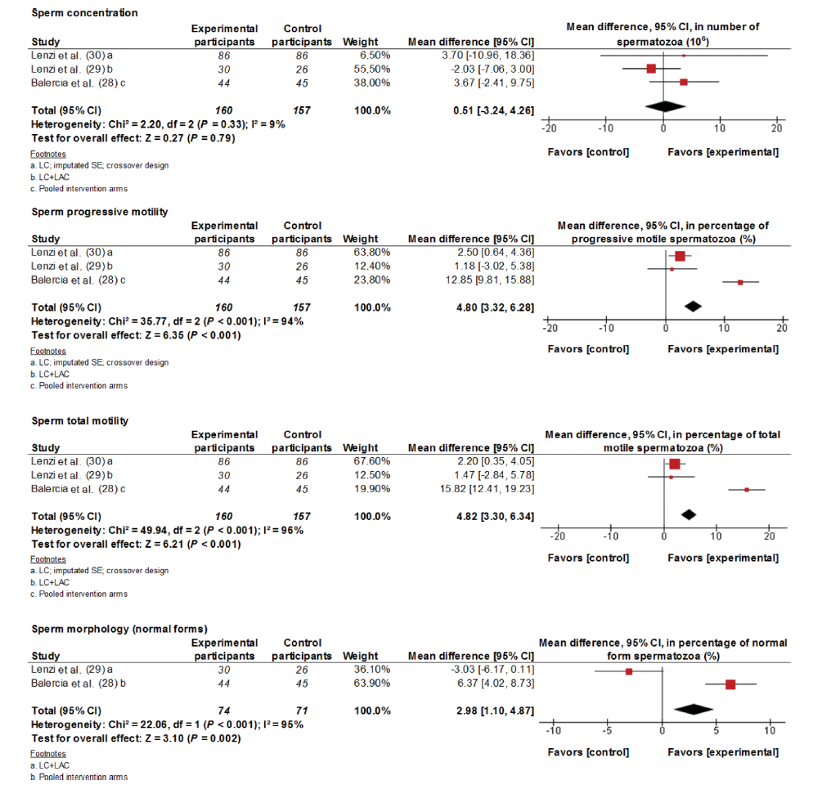
Carnitines
Salas-Huetos et al 2018
Notes:
Improves motility / morphology

Slide 45
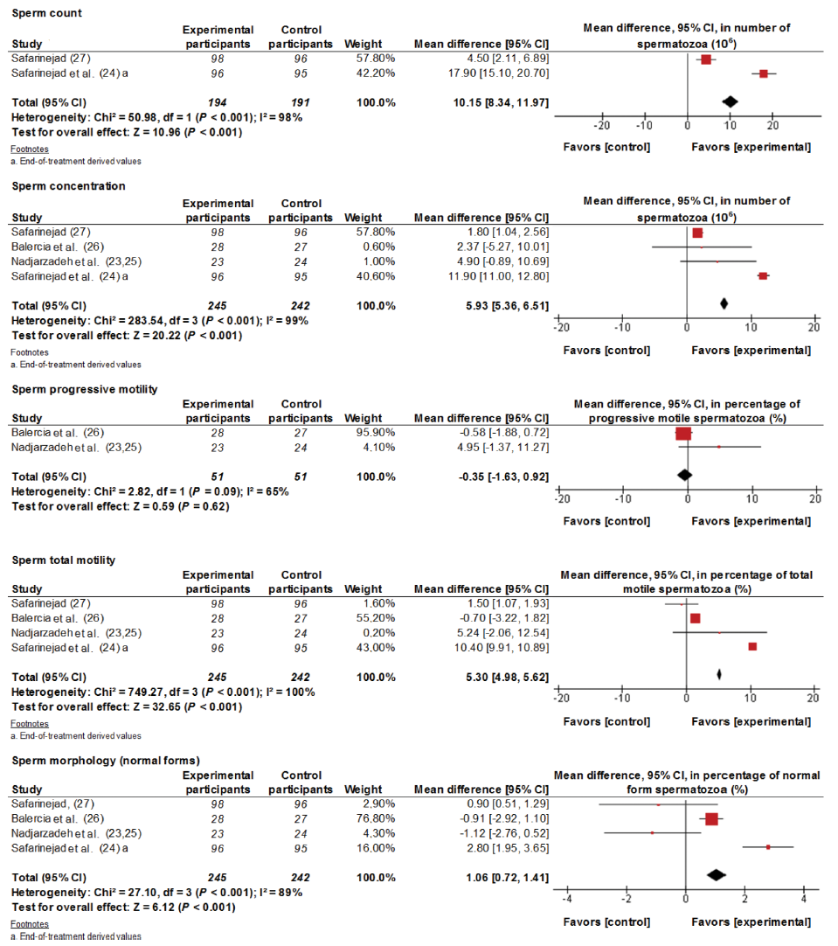
Co-enzyme Q
Salas-Huetos et al 2018
Notes:
Improves sperm conc / total but not progressive motility / morphology

Slide 46
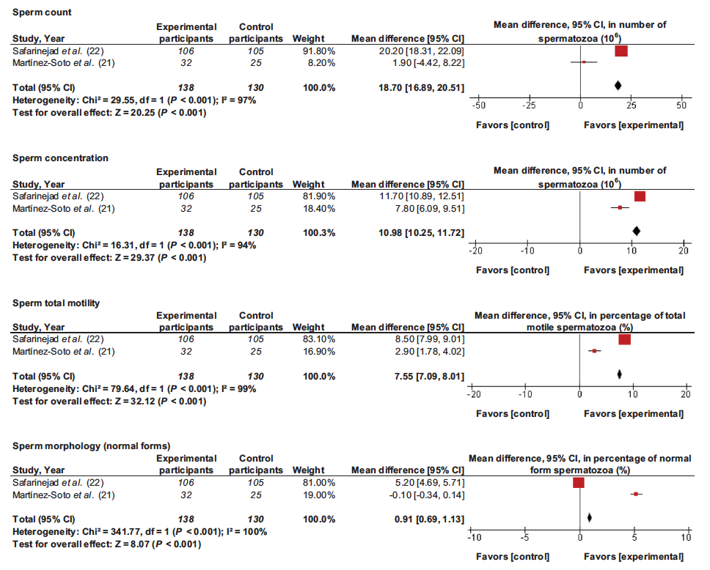
Omega 3 fatty acids
Salas-Huetos et al 2018
Notes:
Improves concentration / motility / morphology

Slide 47
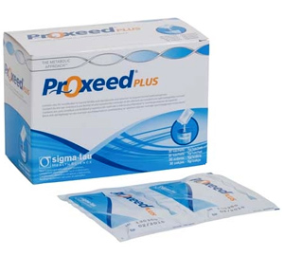
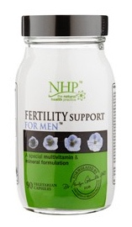
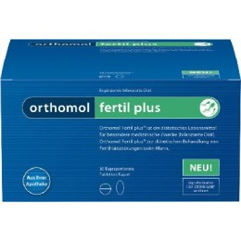
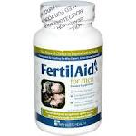
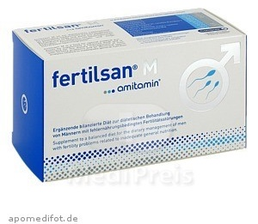
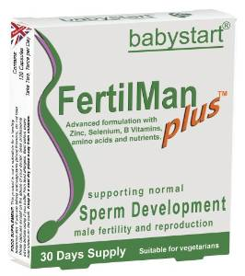
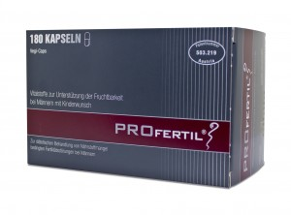
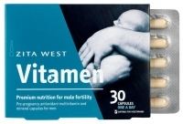
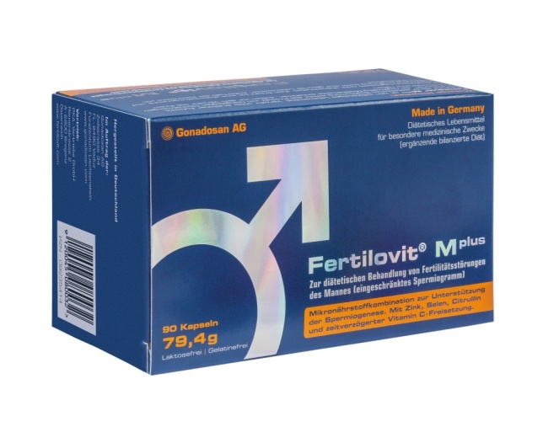
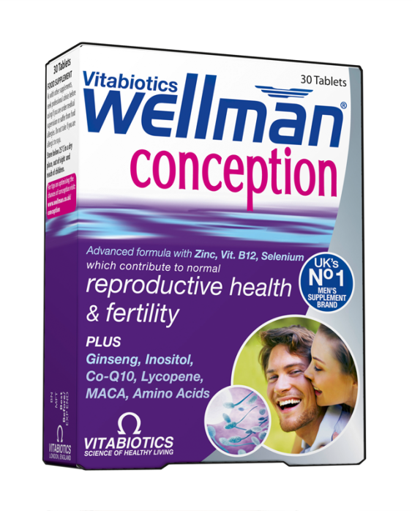
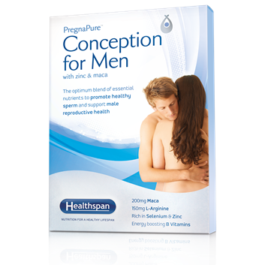
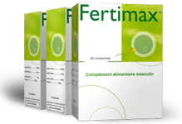

Slide 48
VITAMIN SUPPLEMENTS
 | A | B1 | B2 | B3 | B5 | B6 | B7 | B9 | B12 | C | D | E | K
FertilAid
Fertility Support
Fertilovit M Plus
Fertilman
Fertilsan M
Fertimax
Orthomol Fertil plus
Pregnapure
Profertil
Proxeed plus
Vitamen
Wellman Conception
[Martins da Silva 2019]
Notes:
Analysis of components of 12 common male fertility supplements:
Perhaps not surprisingly, nearly all preparations contain folic acid (vit B9), vit C and/or Vit E

Slide 49
VITAMINs
Vitamin C supplement 1000mg/day x 3/12: statistically significant increase in sperm motility [Dawson et al 1990]
80 – 250mg
Folic acid 15mg daily x 3/12 : 65 males, significant variability following treatment, consistent increase in sperm count and motility [Bentivoglio et al 1993]
400 – 800mg
Vitamin E supplementation (600mg): improves sperm motility [Suleiman et al 1996] and carries significant improvements in CPR and LBR [Kessopolou et al 1995; Suleiman et al 1996]
20mg – 120mg

Slide 50
TRACE ELEMENT SUPPLEMENTS
 | Ca2+ | Cr2+ | Cu2+ | I2 | Fe2+ | Mg2+ | Mn2+ | PO4 | Se | Zn2+
FertilAid
Fertility Support
Fertilovit M Plus
Fertilman
Fertilsan M
Fertimax
Orthomol Fertil plus
Pregnapure
Profertil
Proxeed plus
Vitamen
Wellman Conception
[Martins da Silva 2019]
Notes:
All contain selenium and zinc, with a variety of other trace elements in half of them

Slide 51
TRACE ELEMENTS
Zinc 250mg BD: beneficial effects on sperm motility and fertilising capacity [Omu et al 1998]
15 - 40mg
Magnesium x 3/12: no association with supplementation and sperm motility [Zavaczki et al 2003]
20 – 120mg
Improvement in sperm motility parameters following 200mg selenium supplementation [Scott et al 1998; Safarinejad et al 2009]
50 – 150mg

Slide 52
MICRONUTRIENT SUPPLEMENTS
 | Acetyl L-carnitine | Beta carotene | Coenzyme Q10 | DHA | EPA | Ginseng extract | Glutathione
FertilAid
Fertility Support
Fertilovit M Plus
Fertilman
Fertilsan M
Fertimax
Orthomol Fertil plus
Pregnapure
Profertil
Proxeed plus
Vitamen
Wellman Conception
[Martins da Silva 2019]
Notes:
Most contain coenzyme Q10

Slide 53
MICRONUTRIENT SUPPLEMENTS
 | L- arginine | L- carnitine | L- cirtrulline | L- taurine | Lycopene | N-acetyl L-cysteine | Omega 3 fatty acids | Pine Bark extract
FertilAid
Fertility Support
Fertilovit M Plus
Fertilman
Fertilsan M
Fertimax
Orthomol Fertil plus
Pregnapure
Profertil
Proxeed plus
Vitamen
Wellman Conception
[Martins da Silva 2019]
Notes:
Most also contain L-carnitine, but only 25% (3/12) contain N-aceytl L-cysteine

Slide 54
MICRONUTRIENTS
3G/day L-carnitine: significantly increased sperm motility [Balercia et al 2005; Peivandi et al 2010]
50mg – 3.4G
Significant increase in sperm motility following 600mg N-acetyl cysteine supplementation [Ciftci et al 2009; Safarinejad et al 2009; Attallah et al 2013]
50 – 80mg
Improved sperm motility parameters following 300mg Coenzyme Q10 supplement [Balercia et al 2009; Safarinejad et al 2009; Safarinejad et al 2012]
2 – 60mg

Slide 55
EVIDENCE-BASED MEDICINE?
Busetto et al 2012: 114 infertile men (96 completed) 1 sachet Proxeed daily x 4/12
Progressive motility 18.3 +/- 3.8 increased to 42.1 +/- 5.5%. No significant improvement in sperm count or % morphologically normal sperm
 | STUDY | PROXEED PLUS
L-carnitine | 145mg | 1000mg BD
Acetyl L-carnitine | 64mg | 500mg BD
Selenium | 50mcg | 50mcg BD
Zinc | 10mg | 10mg BD
Coenzyme Q10 | 20mg | 20mg BD
Vit C | 90mg | 90mg BD
Vit B12 | 1.5mcg | 1.5mcg BD
Folic acid | 200mcg | 200mcg BD

Slide 56
COCHRANE Review
Antioxidants for male subfertility [Showell et al 2014]
48 RCTs comparing single / combined antioxidants v. placebo / no treatment / another antioxidant
4179 subfertile men
Age 20 – 52 y
Treated for 3 - 26 weeks
Follow up 3 weeks – 2y

Slide 57
COCHRANE Review
Most studies reported sperm parameters as primary outcome
Only 4 small studies (277 couples in total) evaluated LBR
Only 7 small studies evaluated CPR
Insufficient evidence to demonstrate difference in miscarriage rates
‘More high quality, larger, placebo-controlled trials reporting on outcomes and adverse events are needed to draw definite conclusions’

Slide 58
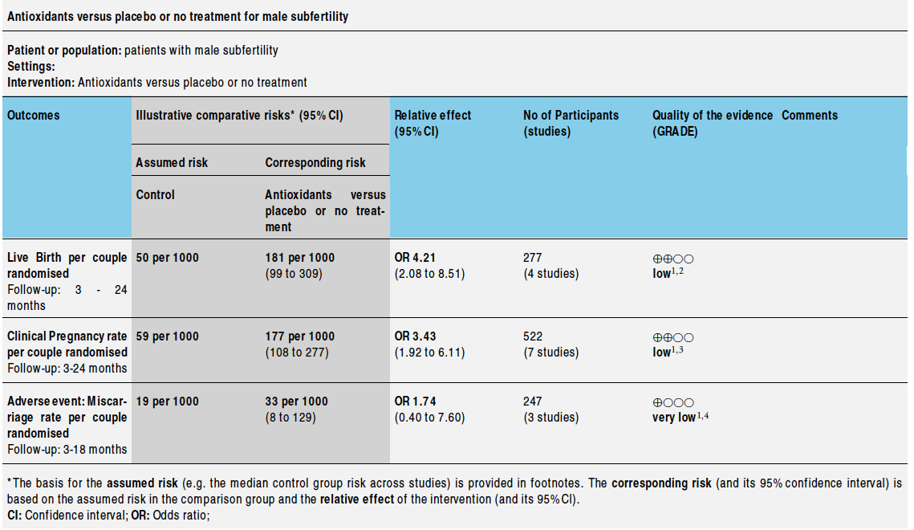
Antioxidants
Showell et al 2014

Slide 59
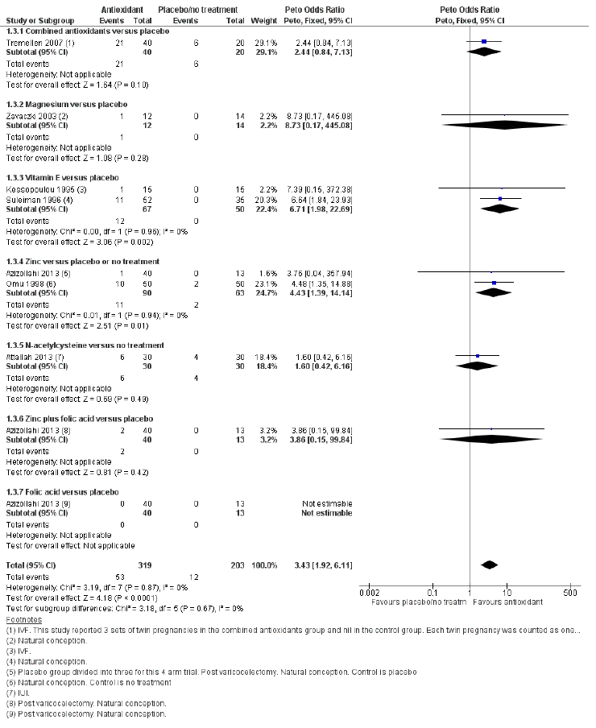
Antioxidants: CPR
Showell et al 2014

Slide 60
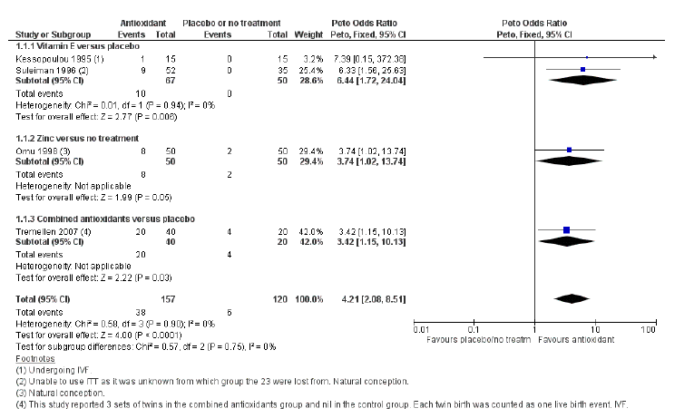
Antioxidants: live birth
Showell et al 2014

Slide 61
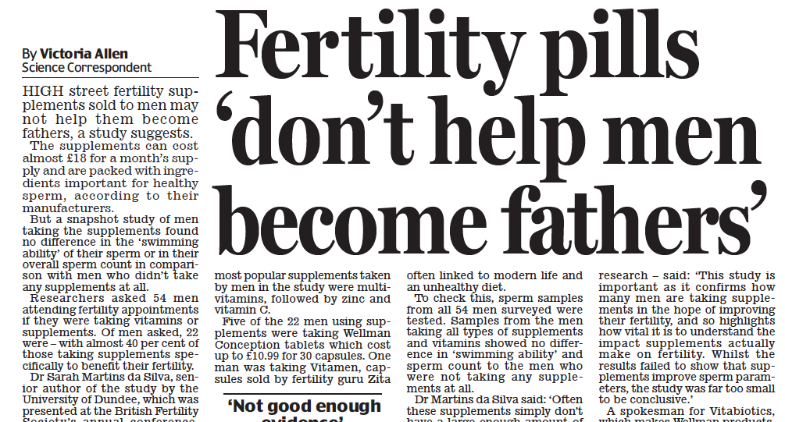

Slide 62
COCHRANE Review 2019
Antioxidants for male subfertility [Smits et al 2019]
61 studies evaluating 18 different antioxidants
6264 subfertile men
Age 18 – 65 y
Only 12 studies reported on live birth or clinical pregnancy

Slide 63
COCHRANE Review 2019
Only 7 small studies (750 couples in total) evaluated LBR: small increase in OR
Only 11 small studies (786 couples) evaluated CPR: OR 2.97 (CI 1.91 – 4.63) increased chance pregnancy
Only 3 studies reported miscarriage: no significant effect
Antioxidants may improve CPR and LBR, but numbers are small and evidence is poor

Slide 64
FASZT STUDY
5 mg folic acid + 30 mg zinc for 6 months
2370 men (1185 randomised to antioxidant, 1185 placebo)
No change in sperm concentration, motility, morphology but supplementation associated with increased DNA fragmentation (risk difference 2.5, 95% CI 0.6–4.4).
No effect on CPR or LBR
No effect on miscarriage
Preterm birth was higher with supplementation (risk difference 1.94, 95% CI 0.24–3.64).
Notes:
Reported ASRM 2019

Slide 65
MOXI trial
Males, Antioxidants, and Infertility (MOXI) trial: multi-centre RCT (USA)
  Vitamin C, vitamin E, folic acid
  Selenium, Zinc
  L Carnitine, lycopene
Treatment for 3-6 months
No improvement in sperm parameters / DNA damage
No increase in CPR or LBR
Notes:
Published 2020

Slide 66
MALE INFERTILITY
15% men infertile – most produce sperm, just fewer in number or poorer swimming ability
  1% men produce no sperm at all
Sperm biology not well understood
IVF-ICSI is highly effective but treats the partner not the problem
We need more research
And we need to advocate for men and couples to challenge the current status quo to raise awareness

Slide 67
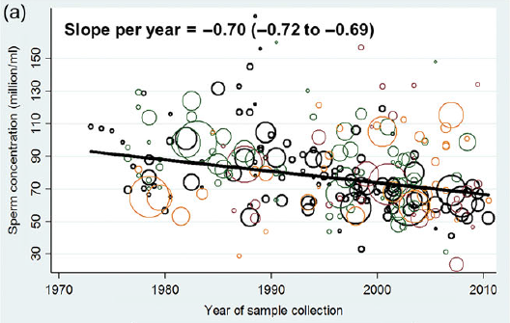
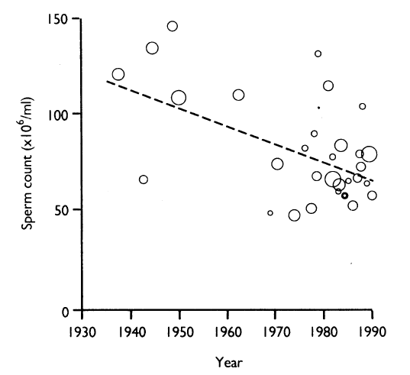
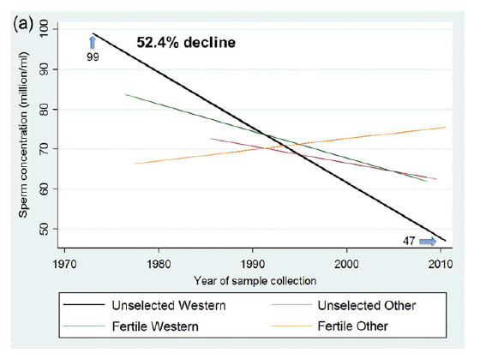
Global challenge
Levine et al 2017
Carlsen et al 1992

Slide 68

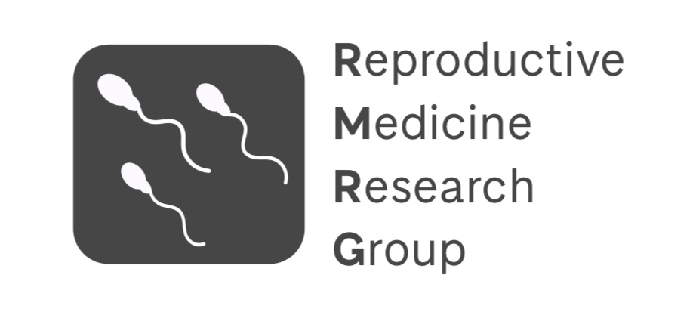



THANK YOU
@SMDS_research

