Slide 1
Food Chaining
Emma Mills
Brain & Body Nutrition

Slide 2
“ One of the most common myths about eating is that it is easy and instinctive.
Eating is actually the most complex physical task humans engage in”
Kay Toomey
Director of Colorado Pediatric Therapy and Feeding Specialists
Food Chaining by Fraker, Fishbein, Cox and Walbert

Slide 3
What is food chaining ?
An effective treatment approach based on an individual’s natural preferences
It builds upon successful eating experiences
Food chains are not linear; it branches off in many different directions as the child accepts or rejects foods
Start with core foods; try similar foods, variants of the original or sauces to mask

Slide 4
Core Foods
Foods that are eaten reliably across all settings
Match core foods to new foods according to sensory properties
colour
shape
taste
texture
smell
temperature

Slide 5
Flavour Mapping
Flavour and texture preferences
sweet
salty
sour
bitter
crunchy
soft
uniform texture
fluids

Slide 6
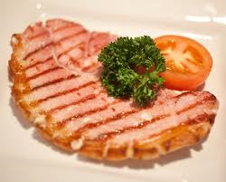
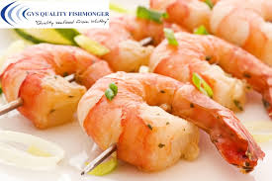
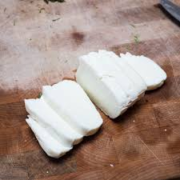
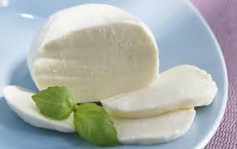
Food Exchanges
Examples:

Slide 7
Core food = McDonald’s chicken nuggets
McDonald’s
chicken nuggets
different brands of chicken nuggets
battered chicken nuggets
with ketchup
homemade breaded chicken strips
with BBQ sauce
breaded chicken pieces
with mayonnaise
breaded fish
with mustard sauce
breaded pork tenderloin

Slide 8
FC Rating Scale
Score | Child’s reaction
1 | Gags and/or vomits upon touching, smelling or seeing food
1+ | Gags upon tasting food
2 | Chews the food or manipulates it briefly in the mouth
3 | Chews the food, but strongly aversive to the taste, grimaces, refuses to try more
4 | Chews and swallows the food, tolerates it but doesn’t enjoy it
5 | Chews and swallows the food, tolerates it with a ‘so-so’ reaction
6 | Chews and swallows several bites of the food, no major grimace or reaction, but still hesitant
7 | Chews and swallows several bites of the food with no hesitation, child appears relaxed
8 | Chews and swallows the food, takes a small serving easily, pleasant look on face
9 | Chews and swallows the food, asks or reaches for more, appears to like it very much
10 | Chews and swallows the food, a strong favourite, accepts it at any time

Slide 9
Sensory Hierarchy
Tolerating ……
being in the same room as the food
the sight of the food
the smell of the food
the feel of the food in your hands ( with or without cling film)
the taste of the food, even if just a single lick
biting the food
chewing the food
swallowing the food
Moving slowly through the sensory hierarchy helps expand tolerance of different foods

Slide 10
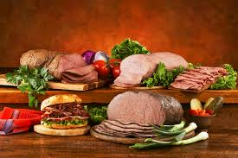
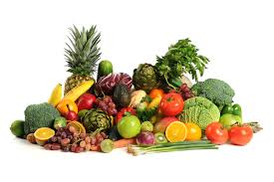
Challenging Foods
Texture and consistency of some meat often makes children feel unsafe eating
fills the mouth space
lots of effort to chew and breakdown
Fruits and vegetables can have multiple textures
initially crunchy and firm
then soft with juices squirting out

Slide 11
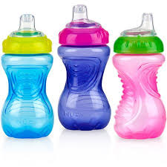
FC and Autism
Sensory Processing Disorder
Don’t always eat out of hunger
A child may drink from a spill-free cup because he likes the feeling of resistance he feels from the valve and the taste of juice is predictable

Slide 12
FC and Autism
Huge capacity to learn about food
counting during food-related activities
classify foods in positive ways
measure and transfer foods
food field trips
Teach the art of prediction
offer lots of descriptive details about foods
use visual aids and positive reinforcement

Slide 13
Practical Advice
Give advance warnings about meals
Give food choices
Not every meal needs to be part of the FC
Time meals and snacks wisely, no grazing
Motivate to succeed with rewards and privileges
Cook very small portions initially to avoid waste
And finally…..

Slide 14
Read the Book !
Food Chaining : The Proven 6-Step Plan to Stop Picky Eating, Solve Feeding Problems and Expand Your Child’s Diet
by Cheri Fraker, Mark Fishbein, Sibyl Cox and Laura Walbert, 2007
ISBN – 13: 978-1-60094-016-3

