Slide 1


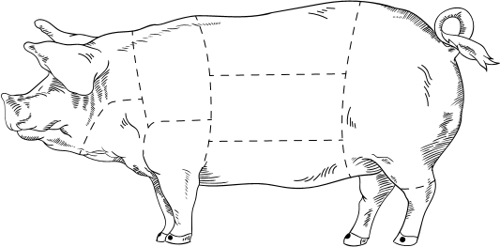

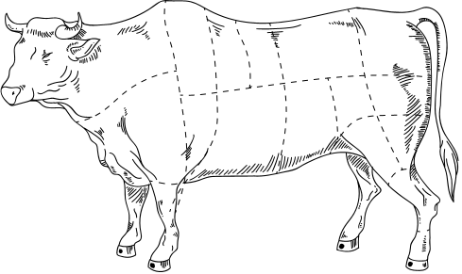
Nose to Tail Eating
EMILY COOPER

Slide 2



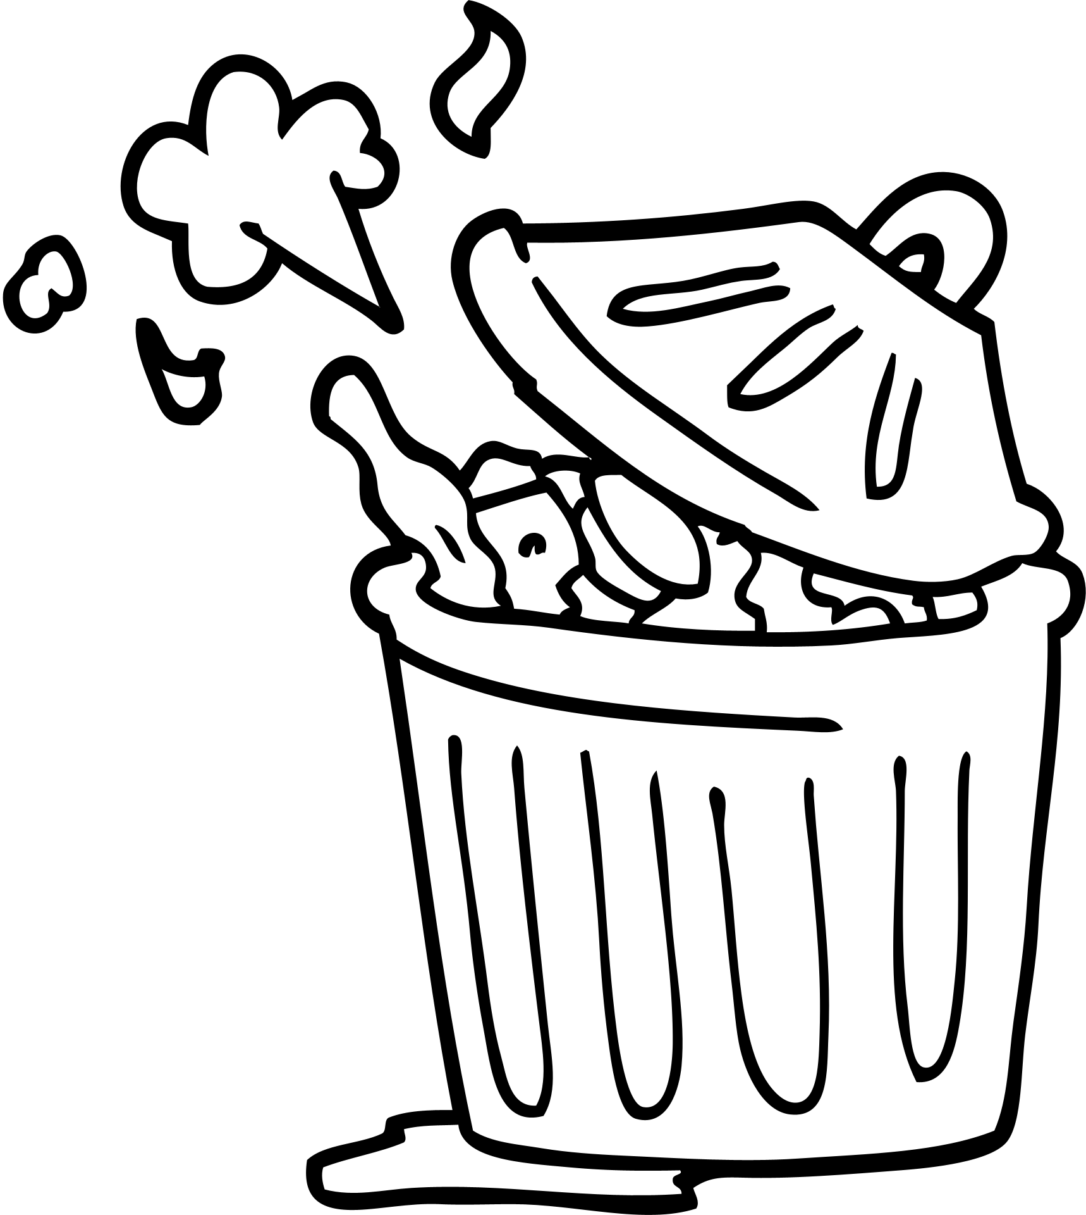
Intelligence
Red and processed meats have the single biggest environmental impact of any type of food
(BDA, 2020)
26%
of meat produced is wasted throughout the supply chain
(Hodges, et al., 2011)

Slide 3



Intelligence
In 1974 the average person was eating 50g of organ meat per week
In 2014 the average person only ate 5g per week in the UK
(Department for Environment, Food and Rural Affairs, 2020)

Slide 4

Intelligence
Very nutritionally dense
Offal is 'Nature's multivitamin'
Higher micronutrient content than muscle meat
(Food Standards Agency, 2008)

Slide 5
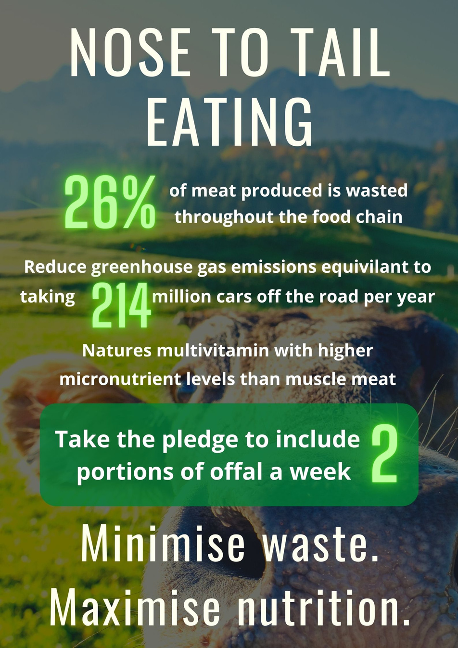

Action
Reduction of greenhouse gas by 2%
(Xue, et al., 2019)

Slide 6
Action
Young adult meat eaters
80% of those aged 18-23 consume meat within their diet
(Johnson, 2021)
250,000 students can't cook pasta
50% of students prefer ready-meals
(Hancock, 2019)

Slide 7



Action
Social Media
  Facebook
  Instagram
Social media usage
Facebook = 55%
Instagram = 42%
Posters within University
81% users are aged 18-34
(Talkwalker, 2020)

Slide 8
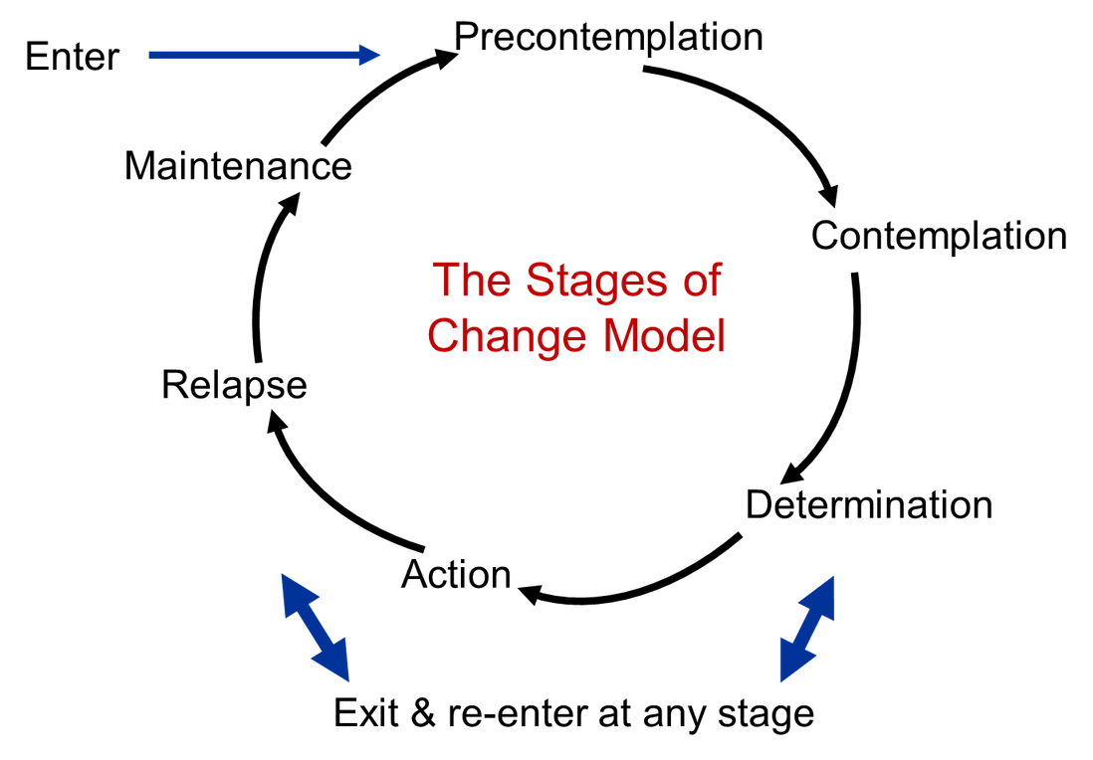
Impact & Evaluation
Don't want to be told what to eat
76% care about the environment
26% would stop eating meat for the environment
(Corrin & Papapodoulos, 2019)

Slide 9



Impact & Evaluation
  Cooking knowledge
  Cultural acceptability
  Unaware of wastage
  Previous health scares
28% find veganism too difficult
27% find veganism too expensive
(McWilliams, 2017)
(VeganLife, 2018)

Slide 10
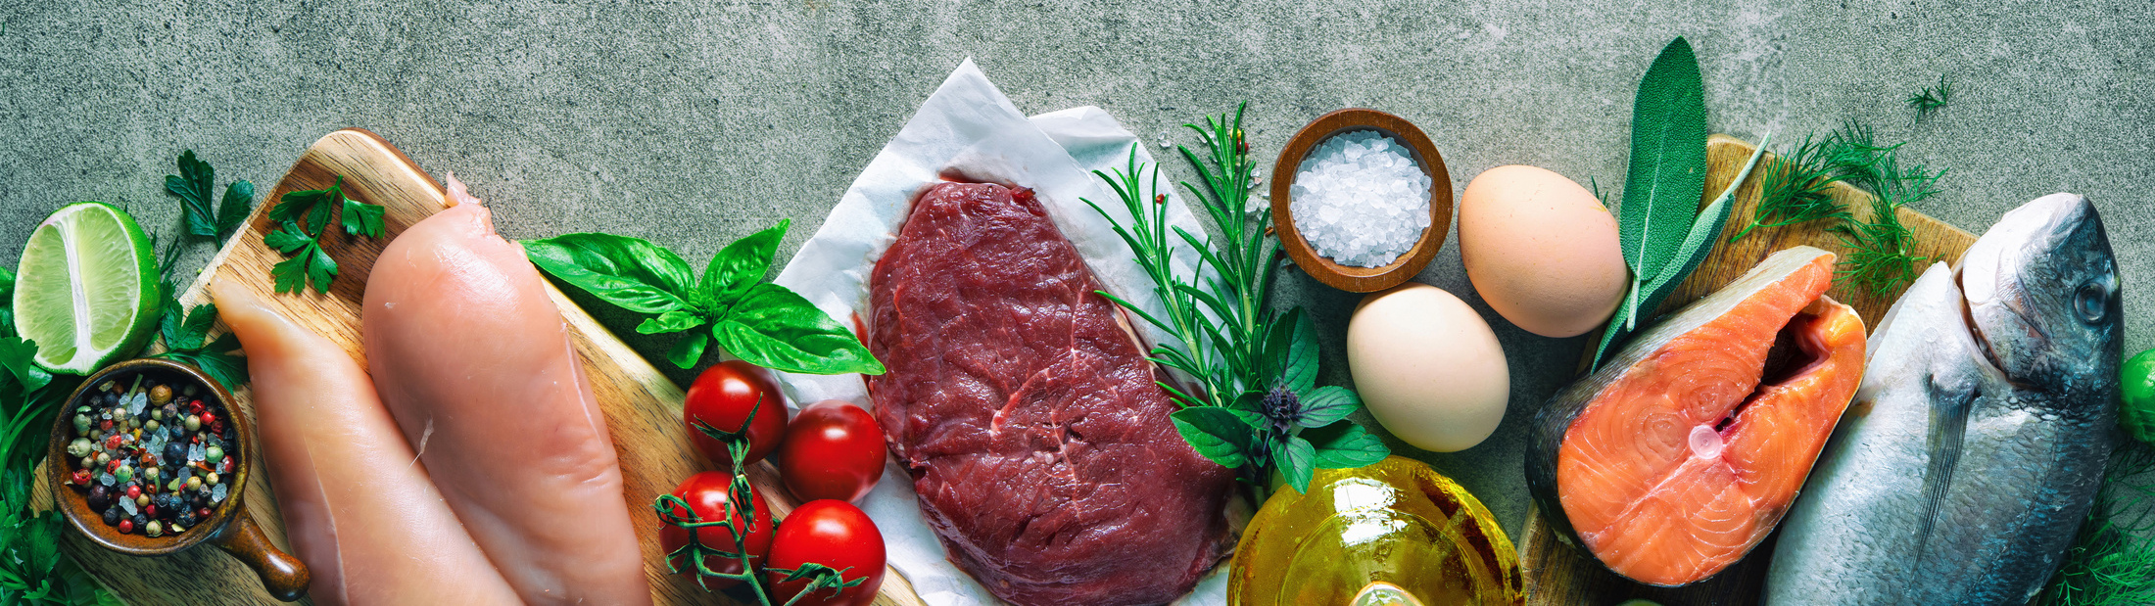
Impact & Evaluation
Social media analytical tools to monitor engagement
Results of the National Diet and Nutrition Survey

Slide 11


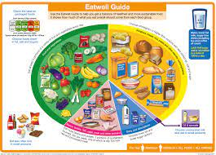
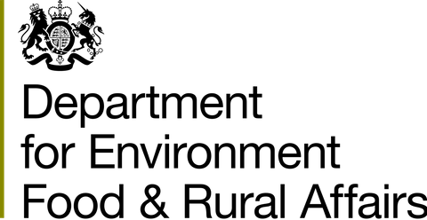
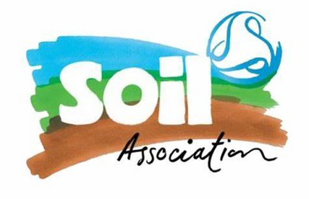
Informing Policy
Dietitan's Role
  Integrating sustainability in practice
  Raise awareness through social media
  Working with campaigns and industry
  Advocating healthy and sustainable diets

Slide 12
Any Questions?

Slide 13
References
BDA, 2020. Eating patterns for health and environmental sustainability, s.l.: s.n.
Corrin, T. & Papapodoulos, A., 2017. Understanding the attitudes and perceptions of vegetarian and plant-based diets to shape future health promotion programs. Appetite, 1(109), pp. 40-47.
Department for Environment, Food and Rural Affairs, 2020. Family food statistics. [Online]
Available at: https://www.gov.uk/government/collections/family-food-statistics
[Accessed 07 06 2021].
Food Standards Agency, 2008. McCance and Widdowson's The Composition of Foods. Sixth Summary Edition ed. Cambridge: Royal Society of Chemistry.
Hancock, S., 2019. Students don’t know how to cook. [Online]
Available at: https://londonstudent.coop/students-dont-know-how-to-cook/
[Accessed 21 06 2021].
Hodges, R., Buzby, J. & Bennett, B., 2011. Postharvest losses and waste in developed and less developed countries: opportunities to improve resource use. Journal of Agricultural Science, Volume 149, pp. 37-45.
Johnson, J. R., 2021. UK diet trends 2021. [Online]
Available at: https://www.finder.com/uk/uk-diet-trends
[Accessed 06 21 2021].
McWilliams, M., 2017. Offal: Rejected and Reclaimed Food: Proceedings of the 2016 Oxford Symposium on Food and Cookery 2016. London: Prospect Books.
Talkwalker, 2020. Social media statistics in the UK. [Online]
Available at: https://www.talkwalker.com/blog/social-media-statistics-in-the-uk
[Accessed 2021 06 2021].
VeganLife, 2018. Over 50% Of Young People In The UK Have Tried Veganism, According To New Data. [Online]
Available at: https://www.veganlifemag.com/over-50-of-young-people-in-the-uk-have-tried-veganism-according-to-new-data/
[Accessed 21 06 2021].
Xue, L. et al., 2019. Efficiency and Carbon Footprint of the German Meat Supply Chain. Environmental Science and Technology, 53(9), p. 5133–5142.

