Slide 1
Dietitians & Me

Slide 2
What is a dietitian?
Dietitians are experts in nutrition. They apply science and evidence to your personal circumstances to prevent or treat disease and improve health and wellbeing.
They are the only regulated health professionals that assess, diagnose and treat dietary and nutritional problems at an individual and wider public-health level.

Slide 3
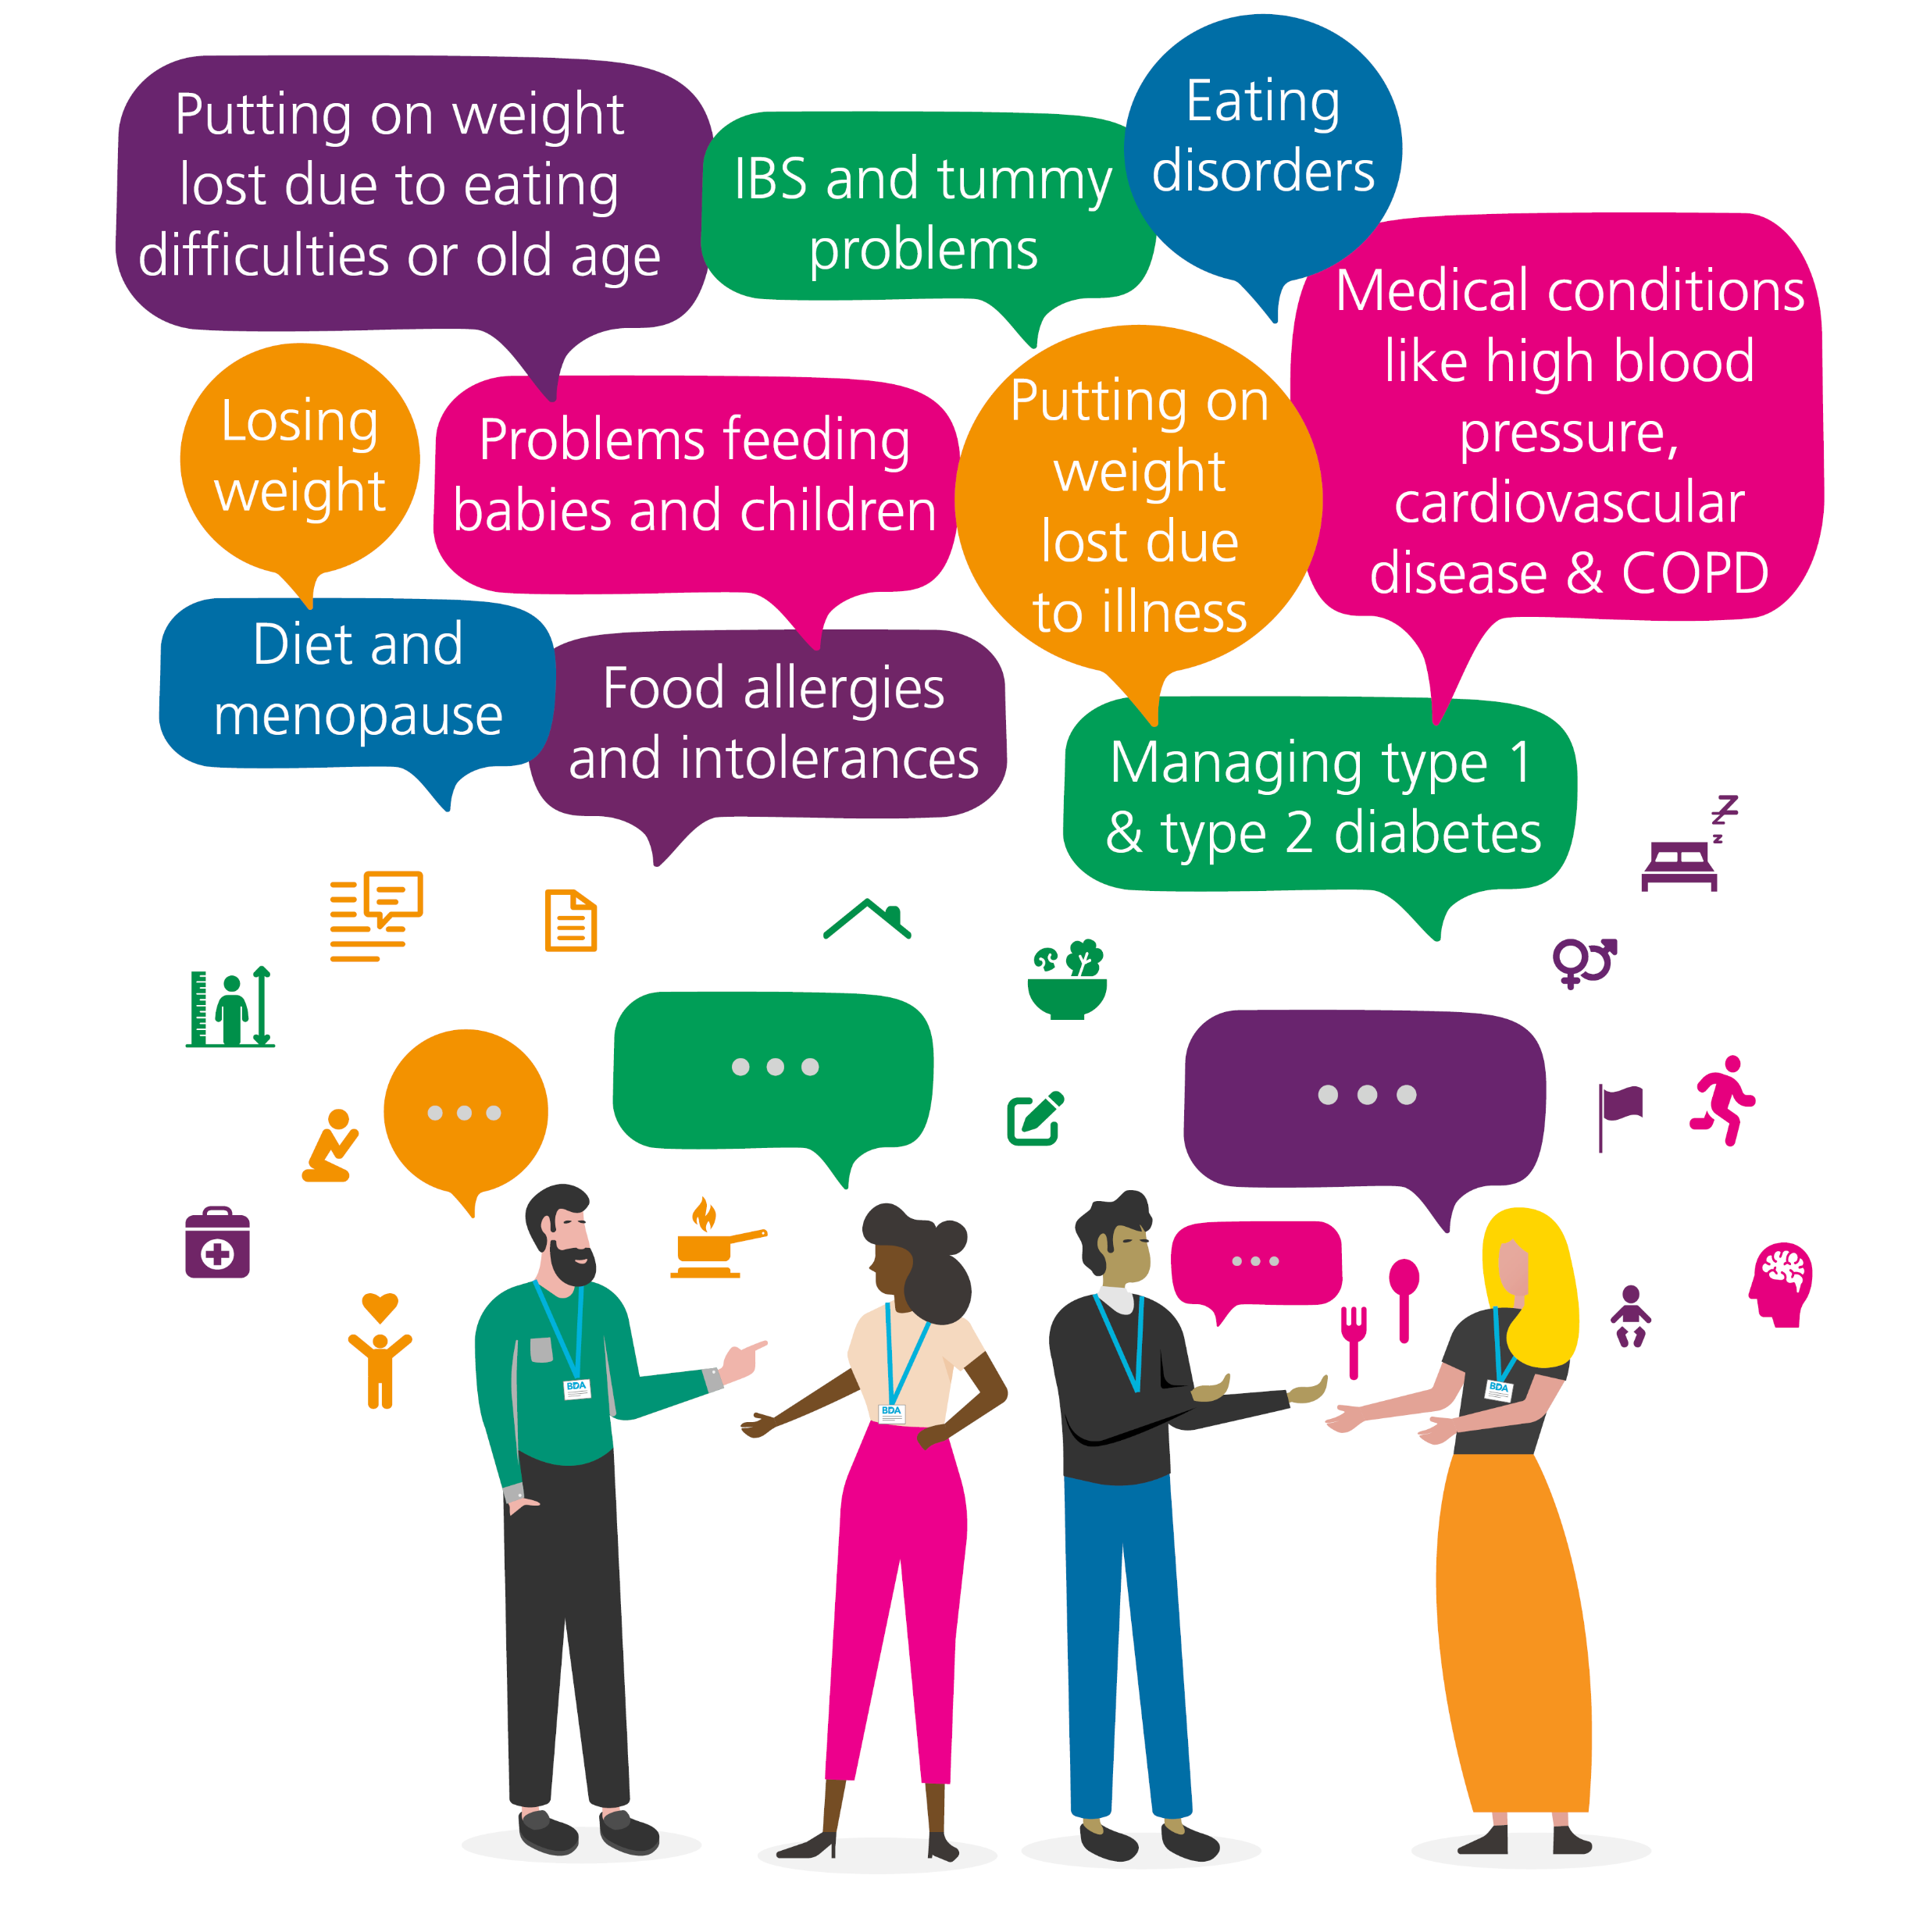
What can a dietitian help with?

Slide 4
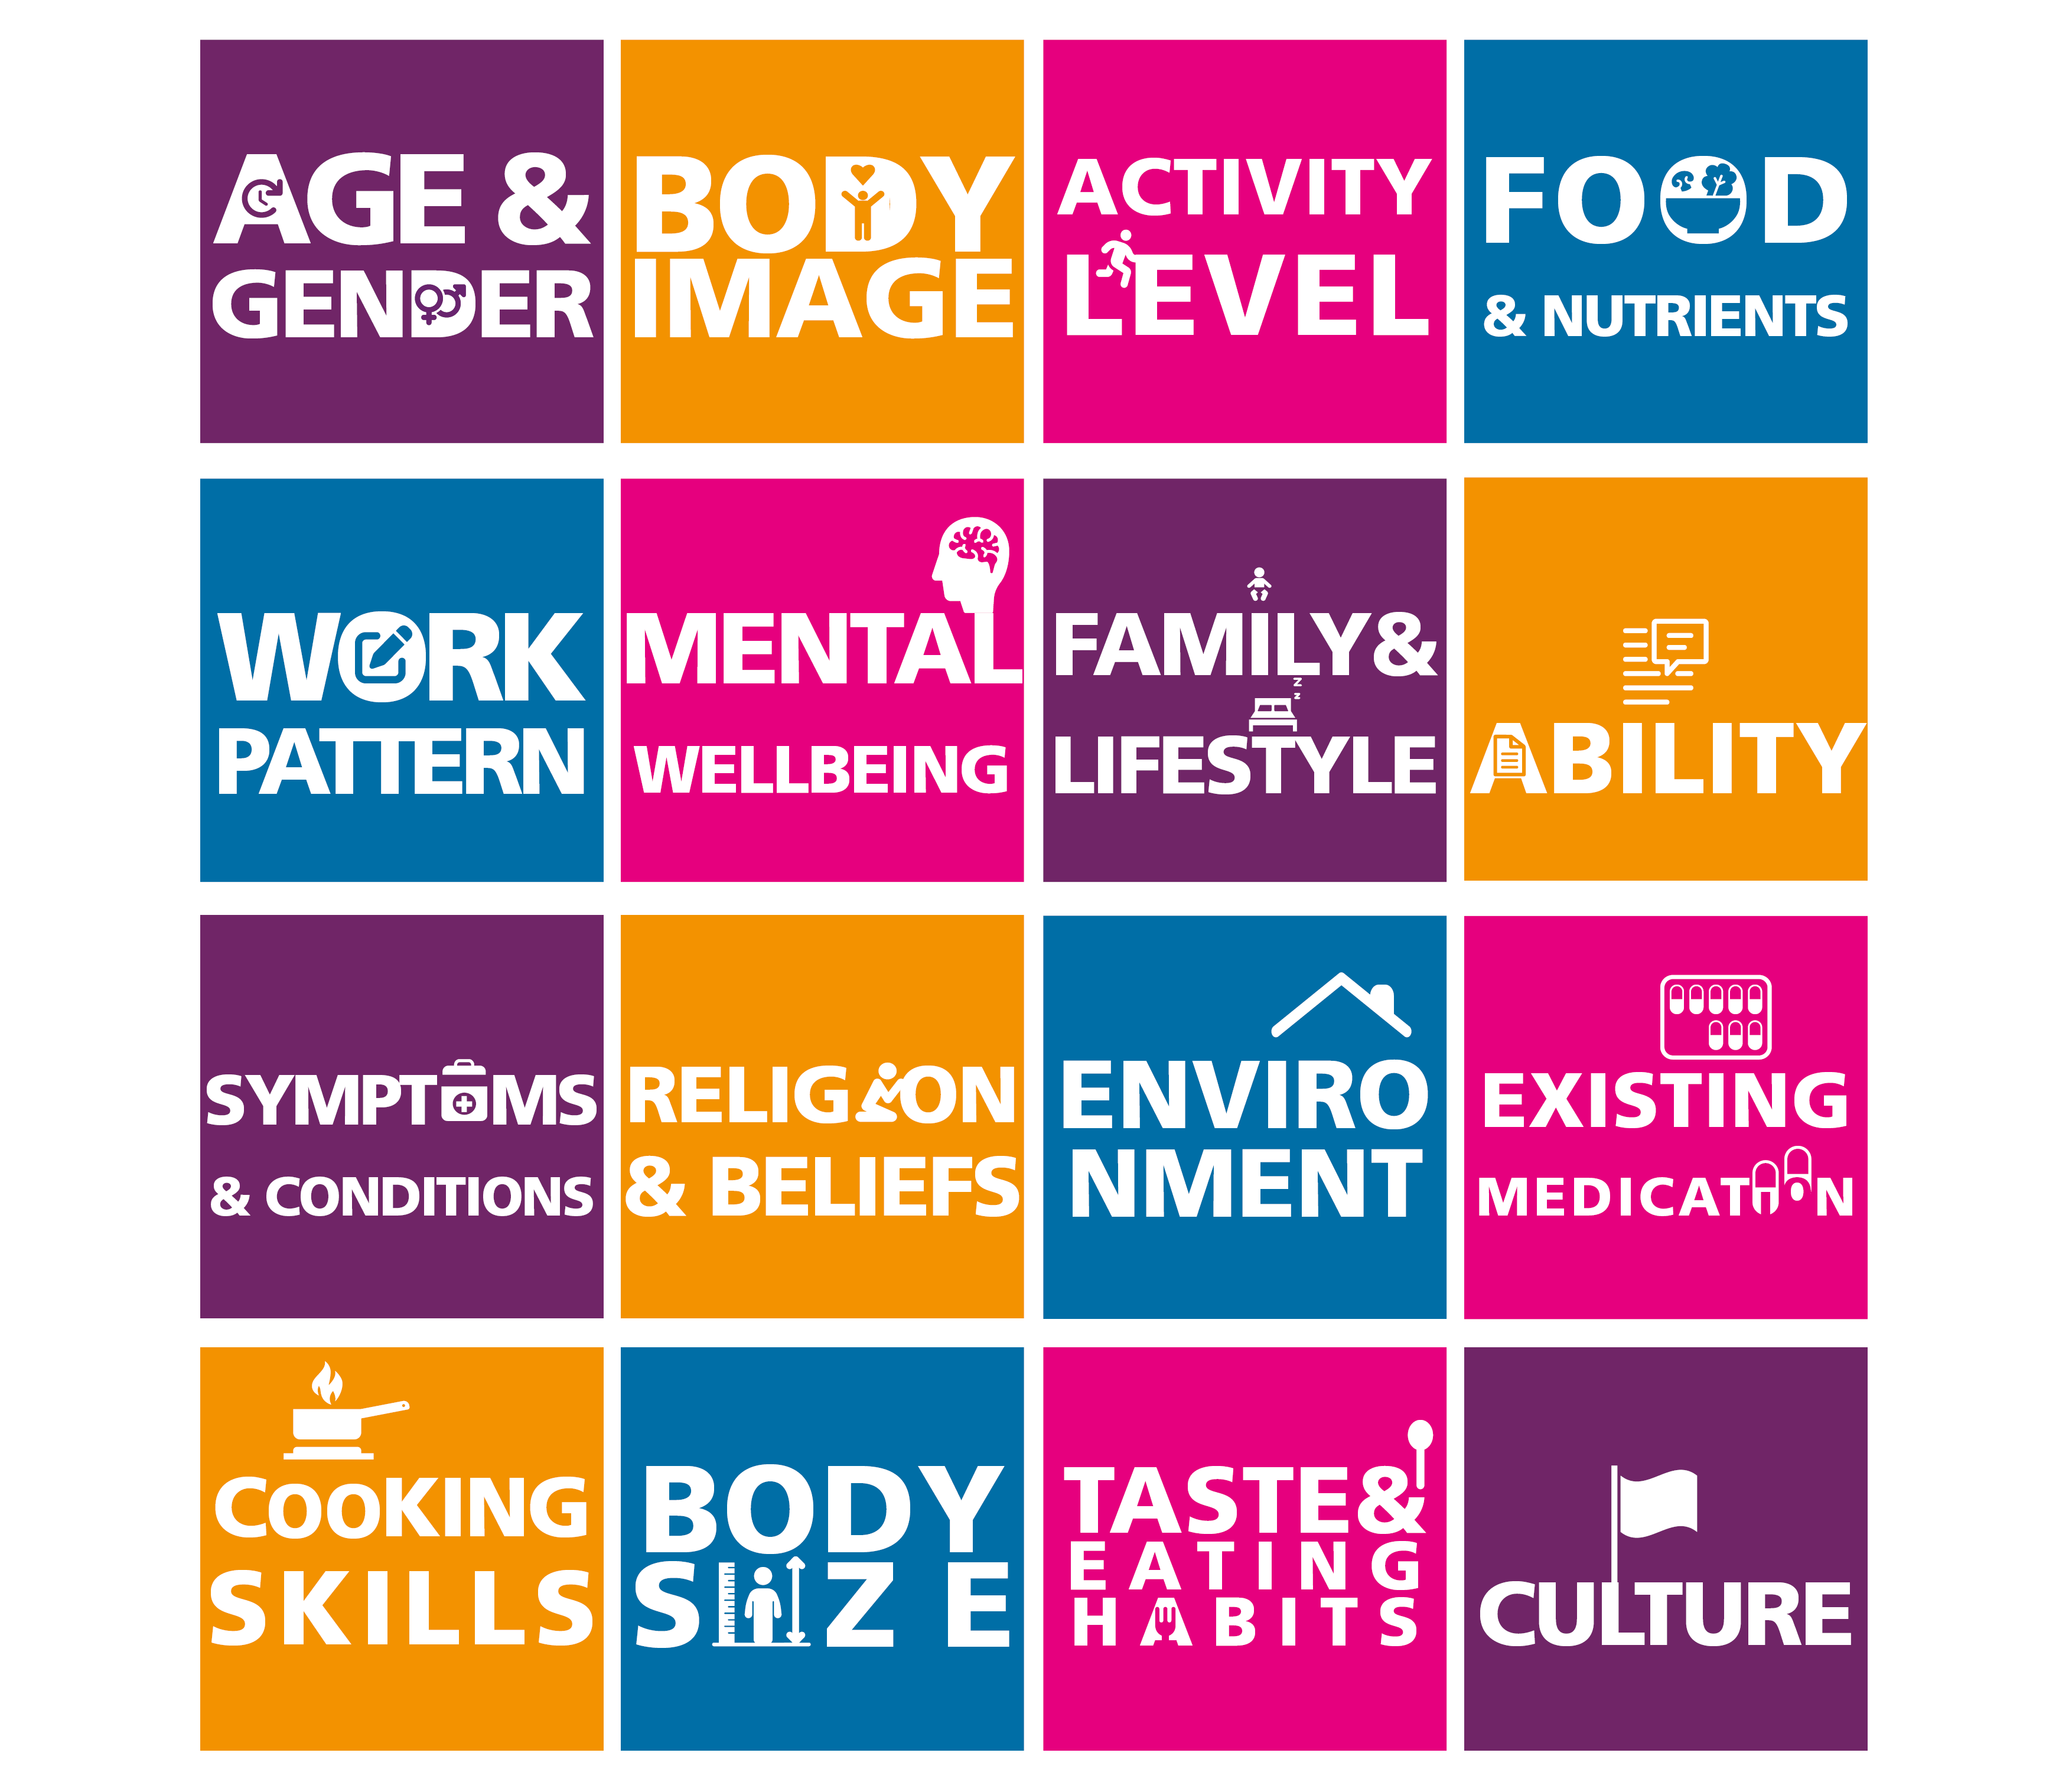
Your dietitian thinks about…

Slide 5
Free evidence-based resources

Slide 6
Find out more about how a dietitian can help you…
bda.uk.com/DietitiansAndMe

