Slide 1


Measuring Menu Capacity
Food Services Specialist Group Webinar
14th June 2022
Notes:
Today’s webinar will be recorded. Is everyone happy for us to start the recording now?

Slide 2
Webinar Outline
3:00pm Introduction the BDA’s Digest and nutrition targets for hospital menus
3:20pm Menu capacity activity 1: A la carte menu
3:40pm Menu capacity activity 2: Cyclical menu
4.00pm Menu assessment checklist and a new menu capacity method
4.20pm Questions and close

Slide 3
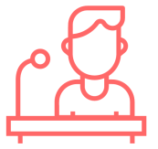
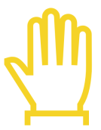
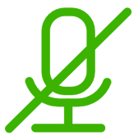
Making the most of the webinar
Get involved with the practical activities and interact with our facilitators
Raise your hand to comment or use chat box function
Remember to mute yourself if not speaking
Notes:
There will be regular opportunities to ask questions after each section.
Maxine will be helping me today and will let me know if there are any questions in the chat or if any of you have raised your hand.

Slide 4
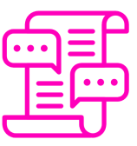
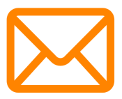

Get in contact after the event
The FSSG discussion forum: https://www.bda.uk.com/group/food-services-specialist-group/discussions.html
Email FSSG: fssg@bda.uk.com
This MS Teams chat

Slide 5
The Nutrition & Hydration Digest 3rd Edition Review Update
Megan Hughes
Digest Review Lead

Slide 6
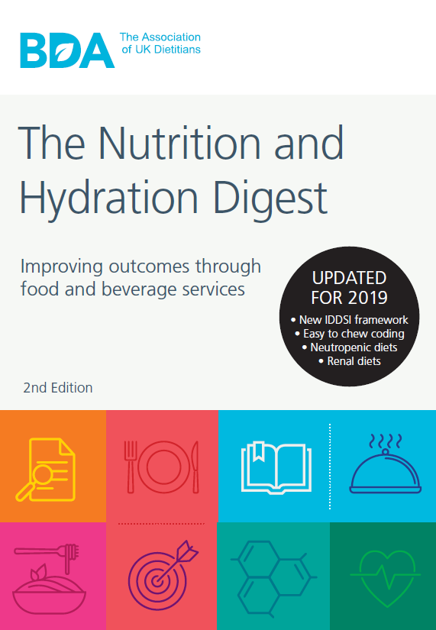
The Digest
A key national document informing hospital food standards:
    1st edition 2012
    2nd edition 2017
    & 2019
    3rd edition 2022

Slide 7
The current Digest
International, national & local influences
Nutrition & hydration, eating & drinking
Catering for staff & visitors in the NHS
Role of the Dietitian in food service
Food service delivery & planning
Catering specifications & contracts
Food composition, labelling & recipe analysis
Menu design & content
Nutritional standards: day parts approach
Analysing menu capacity
Diets, patient groups & menu coding

Slide 8
The current Digest
International, national & local influences
Nutrition & hydration, eating & drinking
Catering for staff & visitors in the NHS
Role of the Dietitian in food service
Food service delivery & planning
Catering specifications & contracts
Food composition, labelling & recipe analysis
Menu design & content
Nutritional standards: day parts approach
Analysing menu capacity
Diets, patient groups & menu coding
Search ‘digest’ on the BDA website to find the 2nd edition and information & slides from the 3rd edition consultation event!

Slide 9
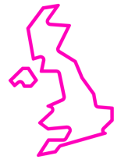
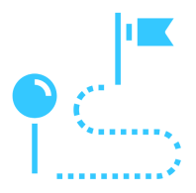
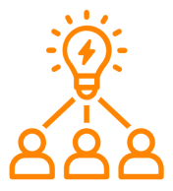
The review process
The working group: 35 BDA and HCA members working in catering across the UK
The timeline: Feb 2021 Nov 2022
The process: Role allocations, brainstorm meetings, stakeholder consultations, write up & review, design & launch

Slide 10
The timeline
Feb 2021: Formation of working
group, allocation of roles
May 2021: Chapter brainstorming
July 2021: Stakeholder consultation
event
Nov 2021: 1st drafts complete
May 2022: Member poll on minimum
calories for a main course
July 2022: Final proofs complete
Sept 2022: Approvals & design
Nov 2022: Launch

Slide 11
Key Updates
New online version (in addition to printable PDF)
Improved layout: more bullet points, tables, smart hyperlinks, practical examples
New chapter: sustainability
New appendices: example Catering Dietitian JD & PS and new role business case guidance
New printable reference table summarising all the nutritional standards in the Digest

Slide 12
Key Updates
Expanded role of Dietitian into other areas: procurement, health and wellbeing
Updates to nutritional standards to match latest guidance and evidence, inc. Protein target
New menu code: higher protein
Improved therapeutic diet section layout: with FAQ style guidance & practical food suggestions

Slide 13

Stay tuned…
We’ll be launching the 3rd edition at our 2022 study day!

Slide 14
Summary of Digest Chapter 9 Nutritional Standards: Day Parts Approach
Rachel Liston
Digest Review Lead for Chapter 9

Slide 15
Nutritional targets to be used when menu planning
Target figures for menu planning found within chapter 9.
November 2022 update: Looking to increase the protein target for nutritionally vulnerable patients from 66-83g to 79-92g/day
Table 9.1: Nutrient standards for Adults, chapter 9, page 148
Notes:
1840kcal is based on EAR for energy, with the lowest target being women aged 75+years at 1840kcal.
The highest target is for men aged 19-24years at 2772kcal.
Protein figures are based on government dietary figures (2016) which are 45g protein/day for females and 56g protein/day for males aged 18-64years.
The highest protein figures have been calculated used average body weights and a recommendation for 1.1g protein/kg/day.
In the updated digest these figures have been reviewed to represent a weight range that is more in keeping with current weight trends (making use of data from the health survey for England 2019) and an updated protein recommendation of 1.2g protein/kg/day. Which takes protein recommendations to a range of 79-92g/day

Slide 16
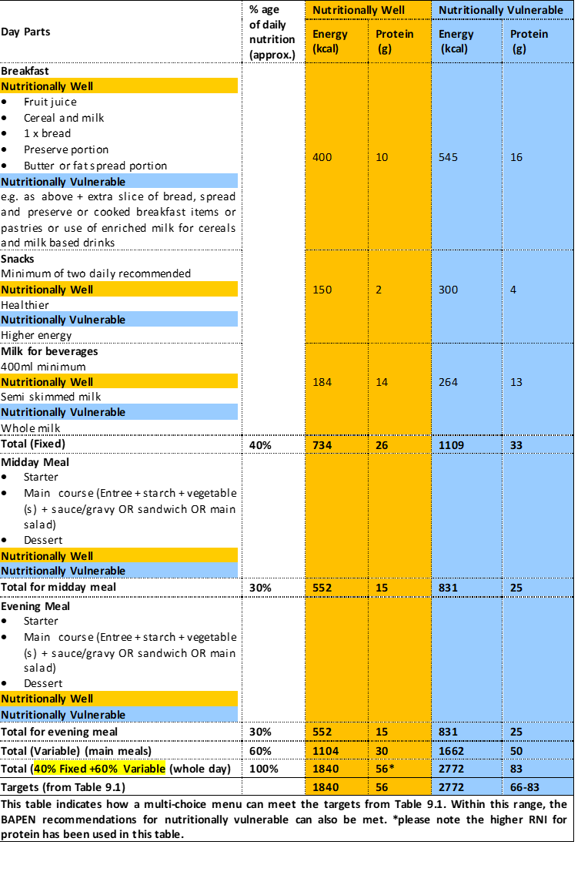

Table 9.3 Example of menu day parts model for food and beverages in care settings.
Chapter 9, page 153, Digest 2nd Edition (2019)
Notes:
This table provides an overview of how we can meet the minimum and maximum targets for energy and protein through the provision of 3 meals, plus snacks and drinks.
40% of the provision comes from breakfast, snacks and milk for drinks and is likely to be the same provision each day.
It is important to check that your breakfast, snacks and drinks provision is capable of meetings these required figures, but this is unlikely to change each day, and so is added to capacity assessments as a fixed number.
60% of the provision will vary each day depending on the choice of dishes for the menu that day.
When assessing menu capacity, this is the part that is assessed.
The table shown here has been taken from the 2nd edition of the Digest. We have made amendments to the figures for the 3rd Edition, due in November this year to ensure the menu has the capacity of meeting the increased protein recommendations. These changes recommend slightly increased protein provision at main meals, taking recommendations from a maximum capacity of 25g to 27g/main meal.
Additional protein has also been added to the fixed parts of the patients day, at snacks and breakfast, which will mean care settings will need to review the capability of snacks and breakfast to deliver adequate protein, which may mean putting thought to the offer of high protein snacks such as cheese and biscuits and yoghurts, and cooked breakfast items.

Slide 17
Analysing Menu Capacity Activity: A la Carte Menu
Joanna Instone
NHS England and NHS Improvement
Digest Review Lead for Chapter 7

Slide 18
Principles
  AIM:
  To confirm that the a la carte menu can supply sufficient energy and protein to meet the daily nutritional requirements of both nutritionally well and nutritionally vulnerable patients
  Assume the patient eats all of the dishes they have chosen
  Separately analyse:
  vegetarian / vegan choices
  religious/ cultural choices and special diets
  sandwiches and salads
  Analyse the menu on 3 days – including one weekend day
Begin by nutritionally analyse food and drink choices/recipes
ISS Classification - Unrestricted

Slide 19
Method: one day
Analyse the minimum choices
  FIXED: Choose the minimum options for breakfast, snacks and milk allowance. Total the nutritional values. Compare with the standards for the nutritionally well patient.
  VARIABLE: Calculate the variable meal choices for lunch and dinner: (starter, main, starch and vegetables, sauces/gravy and condiments and dessert.) Total these and compare with the standards for the nutritionally well patient .
  Calculate the full day – fixed plus variable
Analyse the maximum choices
  FIXED: Choose the maximum options for breakfast, snacks and milk allowance. Total these and compare with the standards for the nutritionally vulnerable patient.
  VARIABLE: Calculate the variable meal choices for lunch and dinner: (starter, main, starch and vegetables, sauces/gravy and condiments and dessert). Total these and compare with the standards for the nutritionally vulnerable patient .
  Calculate the full day – fixed plus variable
Calculate the average for the full menu and compare with standards
Source: Chapter 10, page 168. Digest 2nd Edition (2019)
ISS Classification - Unrestricted

Slide 20
Nutrition Targets
Menu requirement per day
Nutrient | Nutritionally well | Nutritionally vulnerable
Energy (Kcal) | 1840-2772
Protein (g) | 56 | 66-83
Complete Meal: starter + main+ dessert (60%)
Nutrient | Nutritionally well | Nutritionally vulnerable
Energy (Kcal) | 500 | 800
Protein (g) | 15 | 25
Fixed items (40%)
Nutrient | Breakfast | Snacks | Milk
Energy (Kcal) | 400-545 | 150-300 | 184-264
Protein (g) | 10 -16 | 2-4 | 14-13
ISS Classification - Unrestricted

Slide 21
Minimum menu capacity
 | Daily Min | Kcal | Protein (g) | % energy
Fixed | Nutritionally well Breakfast
 | Snacks
 | Beverages
 | Fixed Total |  |  | 40%
Variable 1. Lunch | Starter
 | Meal (main +veg + carbs + sauces + condiments)
 | dessert
Variable 2. Dinner | Starter
 | Meal (main +veg + carbs + sauces + condiments)
 | Dessert
 | Total Min variable +fixed |  |  | 100%
ISS Classification - Unrestricted

Slide 22
Maximum menu capacity - example
 | Daily Max | Kcal | Protein (g) | % energy
Fixed | Nutritionally well Breakfast
 | Snacks
 | Beverages
 | Fixed Total
Variable 1. Lunch | Starter
 | Meal (main +veg +carbs + sauces + condiments)
 | dessert
Variable 2. Dinner | Starter
 | Meal (main + veg + carbs + sauces + condiments)
 | Dessert
 | Total Max variable +fixed |  |  | 100%
 | Total average menu capacity
ISS Classification - Unrestricted

Slide 23
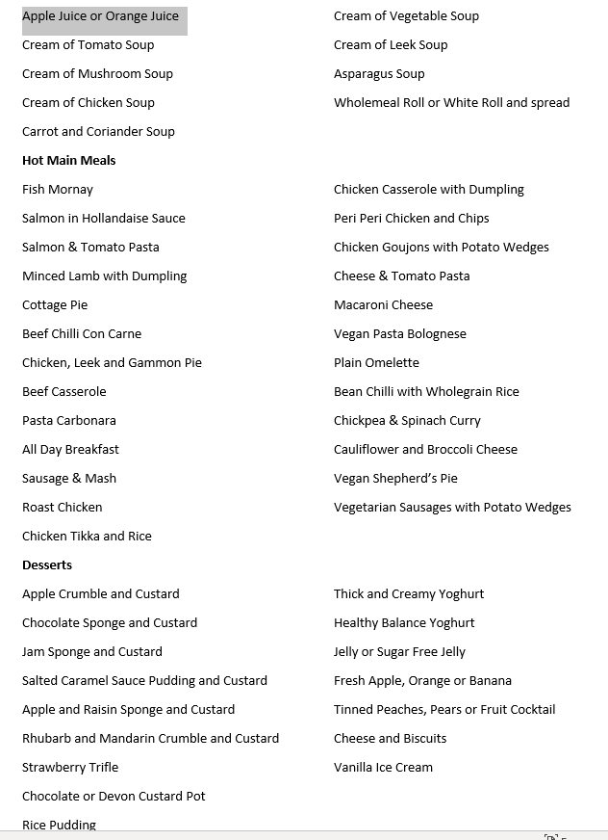
Sample A La Carte menu
ISS Classification - Unrestricted

Slide 24
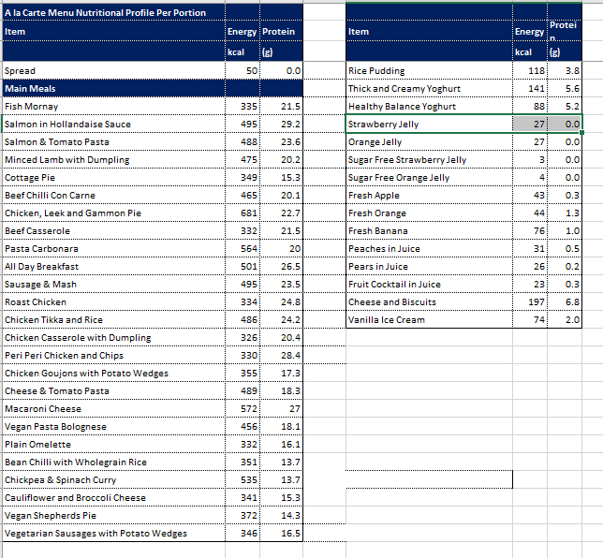
ISS Classification - Unrestricted

Slide 25
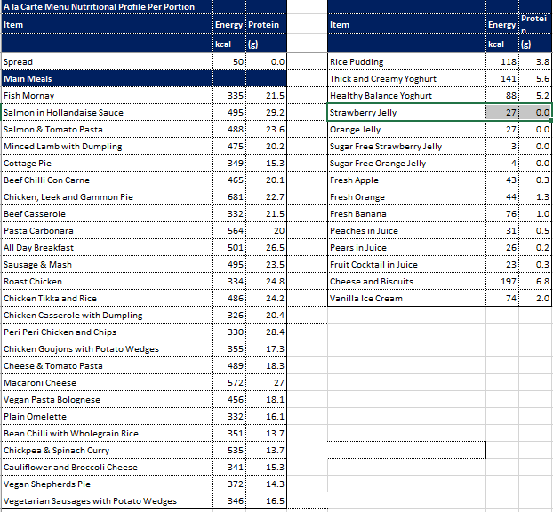
MIN
ISS Classification - Unrestricted

Slide 26
Minimum menu capacity
 | Daily Min | Kcal | Protein (g) | % energy
Fixed | Nutritionally well Breakfast | 400 | 10
 | Snacks | 150 | 2
 | Beverages | 184 | 14
 | Fixed Total | 734 | 26 | 38%
Variable 1. Lunch | Fruit juice | 40 | 0.4
 | Meal (beef casserole+rice+carrots+broccoli) | 579 | 29
 | Strawberry jelly | 27 | 0
Variable 2. Dinner | Minestrone soup | 60 | 1.5
 | Meal (fish mornay+potatoes,carrots and broccoli) | 437 | 26
 | apple | 43 | 0.3
 | Total Min variable +fixed | (1186) 1920 | (57.2) 83.2 | 100%
ISS Classification - Unrestricted

Slide 27
Nutrition Targets
Menu requirement per day
Nutrient | Nutritionally well | Nutritionally vulnerable
Energy (Kcal) | 1840-2772
Protein (g) | 56 | 66-83
Complete Meal: starter + main+ dessert (60%)
Nutrient | Nutritionally well | Nutritionally vulnerable
Energy (Kcal) | 500 | 800
Protein (g) | 15 | 25
Fixed items (40%)
Nutrient | Breakfast | Snacks | Milk
Energy (Kcal) | 400-545 | 150-300 | 184-264
Protein (g) | 10 -16 | 2-4 | 14-13

Slide 28
ISS Classification - Unrestricted

Slide 29
MAX
ISS Classification - Unrestricted

Slide 30
Maximum menu capacity
 | Daily Max | Kcal | Protein (g) | % energy
Fixed | Nutritionally vulnerable Breakfast | 545 | 16
 | Snacks | 300 | 4
 | Beverages | 264 | 13
 | Fixed Total | 1109 | 33 | 33%
Variable 1. Lunch | Leek soup+bread roll + butter | 273 | 7
 | Meal (chicken pie+gravy+peas+sweetcorn+mash) | 1003 | 34.7
 | Rice pudding | 118 | 3.8
Variable 2. Dinner | Fruit juice | 40 | 0.4
 | Meal (pasta carbonara+broccoli+carrots) | 667 | 24.5
 | Muller Yoghurt | 141 | 5.6
 | Total Max variable +fixed | (2242) 3351 | (76) 109 | 100%
 | Total average menu capacity | 2635 | 96.1
ISS Classification - Unrestricted

Slide 31
Nutrition Targets
Menu requirement per day
Nutrient | Nutritionally well | Nutritionally vulnerable
Energy (Kcal) | 1840-2772
Protein (g) | 56 | 66-83
Complete Meal: starter + main+ dessert (60%)
Nutrient | Nutritionally well | Nutritionally vulnerable
Energy (Kcal) | 500 | 800
Protein (g) | 15 | 25
Fixed items (40%)
Nutrient | Breakfast | Snacks | Milk
Energy (Kcal) | 400-545 | 150-300 | 184-264
Protein (g) | 10 -16 | 2-4 | 14-13
ISS Classification - Unrestricted

Slide 32

Break
See you back here in 5 minutes.

Slide 33
Analysing Menu Capacity Activity: Cyclical Menu
Elise Kelly
Specialist Food Service Dietitian
Digest Review Lead for Chapter 11

Slide 34
Principles
  AIM:
  To confirm that the a cyclical menu can supply sufficient energy and protein to meet the daily nutritional requirements of both nutritionally well and nutritionally vulnerable patients
  Assume the patient eats all of the dishes they have chosen
  Separately analyse:
  vegetarian / vegan choices
  religious/ cultural choices and special diets
  sandwiches and salads
  Analyse the menu on 3 days – including one weekend day
Begin by nutritionally analyse food and drink choices/recipes

Slide 35
Methodology
Analyse the minimum choices
  FIXED: Choose the minimum options for breakfast, snacks and milk allowance. Total the nutritional values. Compare with the targets for the nutritionally well patient outlined in Table 9.3 from Chapter 9.
  VARIABLE: Calculate the variable meal choices for the lunch and dinner: (starter, main, starch and vegetables, sauces/gravy and condiments and dessert.) Total these and compare with the targets for the nutritionally well patient.
  Calculate the full day – fixed plus variable
Analyse the maximum choices
  FIXED: Choose the maximum options for breakfast, snacks and milk allowance. Total these and compare with the targets for the nutritionally vulnerable patient.
  VARIABLE: Calculate the variable meal choices for the middle of the day and the evening: (starter, main, starch and vegetables, sauces/gravy and condiments and dessert). Total these and compare with the targets for the nutritionally vulnerable patient .
  Calculate the full day – fixed plus variable
Repeat for two other days (including 1 weekend day) and calculate the average for the full menu and compare with standards
Source: Chapter 10, page 168. Digest 2nd Edition (2019)

Slide 36
Nutrition Targets
Menu requirement per day
Nutrient | Nutritionally well | Nutritionally vulnerable
Energy (Kcal) | 1840-2772
Protein (g) | 56 | 66-83
Complete Meal: starter + main+ dessert (60%)
Nutrient | Nutritionally well | Nutritionally vulnerable
Energy (Kcal) | 500 | 800
Protein (g) | 15 | 25
Fixed items (40%)
Nutrient | Breakfast | Snacks | Milk
Energy (Kcal) | 400-545 | 150-300 | 184-264
Protein (g) | 10 -16 | 2-4 | 14-13

Slide 37
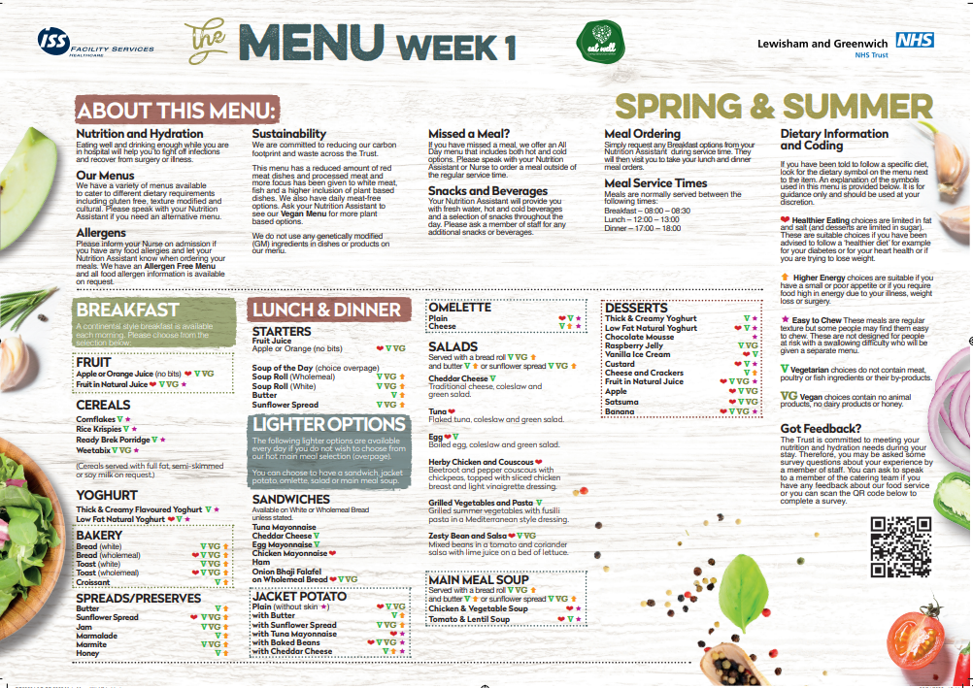
Sample 2 Week Cycle Menu

Slide 38
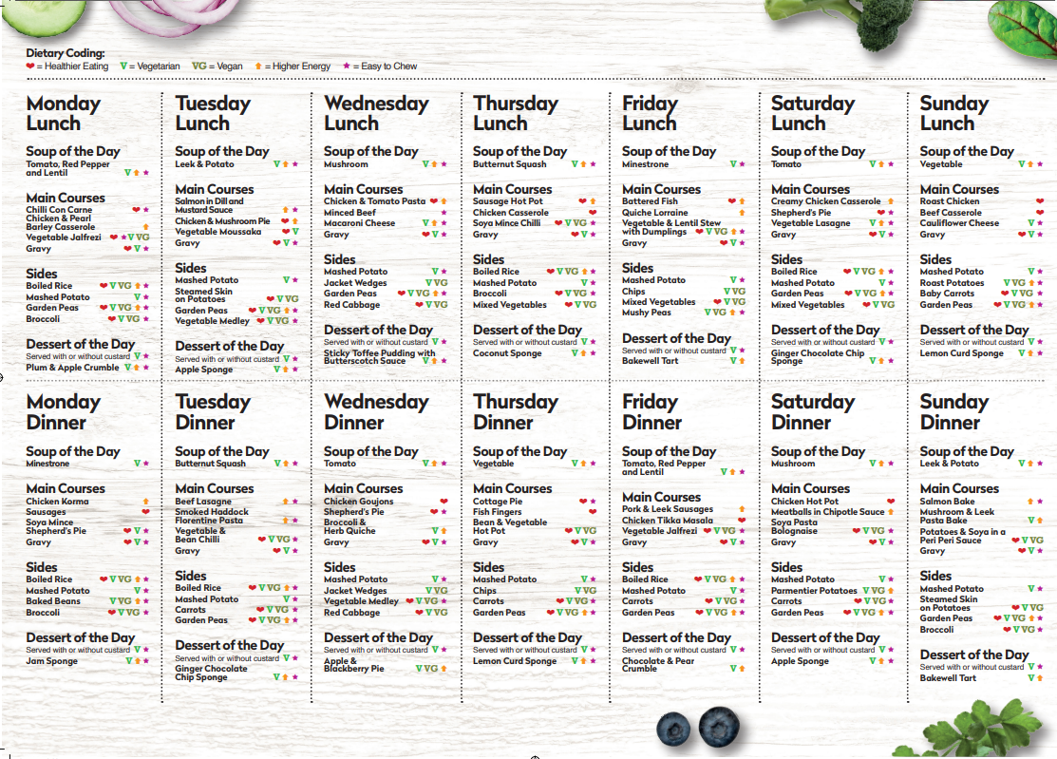
Sample 2 Week Cycle Menu

Slide 39
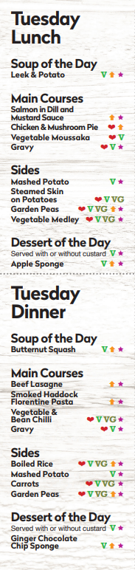
 |  | Energy (kcal) | Protein (g)
Lunch
Starters | Fruit Juice | 38 | 0
 | Leek & Potato Soup | 105 | 3
 | Bread roll with spread | 154 | 4
Mains | Salmon in Dill and Mustard Sauce | 300 | 22
 | Chicken and Mushroom Pie | 307 | 14
Carbs | Mashed Potato | 110 | 2
 | Steamed Skin On Potatoes | 110 | 2
Veg | Garden Peas | 65 | 4
 | Vegetable Medley | 35 | 3
Dessert | Apple Sponge | 221 | 3
 | Custard | 78 | 2
 | Ice cream | 119 | 2
 | Chocolate Mousse | 89 | 2
 | Raspberry Jelly | 64 | 0
 | Fruit in Natural Juice | 75 | 1
 | Thick and Creamy Yoghurt | 141 | 6
 | Natural Low Fat Yoghurt | 68 | 6
 | Cheese and Crackers | 144 | 6
Dinner
Starters | Fruit Juice | 38 | 0
 | Butternut Squash Soup | 108 | 3
 | Bread roll with spread | 154 | 4
Mains | Beef Lasagne | 302 | 19
 | Smoked Haddock and Florentine Pasta | 264 | 15
Carbs | Mashed Potato | 110 | 2
 | Boiled Rice | 155 | 3
Veg | Garden Peas | 65 | 4
 | Carrots | 35 | 0
Dessert | Ginger Chocolate Chip Sponge | 364 | 5
 | Custard | 78 | 2
 | Ice cream | 119 | 2
 | Chocolate Mousse | 89 | 2
 | Raspberry Jelly | 64 | 0
 | Fruit in Natural Juice | 75 | 1
 | Thick and Creamy Yoghurt | 141 | 6
 | Natural Low Fat Yoghurt | 68 | 6
 | Cheese and Crackers | 144 | 6
Step 1: Compile the energy and protein information for each option from Supplier information or a reliable data source
e.g. https://www.nutridex.org.uk/
Note: for this menu capacity assessment we have left out the following options, as these should be assessed separately:
Sandwiches
Salads
Vegetarian and Vegan mains
Omelettes
Jacket Potatoes
See Table 10.3 in Chapter 10, page 162 of the Digest 2nd edition for an example of a capacity assessment of lighter/vegetarian options

Slide 40
 |  | Energy (kcal) | Protein (g)
Lunch
Starters | Fruit Juice | 38 | 0
 | Leek & Potato Soup | 105 | 3
 | Bread roll with spread | 154 | 4
Mains | Salmon in Dill and Mustard Sauce | 300 | 22
 | Chicken and Mushroom Pie | 307 | 14
Carbs | Mashed Potato | 110 | 2
 | Steamed Skin On Potatoes | 110 | 2
Veg | Garden Peas | 65 | 4
 | Vegetable Medley | 35 | 3
Dessert | Apple Sponge | 221 | 3
 | Custard | 78 | 2
 | Ice cream | 119 | 2
 | Chocolate Mousse | 89 | 2
 | Raspberry Jelly | 64 | 0
 | Fruit in Natural Juice | 75 | 1
 | Thick and Creamy Yoghurt | 141 | 6
 | Natural Low Fat Yoghurt | 68 | 6
 | Cheese and Crackers | 144 | 6
Dinner
Starters | Fruit Juice | 38 | 0
 | Butternut Squash Soup | 108 | 3
 | Bread roll with spread | 154 | 4
Mains | Beef Lasagne | 302 | 19
 | Smoked Haddock and Florentine Pasta | 264 | 15
Carbs | Mashed Potato | 110 | 2
 | Boiled Rice | 155 | 3
Veg | Garden Peas | 65 | 4
 | Carrots | 35 | 0
Dessert | Ginger Chocolate Chip Sponge | 364 | 5
 | Custard | 78 | 2
 | Ice cream | 119 | 2
 | Chocolate Mousse | 89 | 2
 | Raspberry Jelly | 64 | 0
 | Fruit in Natural Juice | 75 | 1
 | Thick and Creamy Yoghurt | 141 | 6
 | Natural Low Fat Yoghurt | 68 | 6
 | Cheese and Crackers | 144 | 6
Step 2: Identify all of the lowest energy options for each meal components and add together to get the minimum menu capacity for Nutritionally Well patients.

Slide 41
 |  | Energy (kcal) | Protein (g)
Lunch
Starters | Fruit Juice | 38 | 0
 | Leek & Potato Soup | 105 | 3
 | Bread roll with spread | 154 | 4
Mains | Salmon in Dill and Mustard Sauce | 300 | 22
 | Chicken and Mushroom Pie | 307 | 14
Carbs | Mashed Potato | 110 | 2
 | Steamed Skin On Potatoes | 110 | 2
Veg | Garden Peas | 65 | 4
 | Vegetable Medley | 35 | 3
Dessert | Apple Sponge | 221 | 3
 | Custard | 78 | 2
 | Ice cream | 119 | 2
 | Chocolate Mousse | 89 | 2
 | Raspberry Jelly | 64 | 0
 | Fruit in Natural Juice | 75 | 1
 | Thick and Creamy Yoghurt | 141 | 6
 | Natural Low Fat Yoghurt | 68 | 6
 | Cheese and Crackers | 144 | 6
Dinner
Starters | Fruit Juice | 38 | 0
 | Butternut Squash Soup | 108 | 3
 | Bread roll with spread | 154 | 4
Mains | Beef Lasagne | 302 | 19
 | Smoked Haddock and Florentine Pasta | 264 | 15
Carbs | Mashed Potato | 110 | 2
 | Boiled Rice | 155 | 3
Veg | Garden Peas | 65 | 4
 | Carrots | 35 | 0
Dessert | Ginger Chocolate Chip Sponge | 364 | 5
 | Custard | 78 | 2
 | Ice cream | 119 | 2
 | Chocolate Mousse | 89 | 2
 | Raspberry Jelly | 64 | 0
 | Fruit in Natural Juice | 75 | 1
 | Thick and Creamy Yoghurt | 141 | 6
 | Natural Low Fat Yoghurt | 68 | 6
 | Cheese and Crackers | 144 | 6
Step 2: Identify all of the lowest energy options for each meal components and add together to get the minimum menu capacity for Nutritionally Well patients.
Compare to nutrition targets from Chapter 9.

Slide 42
Minimum menu capacity
 | Daily Min | Kcal | Protein (g) | % energy
Fixed | Nutritionally well Breakfast | 400 | 10
 | Snacks | 150 | 2
 | Beverages | 184 | 14
 | Fixed Total | 734 | 26 | 39%
Variable 1. Lunch | Fruit juice | 38 | 0
 | Meal (salmon + potatoes + vegetable medley) | 445 | 27
 | Raspberry jelly | 64 | 0
Variable 2. Dinner | Butternut Squash Soup | 108 | 3
 | Meal (haddock pasta + mash + carrots) | 409 | 17
 | Low Fat Natural Yoghurt | 68 | 6
 | Variable Total | 1132 | 53 | 61%
 | Total Minimum | 1866 | 79 | 100%

Slide 43
Nutrition Targets
Menu requirement per day
Nutrient | Nutritionally well | Nutritionally vulnerable
Energy (Kcal) | 1840-2772
Protein (g) | 56 | 66-83
Complete Meal: starter + main+ dessert (60%)
Nutrient | Nutritionally well | Nutritionally vulnerable
Energy (Kcal) | 500 | 800
Protein (g) | 15 | 25
Fixed items (40%)
Nutrient | Breakfast | Snacks | Milk
Energy (Kcal) | 400-545 | 150-300 | 184-264
Protein (g) | 10 -16 | 2-4 | 14-13

Slide 44
 |  | Energy (kcal) | Protein (g)
Lunch
Starters | Fruit Juice | 38 | 0
 | Leek & Potato Soup | 105 | 3
 | Bread roll with spread | 154 | 4
Mains | Salmon in Dill and Mustard Sauce | 300 | 22
 | Chicken and Mushroom Pie | 307 | 14
Carbs | Mashed Potato | 110 | 2
 | Steamed Skin On Potatoes | 110 | 2
Veg | Garden Peas | 65 | 4
 | Vegetable Medley | 35 | 3
Dessert | Apple Sponge | 221 | 3
 | Custard | 78 | 2
 | Ice cream | 119 | 2
 | Chocolate Mousse | 89 | 2
 | Raspberry Jelly | 64 | 0
 | Fruit in Natural Juice | 75 | 1
 | Thick and Creamy Yoghurt | 141 | 6
 | Natural Low Fat Yoghurt | 68 | 6
 | Cheese and Crackers | 144 | 6
Dinner
Starters | Fruit Juice | 38 | 0
 | Butternut Squash Soup | 108 | 3
 | Bread roll with spread | 154 | 4
Mains | Beef Lasagne | 302 | 19
 | Smoked Haddock and Florentine Pasta | 264 | 15
Carbs | Mashed Potato | 110 | 2
 | Boiled Rice | 155 | 3
Veg | Garden Peas | 65 | 4
 | Carrots | 35 | 0
Dessert | Ginger Chocolate Chip Sponge | 364 | 5
 | Custard | 78 | 2
 | Ice cream | 119 | 2
 | Chocolate Mousse | 89 | 2
 | Raspberry Jelly | 64 | 0
 | Fruit in Natural Juice | 75 | 1
 | Thick and Creamy Yoghurt | 141 | 6
 | Natural Low Fat Yoghurt | 68 | 6
 | Cheese and Crackers | 144 | 6
Step 3: Identify all of the highest energy options for each meal components and add together to get the maximum menu capacity for Nutritionally Vulnerable patients.

Slide 45
 |  | Energy (kcal) | Protein (g)
Lunch
Starters | Fruit Juice | 38 | 0
 | Leek & Potato Soup | 105 | 3
 | Bread roll with spread | 154 | 4
Mains | Salmon in Dill and Mustard Sauce | 300 | 22
 | Chicken and Mushroom Pie | 307 | 14
Carbs | Mashed Potato | 110 | 2
 | Steamed Skin On Potatoes | 110 | 2
Veg | Garden Peas | 65 | 4
 | Vegetable Medley | 35 | 3
Dessert | Apple Sponge | 221 | 3
 | Custard | 78 | 2
 | Ice cream | 119 | 2
 | Chocolate Mousse | 89 | 2
 | Raspberry Jelly | 64 | 0
 | Fruit in Natural Juice | 75 | 1
 | Thick and Creamy Yoghurt | 141 | 6
 | Natural Low Fat Yoghurt | 68 | 6
 | Cheese and Crackers | 144 | 6
Dinner
Starters | Fruit Juice | 38 | 0
 | Butternut Squash Soup | 108 | 3
 | Bread roll with spread | 154 | 4
Mains | Beef Lasagne | 302 | 19
 | Smoked Haddock and Florentine Pasta | 264 | 15
Carbs | Mashed Potato | 110 | 2
 | Boiled Rice | 155 | 3
Veg | Garden Peas | 65 | 4
 | Carrots | 35 | 0
Dessert | Ginger Chocolate Chip Sponge | 364 | 5
 | Custard | 78 | 2
 | Ice cream | 119 | 2
 | Chocolate Mousse | 89 | 2
 | Raspberry Jelly | 64 | 0
 | Fruit in Natural Juice | 75 | 1
 | Thick and Creamy Yoghurt | 141 | 6
 | Natural Low Fat Yoghurt | 68 | 6
 | Cheese and Crackers | 144 | 6
Step 3: Identify all of the highest energy options for each meal components and add together to get the maximum menu capacity for Nutritionally Vulnerable patients.
Compare to nutrition targets from Chapter 9

Slide 46
Maximum menu capacity
 | Daily Max | Kcal | Protein (g) | % energy
Fixed | Nutritionally vulnerable Breakfast | 545 | 16
 | Snacks | 300 | 4
 | Beverages | 264 | 13
 | Fixed Total | 1109 | 33 | 34%
Variable 1. Lunch | Leek & Potato Soup with Bread Roll + Spread | 259 | 7
 | Meal (Chicken Mushroom Pie + Mash + Peas) | 482 | 27
 | Apple Sponge + Custard | 299 | 5
Variable 2. Dinner | Butternut Squash Soup with Bread Roll + Spread | 259 | 7
 | Meal (Beef Lasagne + Peas) | 367 | 23
 | Ginger Chocolate Chip Sponge + Custard | 442 | 7
 | Variable Total | 2108 | 76 | 66%
 | Total Maximum | 3217 | 109 | 100%
Total Average Menu Capacity | Total Average Menu Capacity | 2542 | 94

Slide 47
Nutrition Targets
Menu requirement per day
Nutrient | Nutritionally well | Nutritionally vulnerable
Energy (Kcal) | 1840-2772
Protein (g) | 56 | 66-83
Complete Meal: starter + main+ dessert (60%)
Nutrient | Nutritionally well | Nutritionally vulnerable
Energy (Kcal) | 500 | 800
Protein (g) | 15 | 25
Fixed items (40%)
Nutrient | Breakfast | Snacks | Milk
Energy (Kcal) | 400-545 | 150-300 | 184-264
Protein (g) | 10 -16 | 2-4 | 14-13

Slide 48
Menu Assessment Checklist
Elise Kelly
Food Service Specialist Dietitian

Slide 49
Menu Assessment Checklist
Appendix 2 of The Nutrition and Hydration Digest.
Provides:
A food based assessment of menu capacity
Assessment of key operational requirements for food service in hospitals

Slide 50
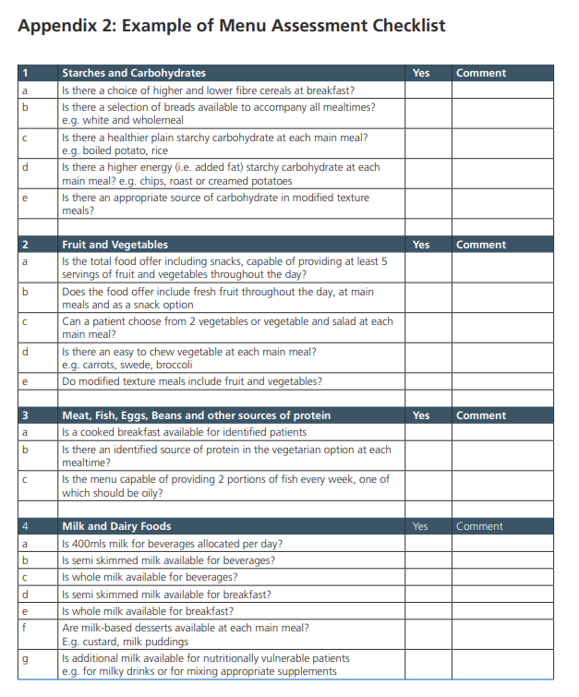
Covers:
Starches and carbohydrates
Fruit and vegetables
Meat, fish, eggs, beans and other sources of protein
Milk and dairy foods
Fats and sugars
Overall choice – standard menu
Other menus
24 hour provision
Service provision
Catering department and service information
Appendix 2, page 222, Digest 2nd Edition (2019)

Slide 51
A New Menu Capacity Analysis Method
Elise Kelly
Food Service Specialist Dietitian

Slide 52
Calculating Menu Capacity Using Analysis Software
Using electronic meal ordering system’s uptake data
Options usually captured as a percentage to allow calculation
Meal Component | Option | Uptake number | % uptake
Starters | Fruit Juice | 1374 | 81%
 | Leek & Potato Soup | 312 | 19%
Main | Salmon in Dill and Mustard Sauce | 225 | 30%
 | Chicken and Mushroom Pie | 442 | 58%
 | Vegetable Moussaka | 90 | 12%
Carb | Mashed Potato | 969 | 89%
 | Steamed Skin on Potatoes | 117 | 11%
Veg | Garden Peas | 481 | 44%
 | Vegetable Medley | 605 | 56%
This can show where menus may need adjusting to comply with standards
Notes:
Many nutritional analysis systems allow users to calculate menu capacity by attributing the uptake figures to each menu item.
This can be either actual uptake figures obtained from catering systems or estimated.
Generally it is done using percentages – with 100% being all the patients in an establishment/unit/ward etc
As an example - where there are two starters attribute the percentage choosing each choice and the analysis will calculate an average uptake for the two dishes.
Over a full menu this can show the menu planner how the menu is likely to meet standards using actual patient uptakes allowing the user to see where menu adjustments need to be made within the cycle to ensure compliance with standards is more likely.
This method can also be used to do menu modelling. In other words the user can “choose” all the higher energy choices to check if the menu meets standards for nutritionally vulnerable or vice versa for healthier choices. This is the same as the other method for calculating menu capacity, only in an electronic format.

Slide 53
Calculating Menu Capacity Using Analysis Software
Using electronic meal ordering system’s uptake data
Options usually captured as a percentage to allow calculation
Meal Component | Option | Uptake number | % uptake
Starters | Fruit Juice | 1374 | 81%
 | Leek & Potato Soup | 312 | 19%
Main | Salmon in Dill and Mustard Sauce | 225 | 30%
 | Chicken and Mushroom Pie | 442 | 58%
 | Vegetable Moussaka | 90 | 12%
Carb | Mashed Potato | 969 | 89%
 | Steamed Skin on Potatoes | 117 | 11%
Veg | Garden Peas | 481 | 44%
 | Vegetable Medley | 605 | 56%
This can show where menus may need adjusting to comply with standards
Notes:
Many nutritional analysis systems allow users to calculate menu capacity by attributing the uptake figures to each menu item.
This can be either actual uptake figures obtained from catering systems or estimated.
Generally it is done using percentages – with 100% being all the patients in an establishment/unit/ward etc
As an example - where there are two starters attribute the percentage choosing each choice and the analysis will calculate an average uptake for the two dishes.
Over a full menu this can show the menu planner how the menu is likely to meet standards using actual patient uptakes allowing the user to see where menu adjustments need to be made within the cycle to ensure compliance with standards is more likely.
This method can also be used to do menu modelling. In other words the user can “choose” all the higher energy choices to check if the menu meets standards for nutritionally vulnerable or vice versa for healthier choices. This is the same as the other method for calculating menu capacity, only in an electronic format.

Slide 54
Any questions?
Thank you for taking part in today’s webinar

