Slide 1
International Dysphagia Diet Standardisation Initiative (IDDSI) Joanne Deery Dietetic Team Lead NHSCT

Slide 2
Key Points- The NI Context
What is IDDSI ?
The Benefits of IDDSI
Implementation Timeframe
Implementation Working Groups
The Challenges
Going Forward…….

Slide 3
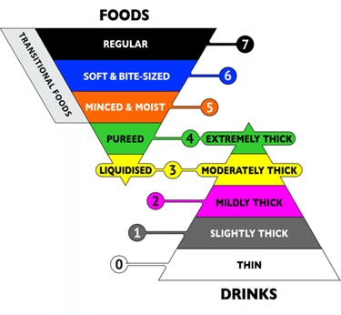
What is IDDSI?
Global standardised framework which provides terminology and definitions for texture modified foods and thickened liquids
It consists of a continuum of 8 levels (0-7)
Colour-coded model
Uses culturally neutral terminology
Includes descriptors, testing methods and evidence for both drink thickness and food texture levels

Slide 4
The Benefits Of IDDSI
Standardisation
Safety
Evidence- based and Science-based
Includes Fluid Descriptors
Internationally transferable
Allows for global research

Slide 6
Testing Methods-Foods
Spoon Tilt
Fork Drip
Spoon Pressure
Fork Pressure
Finger Test
Chop-Stick Test
Particle Size

Slide 7
Overview of IDDSI approved triangle matching the previous UK consistency framework onto the IDDSI framework.
There are differences in the textures between the two frameworks that can be obtained at www.iddsi.org

Slide 14
Challenges……….
Co-ordination of the implementation
Labelling of products- thickeners changing first/ dual-labelling of some products
Inability to directly correlate old descriptor level to new level for some products
Capacity issues for training/re-assessment of patients
Care Homes- range of thickeners used
Patients living alone/unsupported
Patients not open to SLT/RD
Patients living in border areas

Slide 15
Going Forward…….
Join IDDSI -resources, FAQs, monthly newsletter (E-bites),webinars http://iddsi.org/
IDDSI App
Regularly check the BDA website for the latest information
Trust Dietetic Representative
Work together with other colleagues to support implementation.
Regional Newsletter
Updating of Diet Sheets
Menu Review
Translated documents

Slide 17
Any Questions ?

