Slide 1


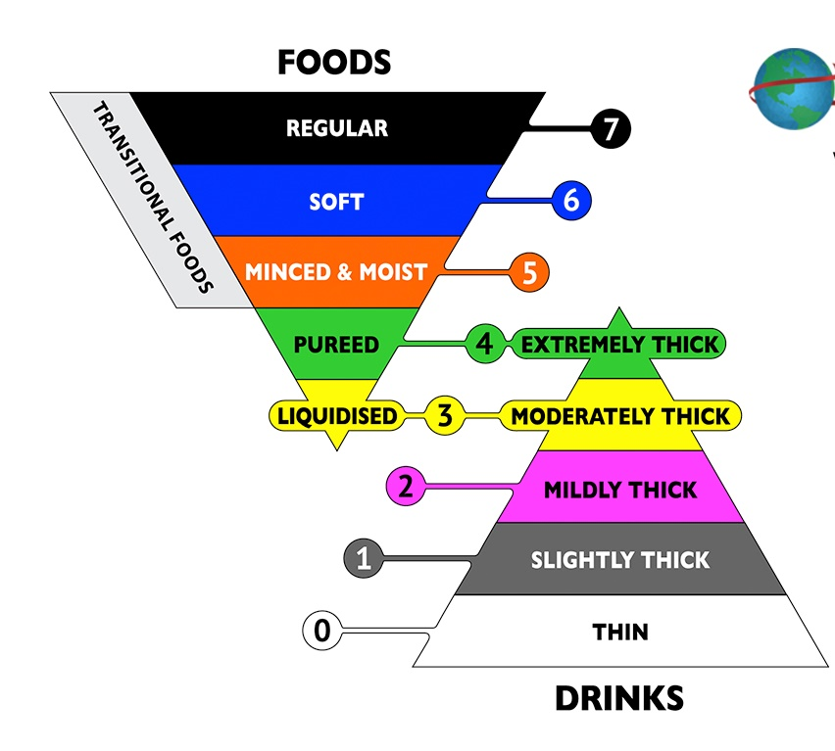
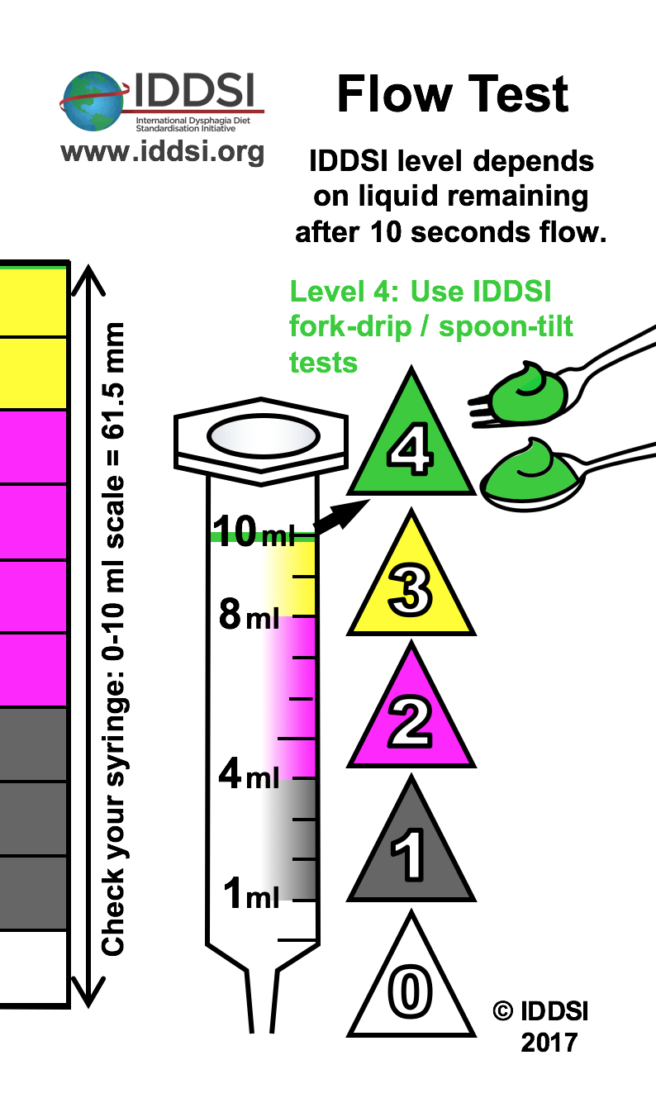
LIQUIDS: Comparing the UK National Descriptors with IDDSI
The IDDSI Levels are clearly defined by measurement using the flow test for Levels 0-3 and the spoon/fork tests for Level 4.
The descriptors broadly match the IDDSI levels 0-4. However these are subjective, not specific.
Product labelling with National Descriptors was not definitive.
www.iddsi.org
✓
Use IDDSI tests or new product guidelines to determine IDDSI Level.
Don’t assume a certain product maps across directly to a certain IDDSI Level.
Stage 3
“Needs to be taken with a spoon…”
Stage 2
“Leaves a thick coat on the back of a spoon…”
Stage 1
“Leaves a thin coat on the back of a spoon…”
Naturally Thick
“Leaves a coating on an empty glass…”
Thin

Slide 2
How thick is your drink?
Moving from National Descriptors to IDDSI
Estimate
Measure
Product labelling with National Descriptors was estimated.
Not definitive.
The IDDSI Levels are clearly defined by measurement using the flow test for Levels 0-3 and the spoon/fork tests for Level 4.
www.iddsi.org
Use IDDSI tests or revised product guidelines to determine IDDSI Level.
“Needs to be taken with a spoon…”
Stage 3
“Leaves a thick coat on the back of a spoon…”
The descriptors broadly match the IDDSI levels 0-4. But descriptors are subjective, not specific.
Stage 2
Stage 1
“Leaves a thin coat on the back of a spoon…”
Naturally Thick
“Leaves a coating on an empty glass…”
Thin

Slide 3
LIQUIDS: From UK National Descriptors to IDDSI
Subjective, estimated
The categories were not clearly defined.
Objective, measured
The IDDSI Levels are defined by measurement using the flow test for Levels 0-3 and the spoon/fork tests
for Level 4.
www.iddsi.org
“Needs to be taken with a spoon…”
10 ml
3
The descriptors broadly match the IDDSI levels 0-4. But descriptors are subjective, not specific.
8 ml
“Leaves a thick coat on the back of a spoon…”
2
“Leaves a thin coat on the back of a spoon…”
4 ml
1
1ml
“Leaves a coating on an empty glass”
0

