Slide 1


The Nutrition & Hydration Digest
3rd Edition Review Consultation Event

Slide 2
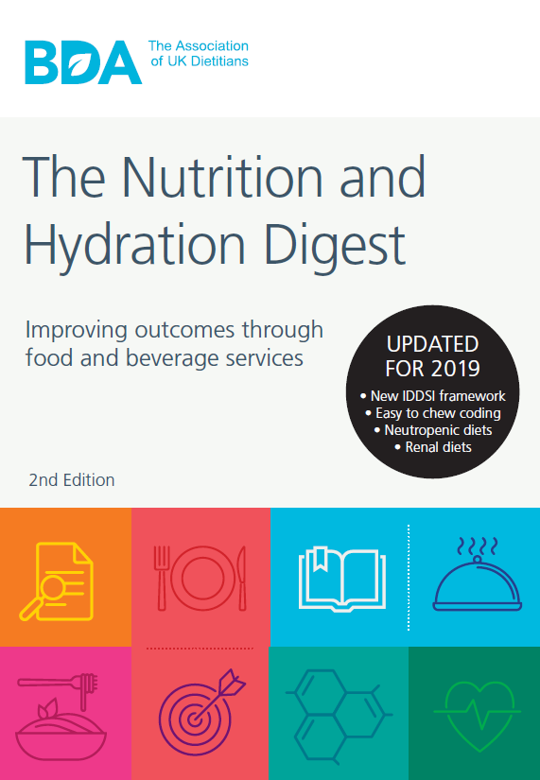
The Digest
A key national document informing hospital food standards:
    1st edition 2012
    2nd edition 2017
    & 2019
    3rd edition 2022

Slide 3
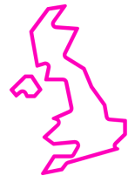
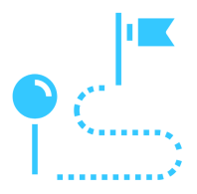
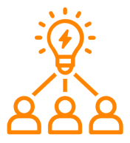
The review process
The working group: 35 BDA and HCA members working in catering across the UK
The timeline: Feb 2021 Nov 2022
The process: Role allocations, brainstorm meetings, stakeholder consultations, write up & review, design & launch

Slide 4
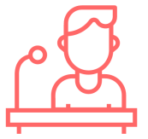
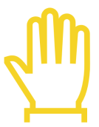
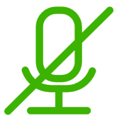
We want to hear from you!
Chapter Review Leads will facilitate a discussion
Raise your hand to comment or use chat box function
Remember to mute yourself if not speaking

Slide 5
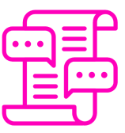
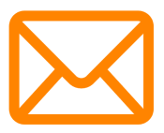

You can keep contributing even after the event…
The FSSG discussion forum: https://www.bda.uk.com/group/food-services-specialist-group/discussions.html
Email FSSG: fssg@bda.uk.com
This MS Teams chat

Slide 6
Day 1: Sustainability and Catering for NHS Staff & Visitors
2.30pm Introduction
2.35pm General feedback on Digest layout
3.00pm Sustainability
3.30pm Chapter 3: Catering for staff & visitors
4.00pm Close

Slide 7
General Feedback on Digest Layout
Facilitated by:
Megan Cameron-Lee, Digest Review Chair
FSSG Web & Media Organiser
Advanced Specialist Catering Dietitian, London North West University Healthcare NHS Trust

Slide 8
General Feedback on Digest Layout
Do you think the layout of the Digest needs to be updated to improve usability? If so, what changes would you make?

Slide 9
Sustainability in the Digest
How close do you think the topic of sustainability is to dietetics within hospital food standards and the wider Digest?
Notes:
First question for the group!
1 MINUTE TO READ/EXPLAIN THE Q AND PUT INTO CONTEXT
5 MINUTES DISCUSSION

Slide 10
Sustainability in the Digest
Are there things related to sustainability (generally or within your area of food service/dietetics) that you’d like to see added to the Digest 3rd Ed?
If so, where do you see them sitting?
Notes:
7-10 MINUTES

Slide 11

Catering for Staff & Visitors in the NHS
Criteria – Health and Wellbeing ?
Implications of National Food Standards?
What does good look like for your site?

Slide 12
The Nutrition & Hydration Digest
3rd Edition Review Consultation Event

Slide 13
Day 2: Menu Design, Nutrition Targets & Catering Contracts
2.30pm Introduction
2.35pm Chapter 8: Menu Design & Chapter 9: Nutritional
Standards
3.30pm Chapter 6: Catering Specifications & Contracts
4.00pm Close

Slide 14
Discussion Points
Should we use an infographic for the process of menu planning including key information about each stage?
The infographic could be an interactive tool online where people can expand on each stage and have interactive links within the document.
Current edition, first step is “assessment of the patient group” suggest change to “setting up the menu planning group”
Any comments re the order of menu planning in Figure 8.1?

Slide 15
Discussion Points
Should this include cyclical, a la carte “main patient menus” and a la carte therapeutic menus?
Do we need to provide guidance on acceptable number of meals on A la carte menus including therapeutic?
Does the guidance provided in the menu structure reflect current opinions?
Discuss :a minimum of 2 courses, Starters, composite dish for cyclical main course 2, ? Vegan/plant based options. Any other comments?

Slide 16
Question 3: Would altering the order of information in chapters 8 and 9 make it easier to find the information you need?

Slide 17
Discussion point:
What order would we like to see the information in chapters 8 & 9?
Menu design
Food based guidance
Nutritional standards

Slide 18
Question 4:
What protein targets should we aim for?

Slide 19
Recommendations for consideration 2022 edition
Reviewed Digest recommendations | Protein (g)
Nutritionally Well | 56*
Nutritionally vulnerable | 72-90
* For females of the same age bracket the RNI is 45g
Weight range of 60-75kg was used to calculate the target
Based on protein target for nutritionally vulnerable individuals (PENG 2018) of 1.2g/kg
Notes:
There has been no change to the lower recommendation of 0.75g/kg. However, new peng references suggest our menus should be able to provide older adults with 1.2g/protein/kg, therefore using a wt 60-75kg this makes a proten recommendation of 72-90g/day

Slide 20
Nutritional Standards for Components of Meals
Discussion point
What is the minimum calorie requirement for a main course?

Slide 21
Nutritional Standards for Components of Meals
  Main Course Minimums
    Current recommendation minimum 300kcal for main course, no recommendation for protein
    Recommendation from some members of FSSG group to review this figure
  Previous justification
    Minimum value equivalent to 50kcals for veg, 100kcal for carbohydrate and 150kcal for roast
    The above example assumes 200kcal will be derived from starter and dessert

Slide 22
Micronutrients in Nutritional Analysis
Discussion point
Do we expand the list of nutrients to be analysed?

Slide 23
The Nutrition & Hydration Digest
3rd Edition Review Consultation Event

Slide 24
Day 3: Menu Coding & Specialist Patient Groups & Closing Session
2.30pm Introduction
2.35pm Chapter 11: Special Diets, Patient Groups & Menu
Coding
3.30pm Closing session (summary of discussions)
4.00pm Close

Slide 25
Chapter 11 Feedback
Healthier Options menu code
  Do we need to consider carbohydrate content?
Higher Energy menu code
  Do we need to consider protein content?
Calorie targets for mental health facilities
  Should mental health facilities be exempt from meeting ‘nutritionally vulnerable’ calorie targets with their menus?
General chapter feedback

Slide 26
You can keep contributing even after the event…
The FSSG discussion forum: https://www.bda.uk.com/group/food-services-specialist-group/discussions.html
Email FSSG: fssg@bda.uk.com
This MS Teams chat

